Slide 2
Titus 1:5
⁵ This is why I left you in Crete, so that you might put what remained into order, and appoint elders in every town as I directed you…

Slide 4
CRETE
Largest island in Greece, flourished 2600-1100BC.
Cults for Augustus & Roma near capital city.
Jewish presence there. (Acts 2:11)
Eusebius wrote about spread of Christianity.

Slide 5
Teach Us Like Titus

Slide 6
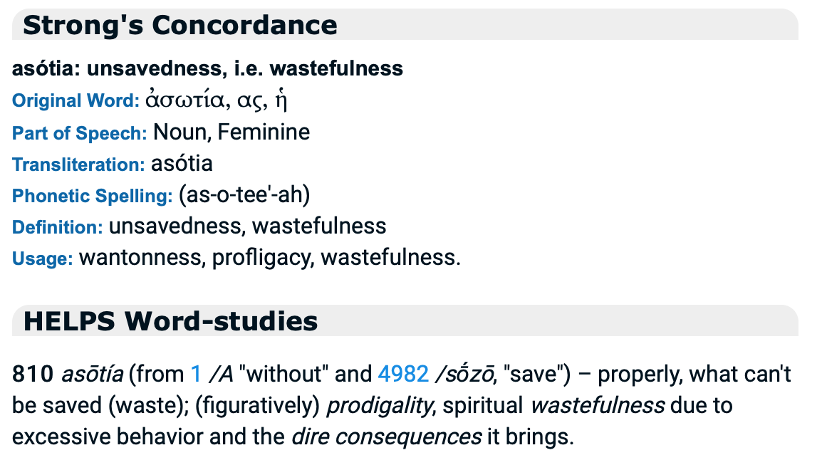
Teach Us Like Titus

Slide 7
Teach Us Like Titus

Slide 8
Teach Us Like Titus

