Slide 1
FAITH
Mt. Moriah
Genesis 22:2

Slide 2
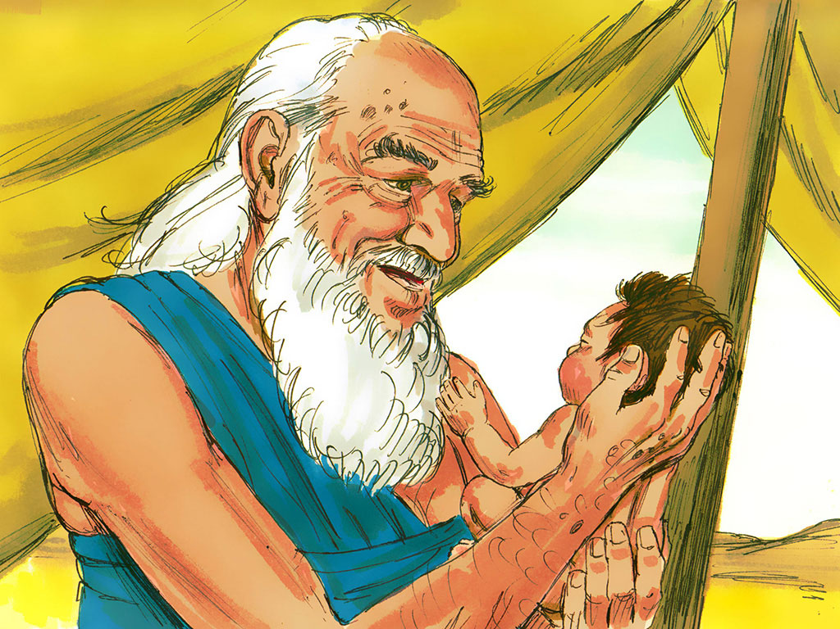
4. Abraham and Sarah loved Isaac very much and looked forward to the day when Isaac would marry and have children. Then those children would grow up and have children and then those children would grow up and have children.
Notes:
4. Abraham and Sarah loved Isaac very much and looked forward to the day when Isaac would marry and have children. Then those children would grow up and have children and then those children would grow up and have children.

Slide 3
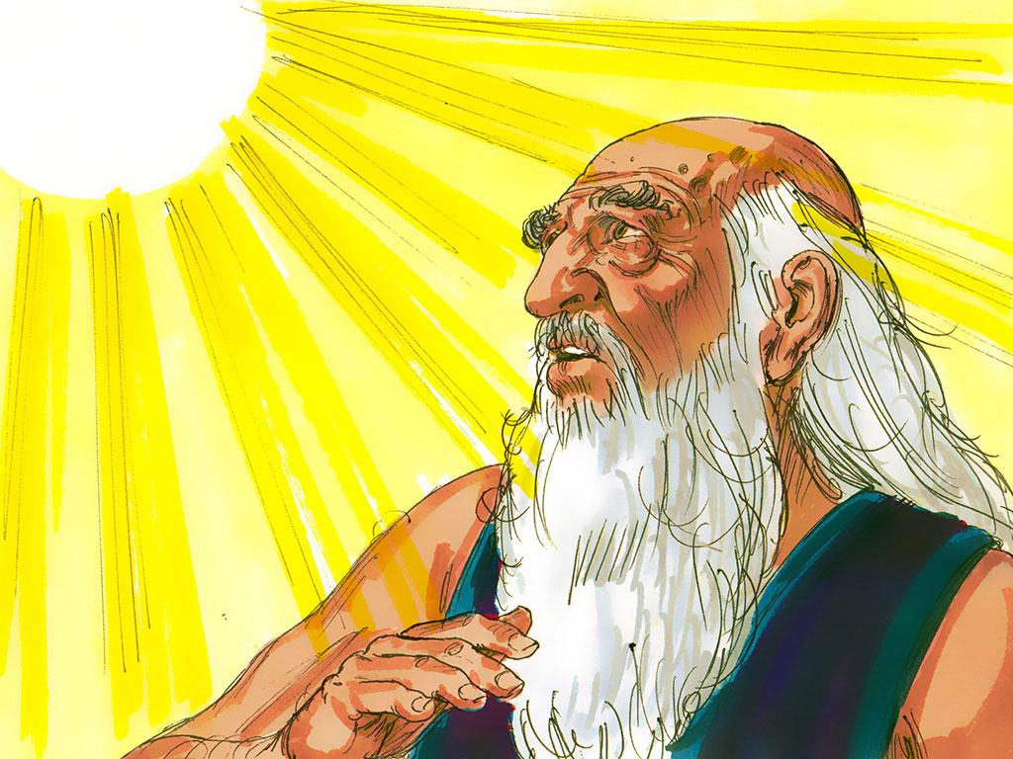
5. Abraham loved his son and loved God. Even though Abraham loved God and believed what God said a day came when Abraham was tested. The testing day was the day God asked Abraham to do a very difficult thing.
Notes:
5. Abraham loved his son and loved God. Even though Abraham loved God and believed what God said a day came when Abraham was tested. The testing day was the day God asked Abraham to do a very difficult thing.

Slide 4
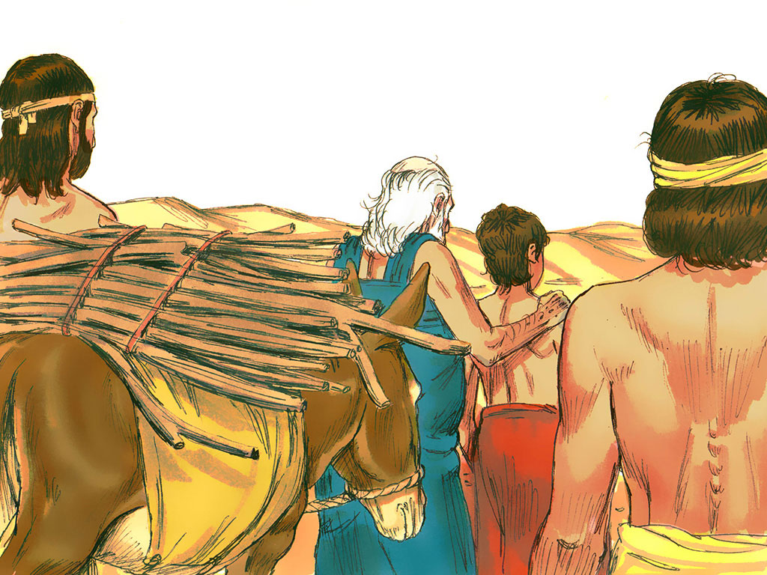
6. During the time of Abraham people showed their devotion to God by placing food or sometimes an animal they had killed on an altar and burning it up. This was called a “sacrifice”.
Even though Abraham knew about this kind of sacrifice he had never heard about the kind of sacrifice that God asked of him on this testing day.
God said, “Take your only son, Isaac, the son you love. Go to the land of Moriah. There kill him and offer him as a whole burnt offering. Do this on one of the mountains there. I will tell you which one.”
Notes:
6. During the time of Abraham people showed their devotion to God by placing food or sometimes an animal they had killed on an altar and burning it up. This was called a “sacrifice”.
Even though Abraham knew about this kind of sacrifice he had never heard about the kind of sacrifice that God asked of him on this testing day.
God said, “Take your only son, Isaac, the son you love. Go to the land of Moriah. There kill him and offer him as a whole burnt offering. Do this on one of the mountains there. I will tell you which one.”

Slide 5
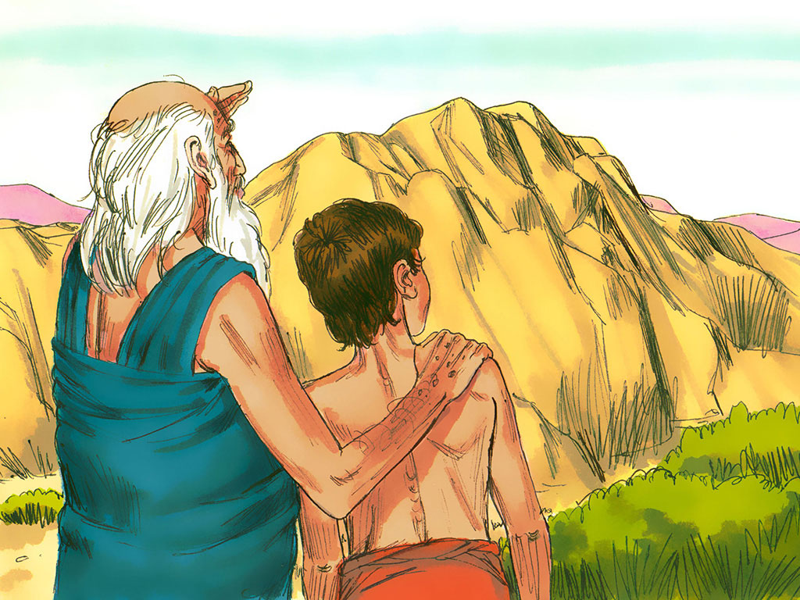
7. Most people would have just said, “NO WAY, GOD!” After all, Abraham loved Isaac. Besides, Isaac was his only son. God had promised him that Isaac would grow up and have children and his children would grow up and have children so the one day God’s people would be so many that no one could count them. If Isaac died this could never happen.
Notes:
7. Most people would have just said, “NO WAY, GOD!” After all, Abraham loved Isaac. Besides, Isaac was his only son. God had promised him that Isaac would grow up and have children and his children would grow up and have children so the one day God’s people would be so many that no one could count them. If Isaac died this could never happen.

Slide 6
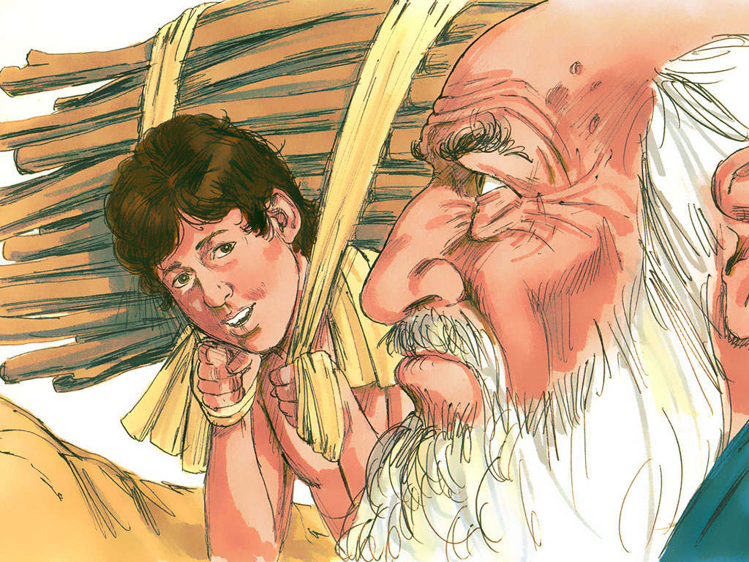
8. And that is when Abraham realised something very important. God would always do the right thing. If he obeyed God, even in this very hard thing, God would make it all right in the end. He thought that maybe God would let Isaac die but then he would bring him back to life.
Abraham did not understand exactly what would happen but he had faith in God. He would do what God said.
Notes:
8. And that is when Abraham realised something very important. God would always do the right thing. If he obeyed God, even in this very hard thing, God would make it all right in the end. He thought that maybe God would let Isaac die but then he would bring him back to life.
Abraham did not understand exactly what would happen but he had faith in God. He would do what God said.

Slide 7
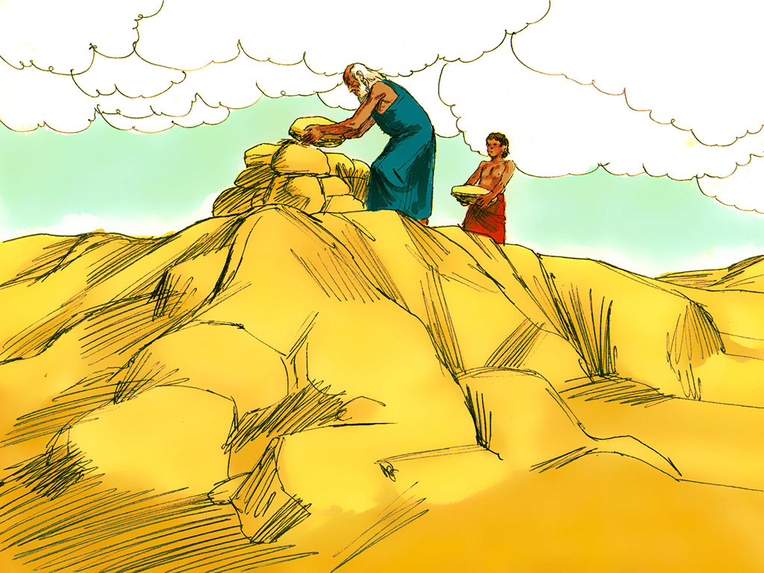
9. When Abraham and his son got to the top of the mountain they stacked stones on top of stones to build an altar. Isaac asked his father what animal they would put on the altar. Only Abraham knew that Isaac would be the one on the altar instead of an animal.
Notes:
9. When Abraham and his son got to the top of the mountain they stacked stones on top of stones to build an altar. Isaac asked his father what animal they would put on the altar. Only Abraham knew that Isaac would be the one on the altar instead of an animal.

Slide 8
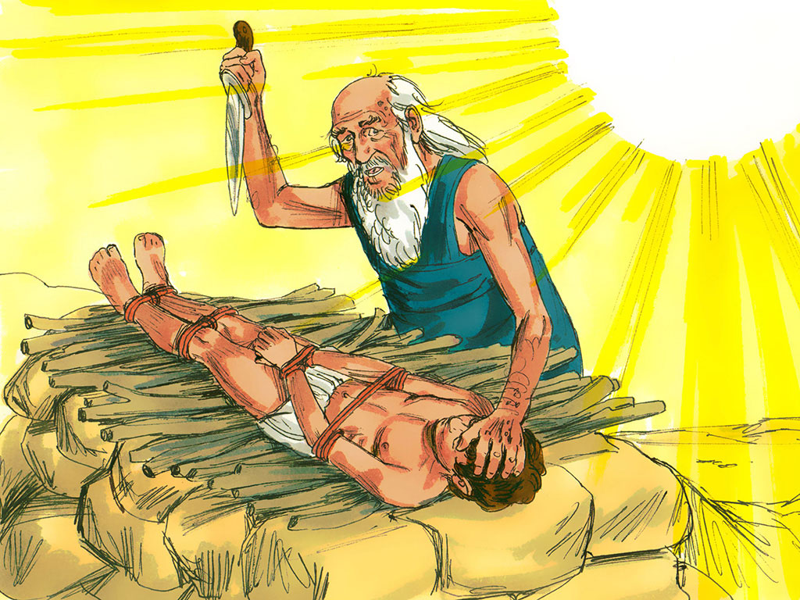
10. And then the time came for Abraham to do what God said and kill his son. But do you think Abraham actually killed his son? No, he did not. At the last minute an angel called out in a loud voice and told Abraham to stop. Even though God knew that Abraham had enough faith to obey him God did not want him to actually kill Isaac.
Notes:
10. And then the time came for Abraham to do what God said and kill his son. But do you think Abraham actually killed his son? No, he did not. At the last minute an angel called out in a loud voice and told Abraham to stop. Even though God knew that Abraham had enough faith to obey him God did not want him to actually kill Isaac.

Slide 9
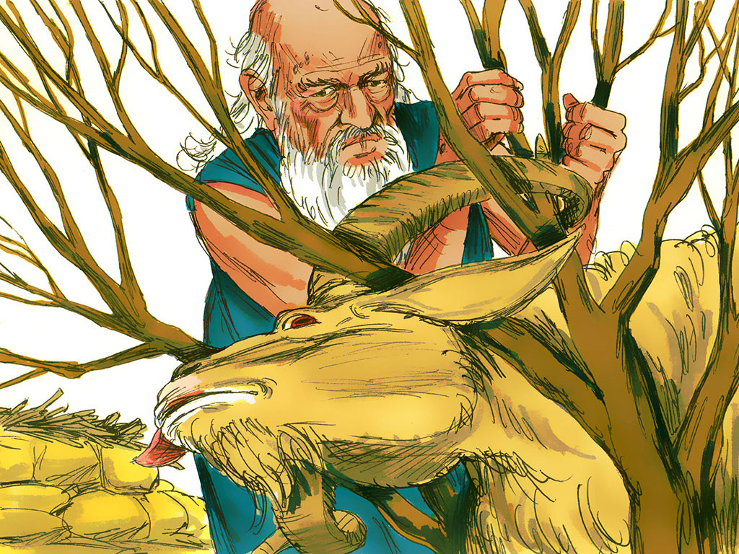
11. What a relief! God would never want a person to be killed and burned on an altar. Abraham looked up and saw a ram caught in some bushes. He and Isaac offered the ram as a sacrifice on the altar.
Notes:
11. What a relief! God would never want a person to be killed and burned on an altar. Abraham looked up and saw a ram caught in some bushes. He and Isaac offered the ram as a sacrifice on the altar.

Slide 10
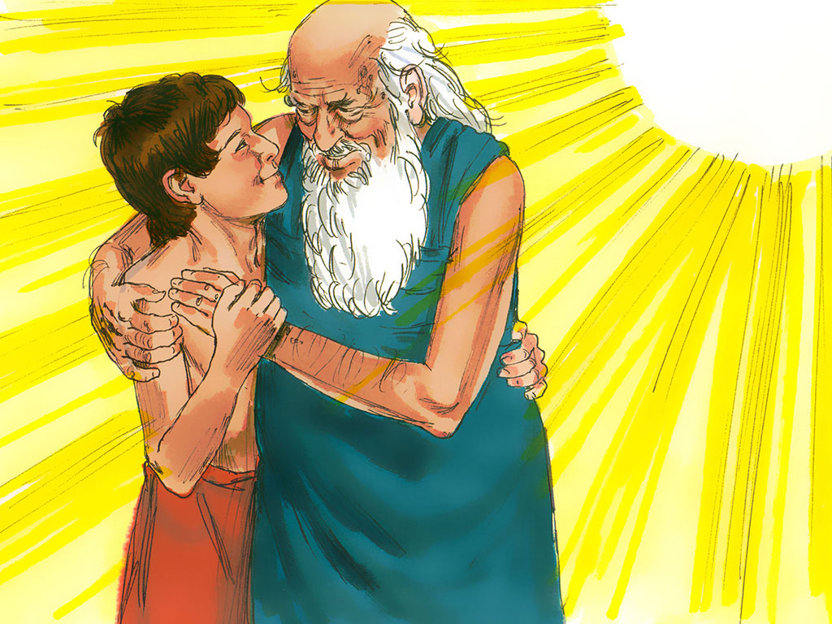
12. On that day Abraham learned that he loved God more than anything else. He would always have faith in God.
And Isaac continued to grow up and follow God. And guess what? He had children and then they had children and then they had children…
As years passed the number of Abraham’s descendants became so many that they were as difficult to count as the number of stars in the sky.
Notes:
12. On that day Abraham learned that he loved God more than anything else. He would always have faith in God.
And Isaac continued to grow up and follow God. And guess what? He had children and then they had children and then they had children…
As years passed the number of Abraham’s descendants became so many that they were as difficult to count as the number of stars in the sky.

Slide 11
FAITH
Mt. Moriah
Genesis 22:2

