Slide 1


Slide 2
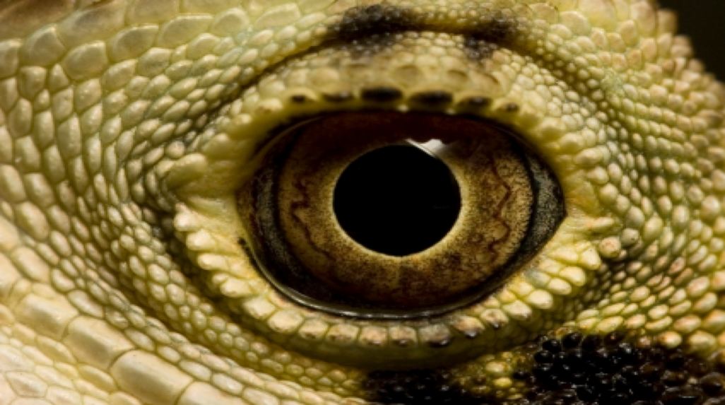



Slide 3

Most children are enthralled with the dinosaurs!

Slide 4

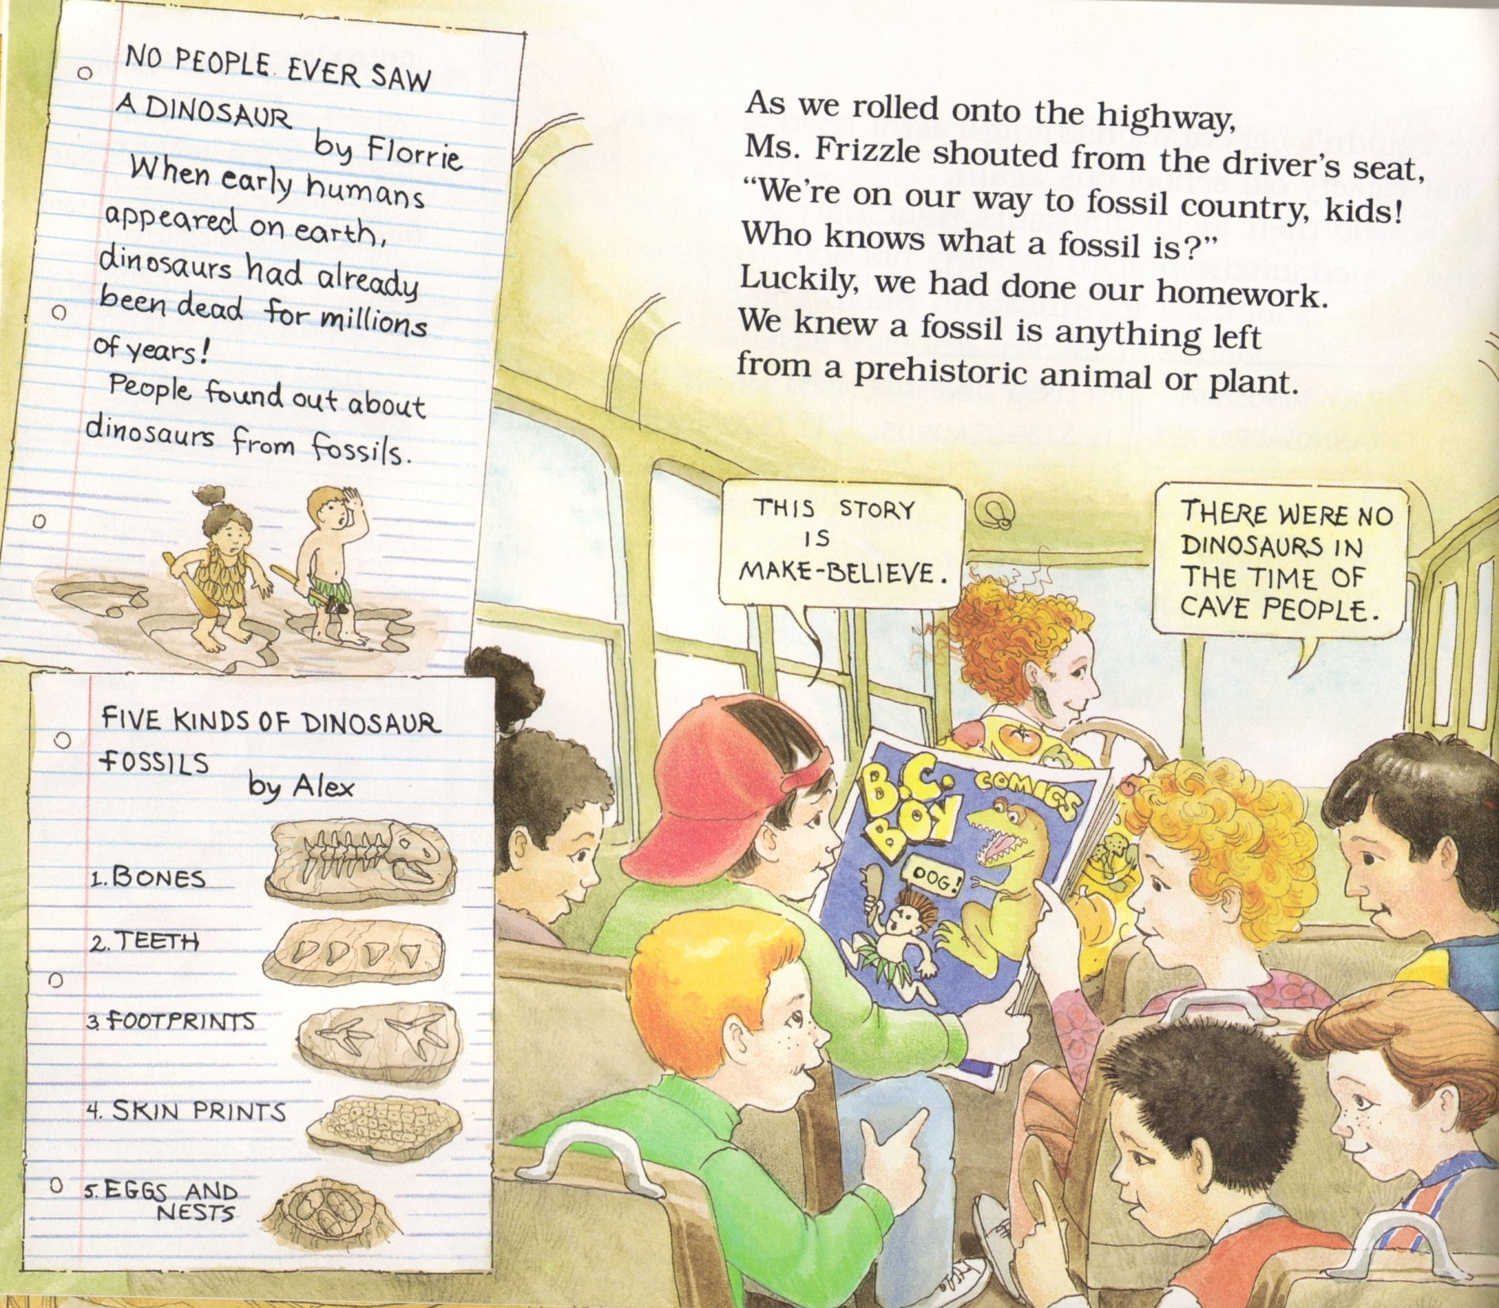
The Magic School Bus in the Time of the Dinosaurs by Joanna Cole, 1994.

Slide 5
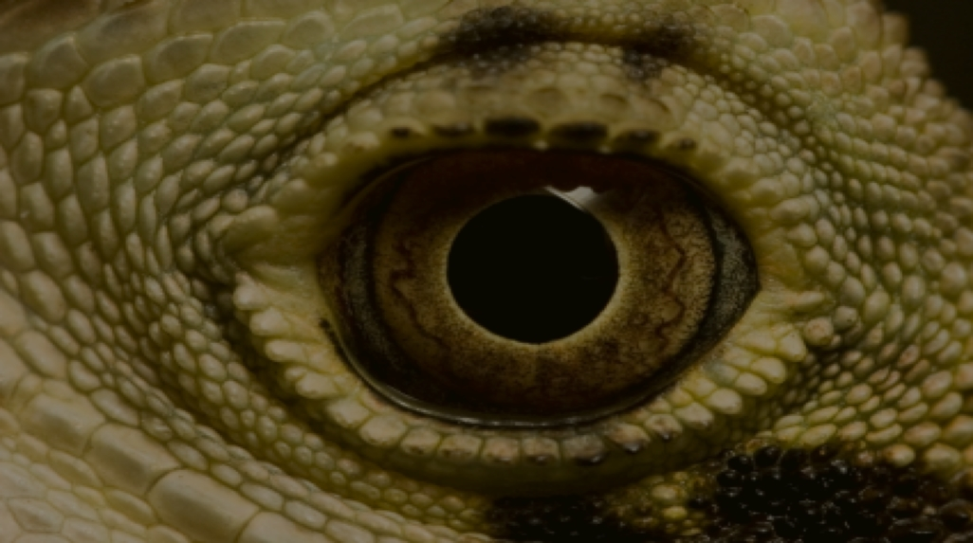
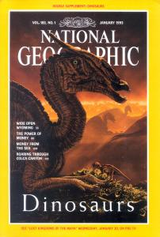

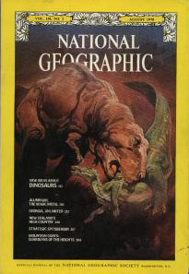


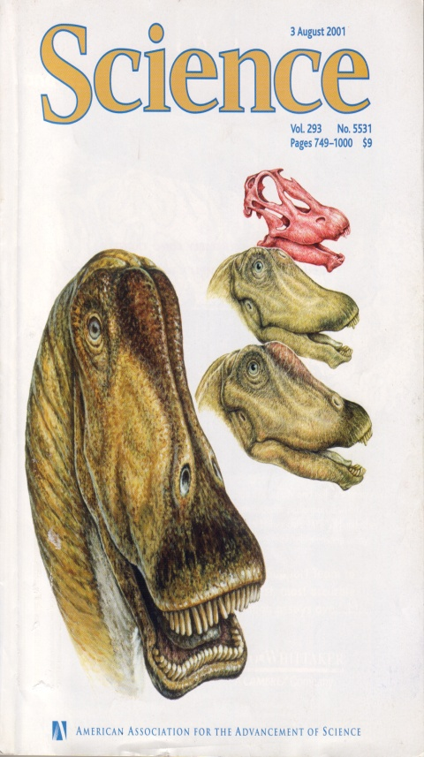
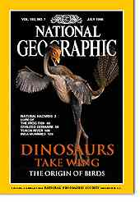
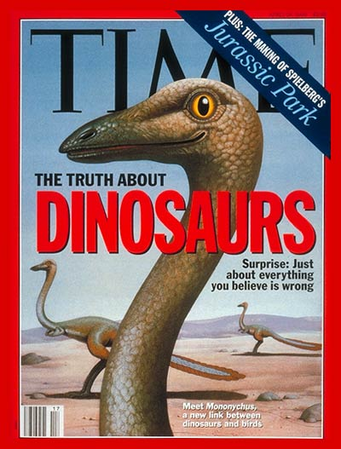

Slide 6
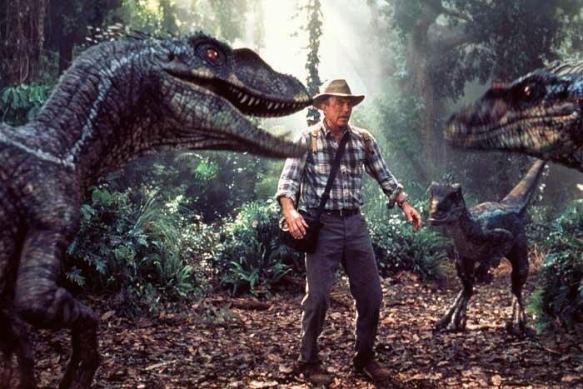
Velociraptors surround man, JP 2

Slide 7
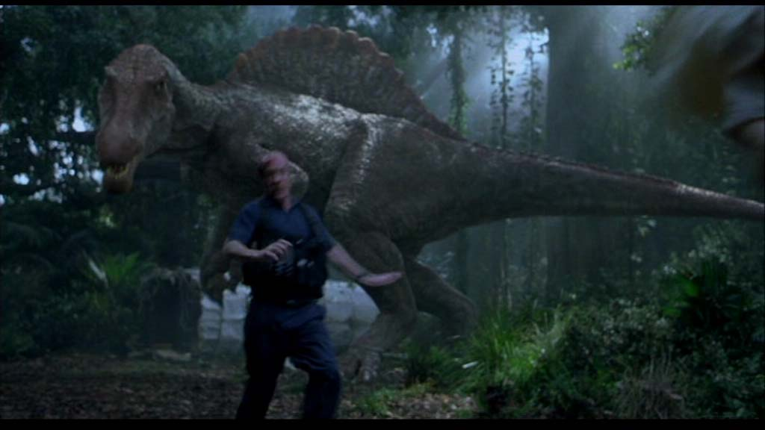
Jurassic Park 2, Chasing man

Slide 8
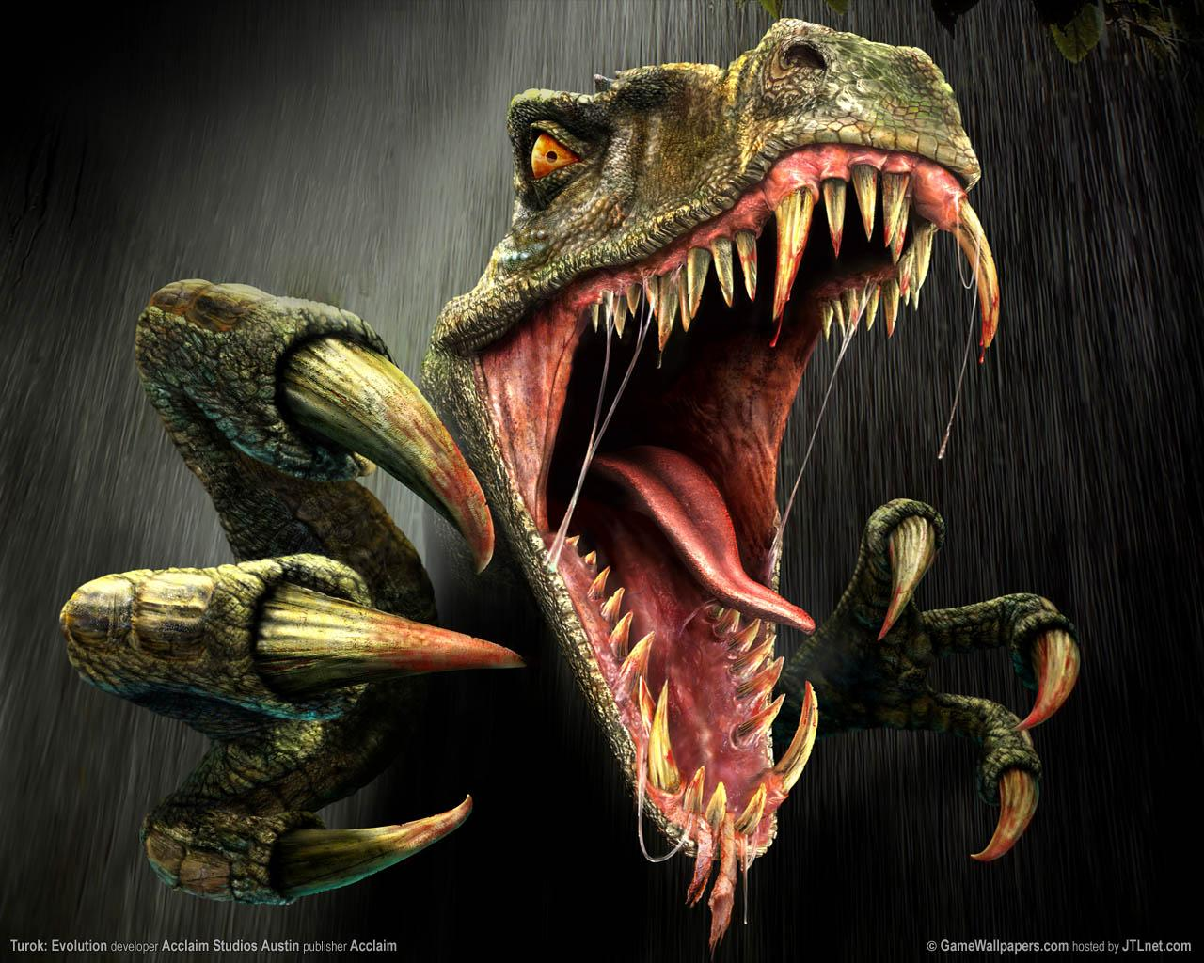
So What About
Dinosaurs
&
Man?

Slide 9
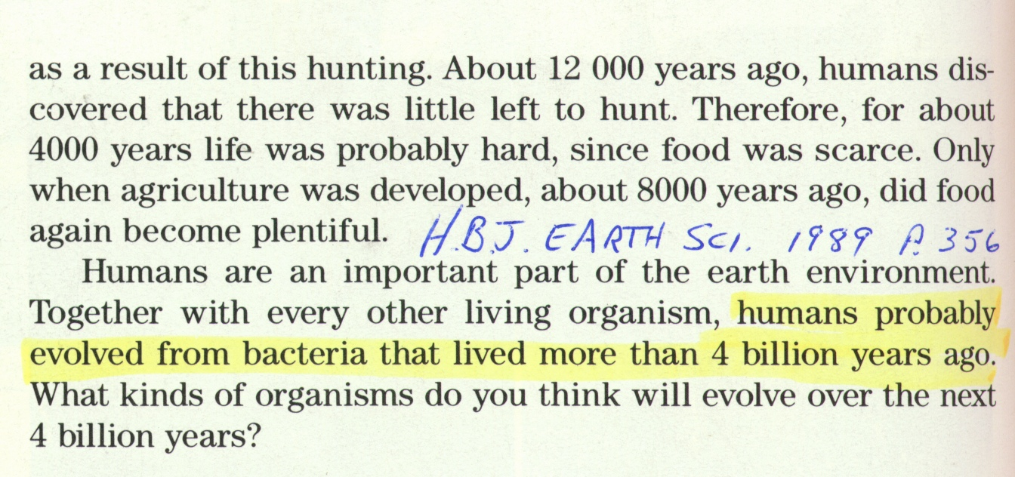
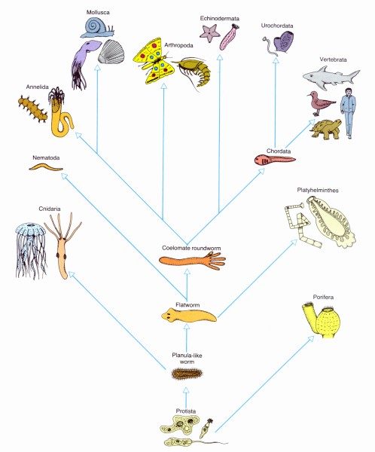

HBJ Earth Science, 1989 p. 356

Slide 10
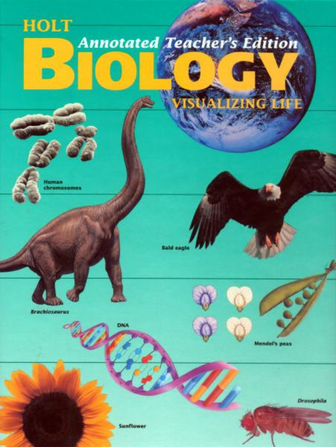
“You are an animal and share a common
heritage with
earthworms.”
Biology: Visualizing Life, Holt, 1994

Slide 11

“We know, for example, that humans evolved from common ancestors we share with other living primates such as chimpanzees and apes” (p. 757).
“Like all other forms of life, humans are products of evolution by natural selection” (p. 352).

Slide 12
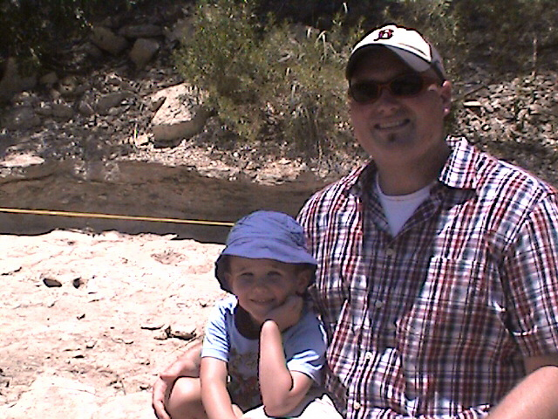
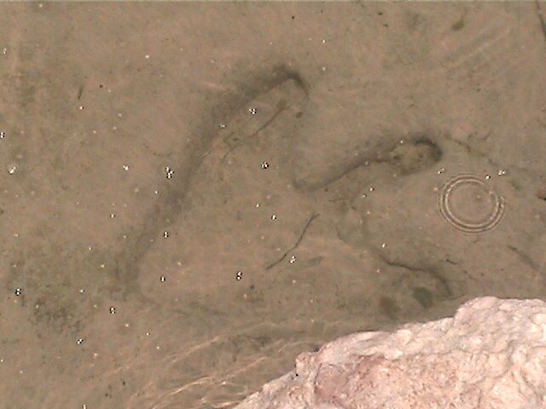
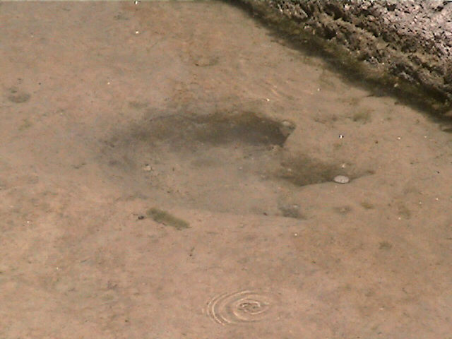
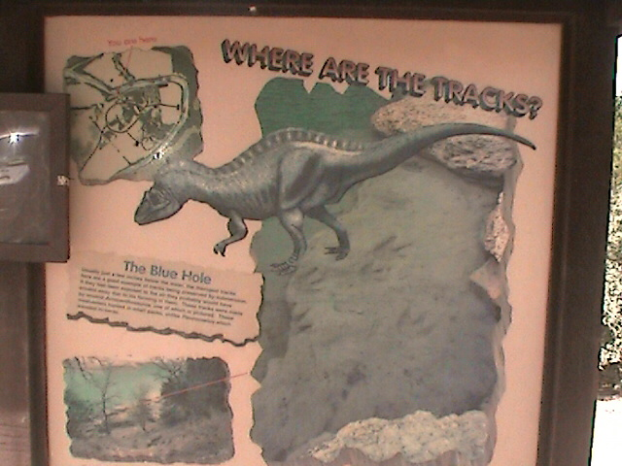

Slide 13
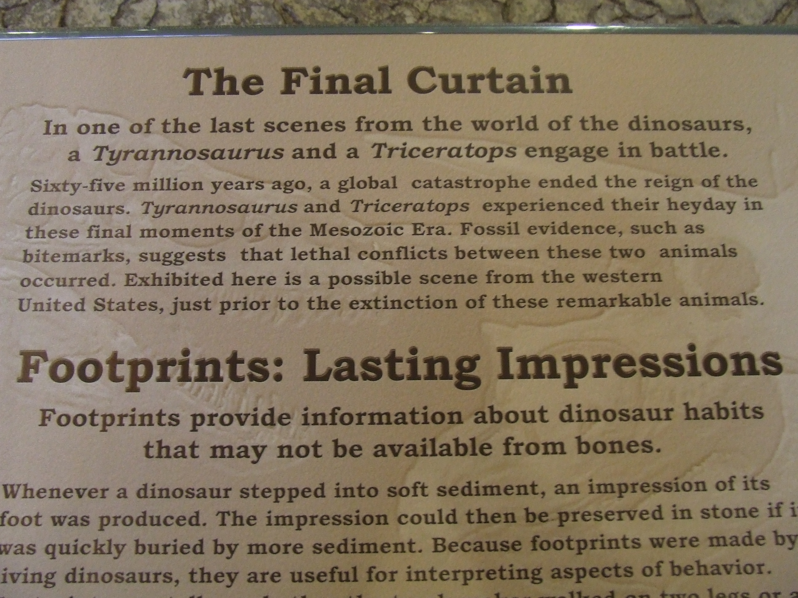
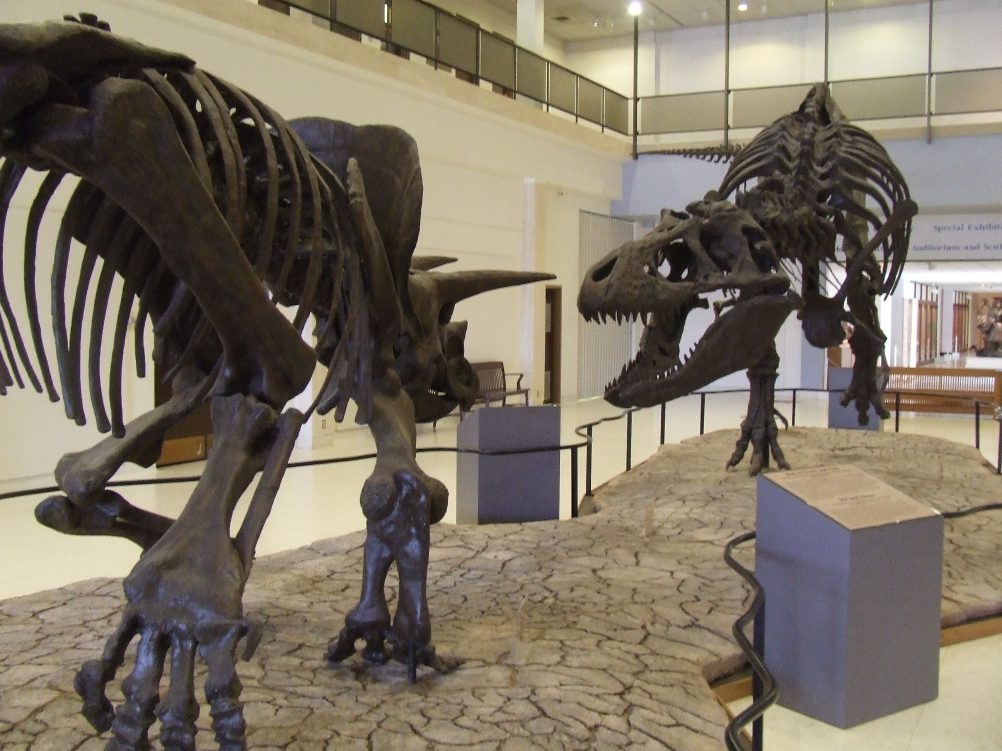

Slide 14
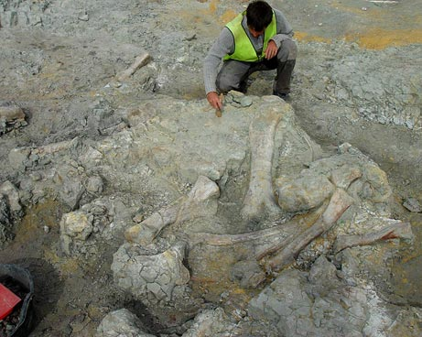
Same
Information

Slide 15
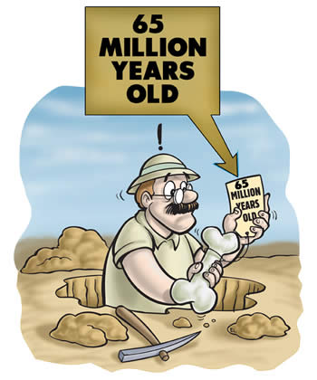

No
Tags
Showing
Dates

Slide 16
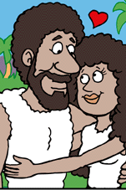
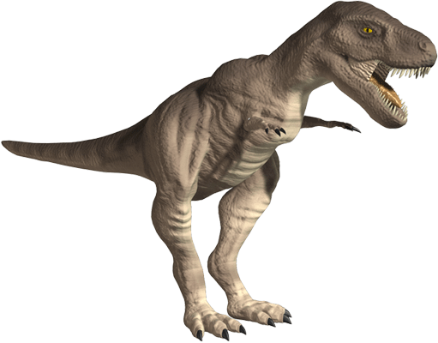

Bible says Man & Dinosaur
Created in the same week.
6000 YA
(4000 BC)
Creation
4400 YA
Flood
0
Jesus’
Birth
2000
Evolutionist’s Time Line
65 - 3 = 62
65 Million years ago Dinosaurs died out
Man Evolved
3 MYA

Slide 17
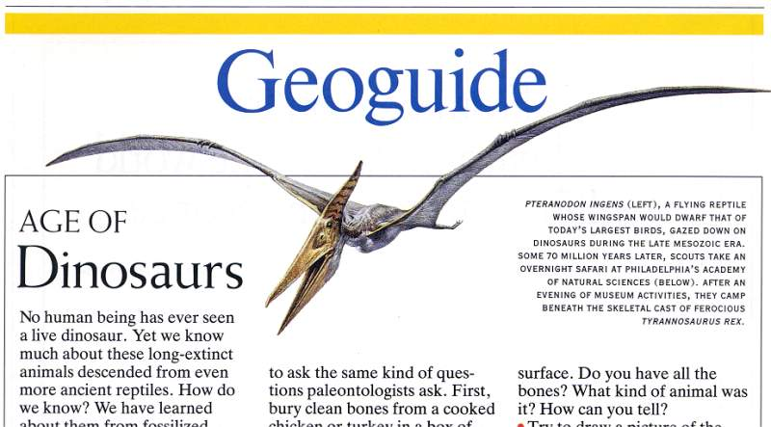
?
Geoguide text – No human has ever seen a dinosaur
“No human being has ever seen a live dinosaur.”
National Geographic, Jan. 1993, p. 142

Slide 18
In Dr. Philip Kitcher’s anti-creationist book titled Abusing Science: The Case Against Creationism (which renowned evolutionist Stephen Jay Gould called a “brilliant book”), he claimed that solid evidence for the co-existence of dinosaurs and humans would “shake the foundations of evolutionary theory, because, of course, the dinosaurs are supposed to have been long extinct by the time the hominids arrived on the scene” (1982, p. 121).

Slide 19
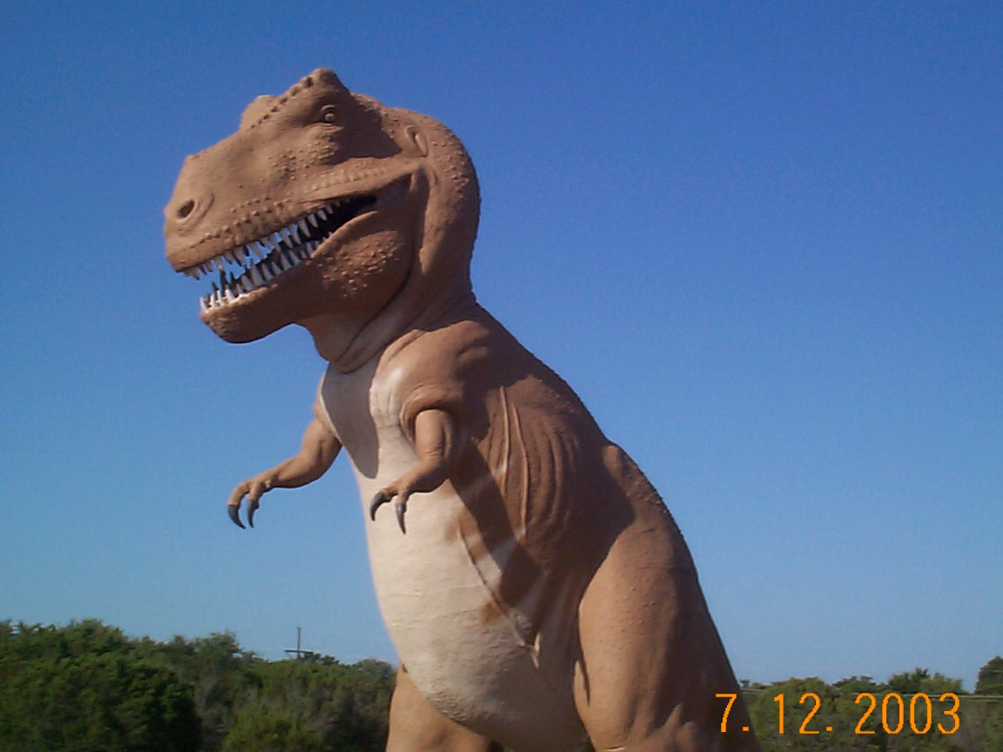
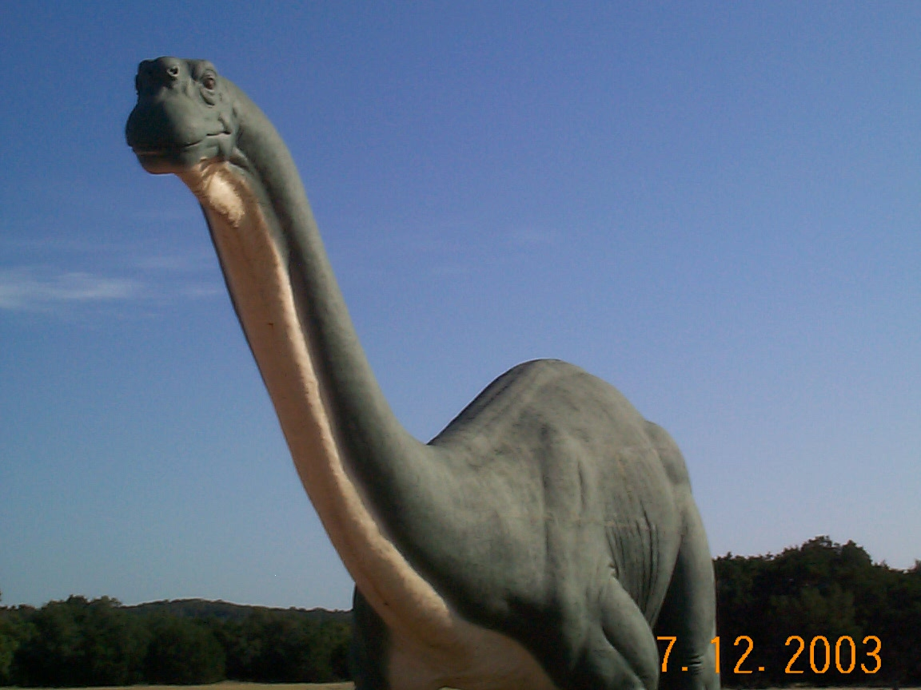
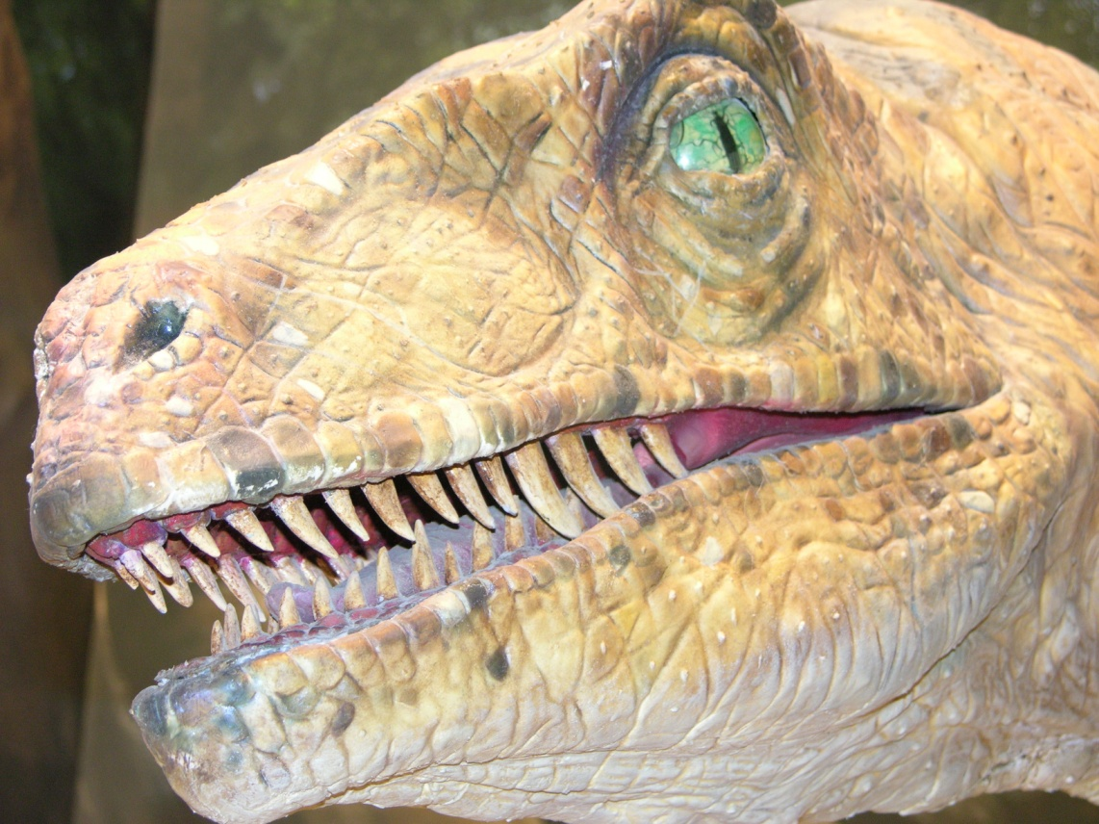
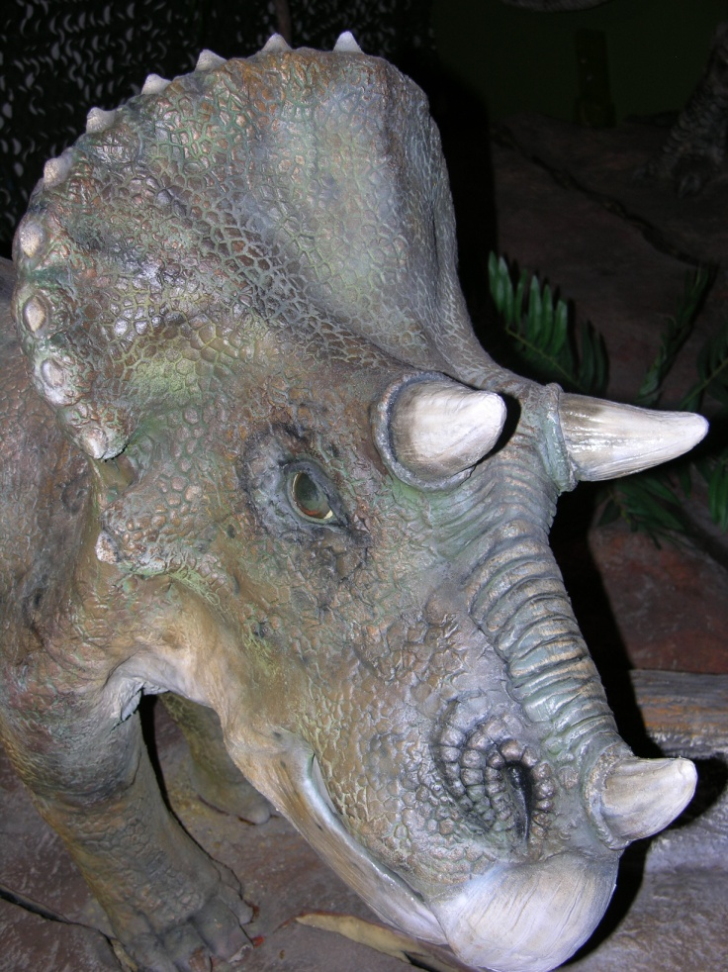
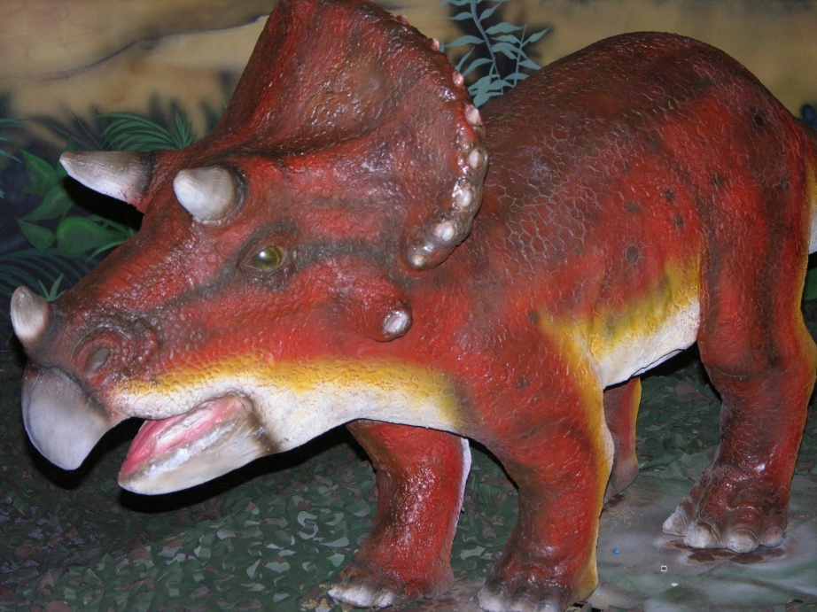
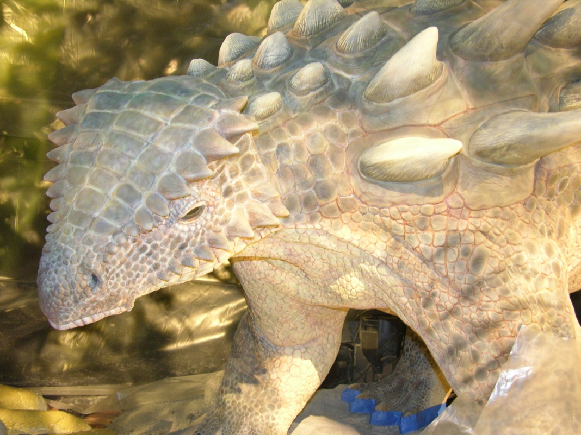

Slide 20
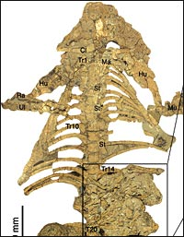
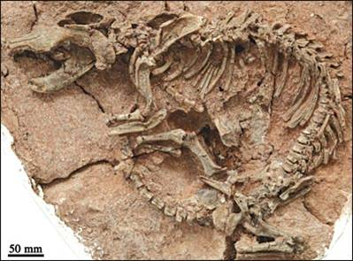
A MAMMAL MUCH LARGER THAN MICE WAS FOUND FOSSILIZED WITH A SMALL DINOSAUR IN THE STOMACH REGION
January 2005

Slide 21
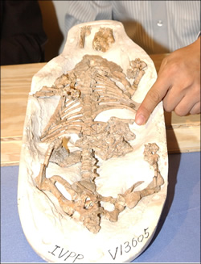
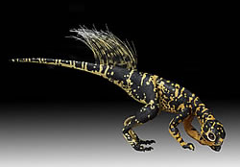
Dinosaur Found in the Stomach of a Fossilized Mammal!
Reported in the January 13, 2005 issue of Nature.

Slide 22
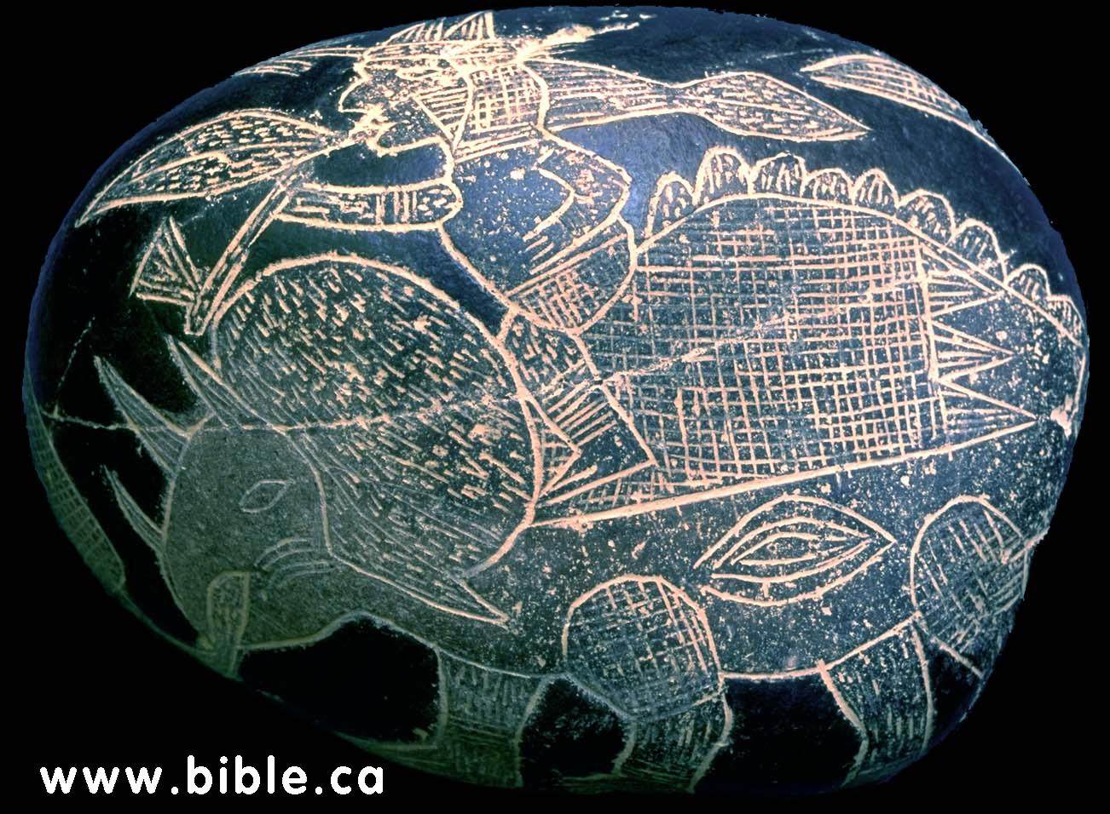
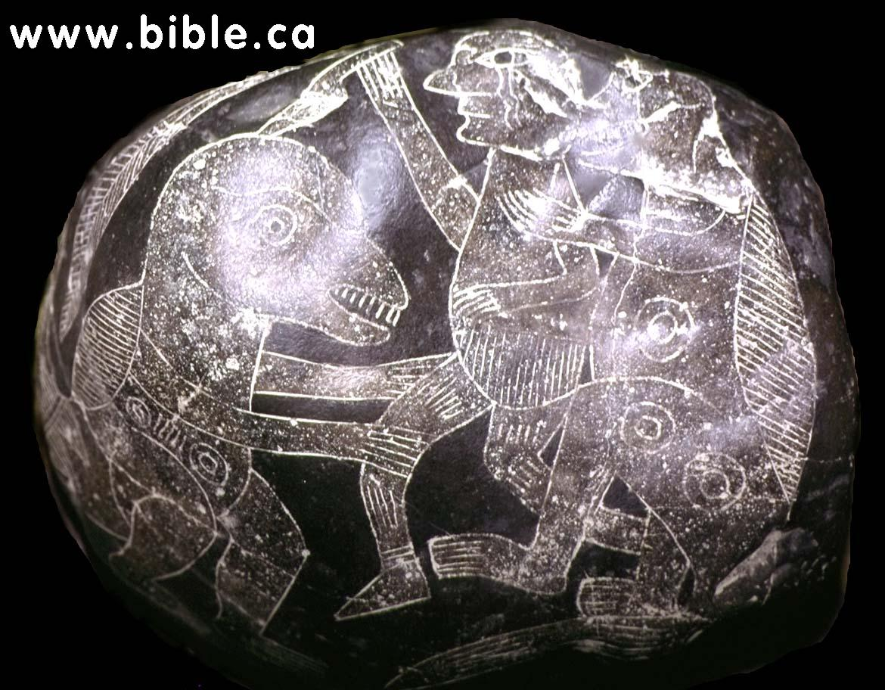
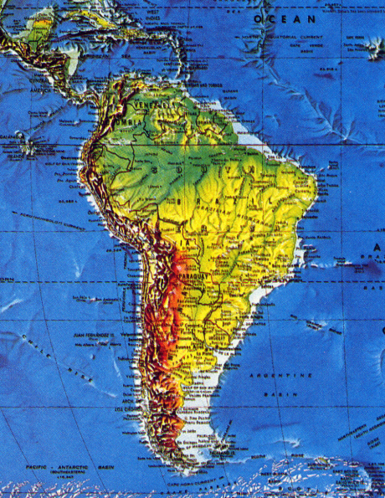
Ica Stones of Peru
[Discovered by Dr. Javier Cabrera Darquea, Inca National University; see Dr. Dennis L. Swift, “Messages on Stone,” Creation Ex Nihilo, 19[2]20-23, March-May 1997]

Slide 23

Peru
Ica, Peru
This is one of the most arid places on earth

Slide 24
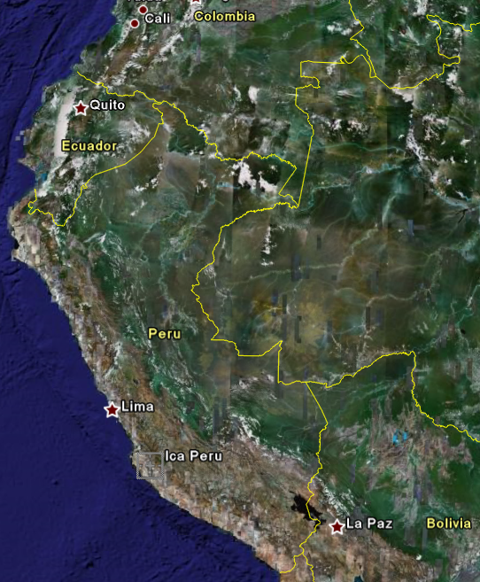
1571 Spanish conquistadors
In 1571 the Spanish conquistadors mentioned there were stones with strange creatures carved on them found in this region of Peru.

Slide 25
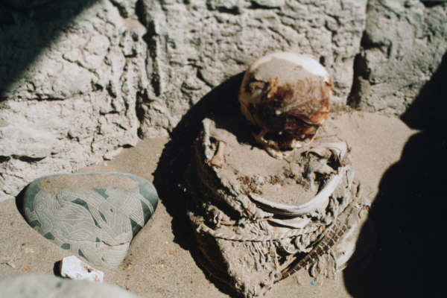

Slide 26
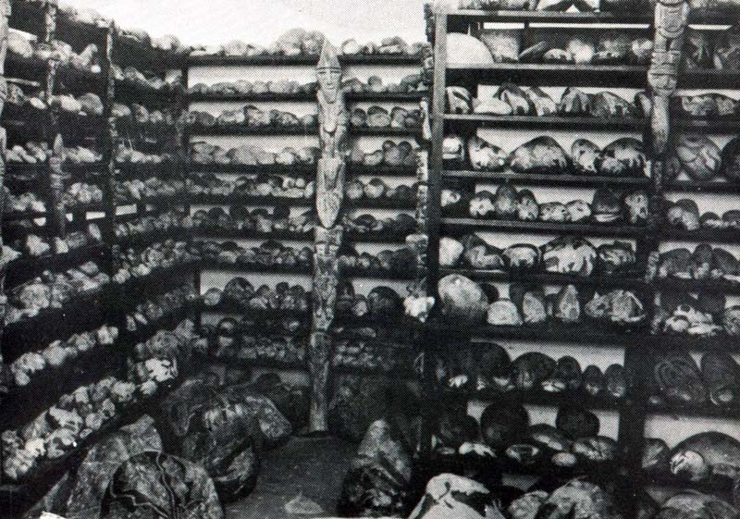
To date 11,000 stones exist, with approx. 1/3 showing figures of dinosaurs on them.

Slide 27
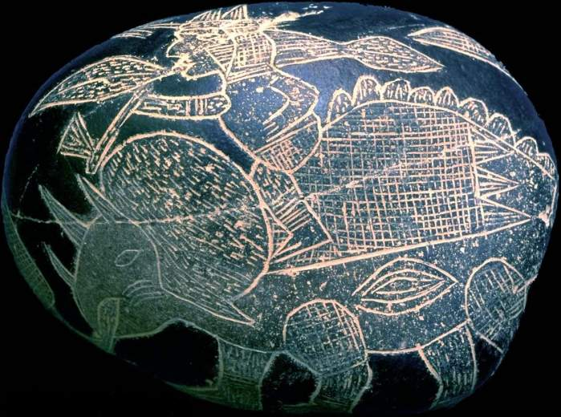

Slide 28
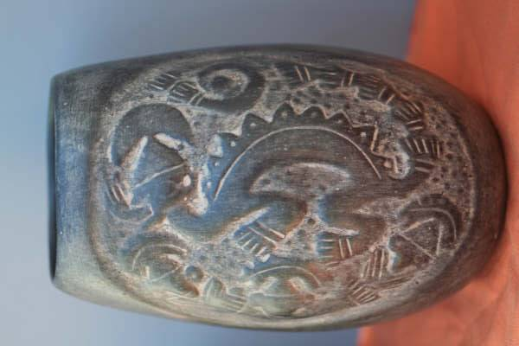
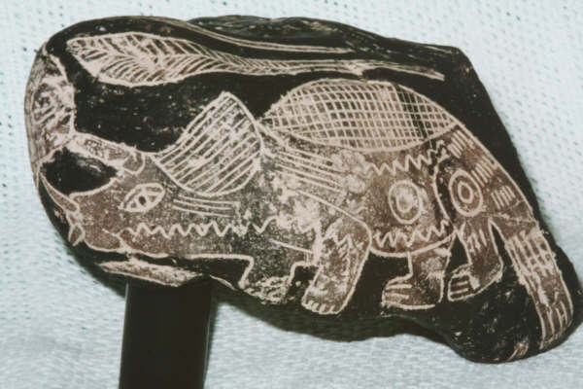
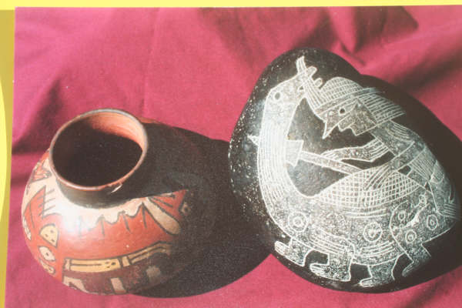

Slide 29
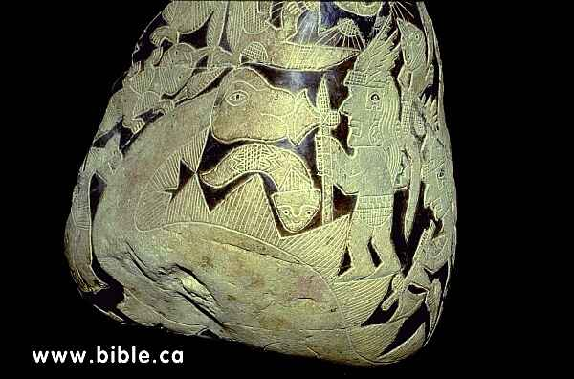
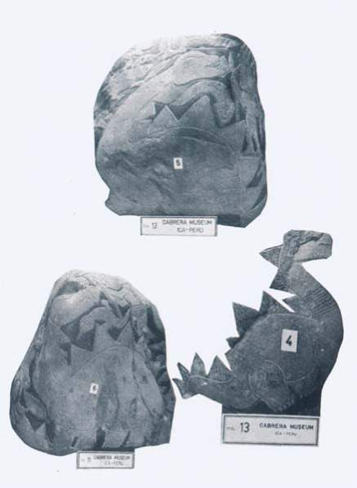
Several Diplodocus-like dinosaurs on the stones have what appear to be dermal frills—something never reported and verified by scientists before the early 1990s.

Slide 30
Dermal frills were first found in modern times in 1992 during an examination of fossilized remains of sauro-pods. In an article titled “New Look for Sauropod Dinosaurs,” evolutionary paleontologist Stephen Czer-kas noted:
  “Recent discovery of fossilized sauropod (diplo-docid) skin impressions reveals a significantly dif-ferent appearance for these dinosaurs. The fos-silized skin demonstrates that a median row of [dermal] spines was present.… Some are quite narrow, and others are broader and more conical” (1992, in Geology, 20:1068).

Slide 31

Concerning sauropod dermal spines found in the Howe dinosaur quarry in Wyoming in 1992, geologist Ellen Morris Bishop wrote: “The biggest spines found were about 9 inches long, shaped a little like a shark’s dorsal fin. The smallest, at tail-tip, were about 3 inches high (1993, The Oregonian, January 14).

Slide 32

Acambaro, Mexico

Slide 33


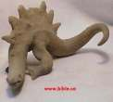
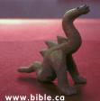

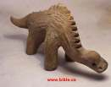












Dinosaur Figurines from Acambaro Mexico

Slide 34









Pop-up One at a time
1000s Depict Dinosaurs
Notes:
http://www.creationists.org/livedinos01.html
Clay Figurines found at base of El Toro Mountain, Mexico The drawing at the left (not pictured because of copyright issues) is from Bob Bakker's book, Dinosaur Heresies (1986). He begins by telling the story of his realization, "There's something wrong with our dinosaurs." He says, "I had grown up with the dinosaurian orthodoxy about dinosaur ways - how they were swamp bound monsters of sluggish dispositions, plodding with somnolent strides through the sodden terrain..." His contrasting view has drastically altered the way dinosaurs are now depicted.
The same modern ideas are reflected in clay figurines from the Pre-classical Chupicuaro Culture (800 B.C to 200 A.D.) found near Acambaro, Guanajuato, Mexico. Ankylosaurs exhibited a great deal of variety as do our modern dogs, however, the general type is readily recognizable in the Acambaro figurine. The most obvious explanation for hundreds of life-like depiction's of dinosaurs is that they have not been gone that long. These people saw them.
(132 KB)
(183 KB)
In 1945 German archeologist, Waldemar Julsrud discovered clay figurines buried at the foot of El Toro Mountain on the outskirts of Acambaro, Guanajuato, Mexico. Eventually over 32,000 figurines and artifacts were found. They were similar to artifacts identified with the Pre-classical Chupicuaro Culture (800 BC to 200 AD) found throughout this area.
The authenticity of the find was challenged because the collection included dinosaurs. Since many archeologists believe dinosaurs have been extinct for the past 65 million years and man's knowledge of them has been limited to the past 200 years. If this is true, man could not possibly have seen and modeled them 2500 years ago. In 1954 the Mexican government sent four well known archeologists to investigate. A different but nearby site was selected and meticulous excavation was begun. They found numerous examples of similar figurines and concluded that the find was authentic. However, three weeks later their report declared the collection to be a fraud because of the "fantastic representation of man and dinosaur together."
In 1955 Charles Hapgood, respected ⁽¹⁾ Professor of Anthropology at the University of New Hampshire, concluded an elaborate investigation including extensive radiometric dating. Interestingly, his work was supported by Earl Stanley Gardner, former District Attorney of the city of Los Angeles, California and the creator of Perry Mason. Hapgood responded to charges that Julsrud manufactured the figurines, by excavation under the house of the Chief of Police, which was built 25 years before the Julsrud arrived. Forty three more examples of the same type were found, including dinosaurs. Three radiocarbon tests were performed by Isotopes Incorporated of New Jersey resulting in dates of 1640 BC, 4530 BC and 1110 BC. Eighteen samples were subjected to thermoluminescent testing by the University of Pennsylvania, all of which gave dates of approximately 2500 BC. These results were subsequently withdrawn when it was learned that some of the samples were from dinosaurs.
In 1990 an investigation was conducted by Neal Steedy, an archeologist who's livelihood depends on contract work from the Mexican government. He arbitrarily selected an excavation site considerably removed form the Julsrud site. Shards were found but no figurines. He commissioned radiocarbon tests for a few samples from the Julsrud collection which produced a range of dates; 4000 years for a human face and 1500 years for a dinosaur. However, he concluded that the laboratory had not given true dates because he felt the samples were too soft to last more than 20 years.

Slide 35

What does their own radiocarbon dating really show?

Slide 36


800 Year Old Buddhist Temple in Cambodia

Slide 37


Natural Bridges National Monument is located in south-eastern Utah about 40 miles west of Blanding, Utah.
At Kachina Bridge, one can see numerous petroglyphs and picto-graphs that date back to the time of the Anasazi Indians.

Slide 38

Dinosaur Petroglyph-National Bridges National Monument (Blanding, Utah)
“There is a petroglyph in Natural Bridges National Monument that bears a striking resemblance to a dinosaur.”
(Fran Barnes, evolutionist and recognized authority on rock art of the American Southwest, in Barnes and Pendleton, Canyon Country Prehistoric Indians—Their Culture, Ruins, Artifacts, and Rock Art, Wasatch Publishers, Salt Lake City, Utah, 1995)

Slide 39

Quotation from Herodotus (a Greek historian from the fifth century B.C.):
  There is a place in Arabia...to which I went, on hearing of some winged serpents; and when I arrived there, I saw bones and spines of serpents, in such quantities as it would be impossible to describe. The form of the serpent is like that of a water-snake; but he has wings without feathers, and as like as possible to the wings of a bat (1850 reprint, Historiae, trans. Henry Clay, 2:75-76).
Herodotus knew of flying reptiles, and recognized that these creatures were neither birds, mammals, nor insects—but reptiles with wings.
Dimorphodon

Slide 40
The Jewish historian Josephus wrote 2,000 years ago about Moses and his army having a difficult time passing through a particular region because of the presence of flying serpents.
  When the ground was difficult to be passed over, because of the multitude of serpents (which it produces in vast numbers ...some of which ascend out of the ground unseen, and also fly in the air, and do come upon men at unawares, and do them a mischief)....
  [Moses] made baskets like unto arks, of sedge, and filled them with ibes [i.e., birds], and carried them along with them; which animal is the greatest enemy to serpents imaginable, for they fly from them when they come near them; and as they fly they are caught and devoured by them (n.d., Antiquities of the Jews, 2:10:2, emp. added).

Slide 41

Tomb of Bishop
Richard Bell d. 1496
Carlisle Cathedral, England
Photo by Jon Galloway, October 2003

Slide 42




Slide 43

Carlisle Cathedral, England
Photo by Jon Galloway, October 2003

Slide 44


Textiles from Nazca Tombs

Slide 45
Dr. Samuel Hubbard

Slide 46

Hava Supai Canyon, Arizona

Slide 47

Hava Supai Canyon
Notes:
The Doheny Expedition excerpt from: http://www.apologeticspress.org/articles/15
In the late 1800s, Samuel Hubbard, honorary curator of archaeology at the Oakland, California, Museum of Natural History, was excavating ancient Indian dwellings in the Hava Supai Canyon in Arizona. On the walls of the canyon where the Indians’ ancestors once lived, Dr. Hubbard found elegant drawings of an elephant, an ibex, a dinosaur, and other animals. He stated concerning the dinosaur drawing: “Taken all in all, the proportions are good.” He further suggested that the huge reptile is “depicted in the attitude in which man would be most likely to see it—reared on its hind legs, balancing with the long tail, either feeding or in fighting position, possibly defending itself against a party of men” (as quoted in Verrill, 1954, pp. 155ff.). Dr. Hubbard also noted:
The fact that some prehistoric man made a pictograph of a dinosaur on the walls of this canyon upsets completely all of our theories regarding the antiquity of man.... The fact that the animal is upright and balanced on its tail would seem to indicate that the prehistoric artist must have seen it alive (1925, pp. 5,7, emp. in orig.). Left: Edmontosaurus (courtesy of Paul S. Taylor, Eden Communications).
Right: Petroglyph discovered by Dr. Samuel Hubbard in Havai Supai Canyon (courtesy of www.bible.ca).
Nearby, Dr. Hubbard and his team of archaeologists discovered dinosaur tracks preserved in strata identified as Triassic—alleged by evolutionists to be more than 165 million years old. Question: How could Indians have known how to draw such a perfect picture of an animal (the dinosaur) that they never had seen (or had described to them by someone who had seen it)?
According to the belief commonly held by evolutionists, no advanced mammals were present during the “age of the dinosaurs.” Artists’ reconstructions generally show the huge reptiles living in swamps, surrounded only by other species of dinosaurs. The late evolutionary paleontologist George Gaylord Simpson suggested that the only mammals that had evolved up to that point in time (even at the very end of the Cretaceous period) were supposedly “small, mostly about mouse-sized, and rare” (Simpson, et al., 1957, p. 797). In his book, Wonderful Life: The Burgess Shale and the Nature of History, Stephen J. Gould addressed the same issue when he wrote:
Mammals evolved at the end of the Triassic, at the same time as dinosaurs, or just a tad later. Mammals spent their first hundred million years—two-thirds of their total history—as small creatures living in the nooks and crannies of a dinosaur’s world. Their sixty million years of success following the demise of the dinosaurs has been something of an afterthought (1989, p. 318).
It thus is completely unthinkable, in evolutionary terms, that dinosaurs and advanced mammals (like elephants or giraffes) could have co-existed. Again, however, Dr. Hubbard’s discoveries have “thrown a monkey wrench” into the evolutionary timescale.
However, a discovery reported in the January 13, 2005, issue of Nature challenged everything evolutionists have ever maintained regarding dinosaurs and mammals. The Associated Press reported: “Villagers digging in China’s rich fossil beds have uncovered the preserved remains of a tiny dinosaur in the belly of a mammal, a startling discovery for scientists who have long believed early mammals couldn’t possibly attack and eat a dinosaur” (Verrengia, 2005). Not only do we now have additional proof of mammals coexisting with dinosaurs, but we also have scientific evidence of a large mammal eating a dinosaur! The authors discovered the fossil remains of two different mammals. One was 50% larger than previous mammal fossils that were considered to be living with the dinosaurs, and was named Repenomamus giganticus. The other, Repenomamus robustus was fully intact—and had a dinosaur in its stomach. Yaoming Hu and his colleagues noted:
During preparation of the specimen a patch of small bones was revealed within the ribcage, on the ventral sides of the posterior left thoracic ribs and vertebrae, where the stomach is positioned in extant mammals. Unduplicated dentition [teeth—BH], limb bones and phalanges [bones of the toes or “fingers”—] in the patch confirm that these bones belong to a juvenile individual of Psittacosaurus, an herbivorous dinosaur that is common in Jehol Biota. The serrated teeth in the patched skeleton are typical of juvenile Psittacosaurus. The skull and most of the skeleton of the juvenile Psittacosaurus are broken, disarticulated and displaced, in contrast to the preservation of the R. robustus skeleton, which is essentially in its original anatomical relation. Although fragmentary, the bones of the Psittacosaurus are packed in a restricted area. These conditions indicate that the juvenile skeleton of Psittacosaurus is the remaining stomach contents of the mammal (Hu, et al., 2005, 433:151).
To complicate matters, researchers reported in the April 18, 2002 issue of Nature, one of the premier science journals in the world, that they now have determined that the “last common ancestor of extant primates” existed (as dated by evolutionary dating methods) 85 million years ago (Tavaré, et al., 2002). Since dinosaurs are supposed to have died out 65 million years ago, that means the primate would have lived with the dinosaurs for at least 20 million years. One of the co-authors of the Nature paper, Christophe Soligo of London’s Natural History Museum, stated in regard to the find: “What we demonstrate is that modern orders of mammals appeared well before dinosaurs disappeared...” (see “Primate Ancestor Lived with Dinos,” 2002). So much for the belief that mammals evolved “just a tad later” than the dinosaurs.

Slide 48

Supai Trail, Grand Canyon

Slide 49
“Taken all in all, the proportions are good. The huge reptile is depicted in the attitude in which man would be most likely to see it—reared on its hind legs, balancing with the long tail, either feeding or in fighting position, possibly defending itself against a party of men.” ¹
¹ Dr. Samuel Hubbard, Honorary Curator of Archaeology, Oakland, California Museum of Natural History, in Strange Prehistoric Animals and Their History, A.H. Verrill, L.C. Page & Co., Boston, 1954, pp. 155ff.
² Dr. Samuel Hubbard, Discoveries Relating to Prehistoric Man by the Doheny Scientific Expedition, Oakland, California Museum of Natural History, 1925, pp. 5,7, emp. in orig.
[NOTE: Nearby were dinosaur tracks preserved in stratum identified as Triassic—supposedly more than 165 million years old.]
“The fact that some prehistoric man made a pictograph of a dinosaur on the walls of this canyon upsets completely all of our theories regarding the antiquity of man…. The fact that the animal is upright and balanced on its tail would seem to indicate that the prehistoric artist must have seen it alive.” ²

Slide 50

Indian pictograph from the Grand Canyon
Photo taken by
Dr. DeLancy
719 S. Main St. Perkasie, PA 18944.
His widow has the originals.
Notes:
http://www.bible.ca/tracks/native-american-dino-art.htm
Grand Canyon:
An example of Native American rock art carved into the walls of Grand Canyon. It was discovered in 1879 by E. L. Doheny and documented in 1924 by a scientific expedition which included Dr. Charles W. Gilmore, Curator of Vertebrate Paleontology, United States National Museum. The resulting publication reported as "fact" that "some prehistoric man made a pictograph of a dinosaur on the walls of this canyon..." Doheny Scientific Expedition, p.5. Recenly someone used it as a target practice and you can see a bullet hole at the base of the tail. It shows just how old the etchings must be since the fresh bullet mark cuts through the thick "rock varnish".

Slide 51



Slide 52

T. REX FOSSIL FOUND THAT CONTAINS SOFT TISSUE AND BLOOD VESSELS
March 24, 2005
Tissue fragments from a Tyrannosaurus rex femur are shown at left, when it is flexible and resilient and when stretched (arrow) returns to its original shape. The middle photo shows the bone after it is air dried. The photo at right shows regions of bone showing fibrous character, not normally seen in fossil bone.

Slide 53

T. REX FOSSIL FOUND THAT CONTAINS SOFT TISSUE AND BLOOD VESSELS
March 24, 2005
Tissue fragments from a Tyrannosaurus rex femur are shown at left, when it is flexible and resilient and when stretched (arrow) returns to its original shape. The middle photo shows the bone after it is air dried. The photo at right shows regions of bone showing fibrous character, not normally seen in fossil bone.
Notes:
Image from: http://www.bible.ca/tracks/rapid-fossils-dino-blood-cells.jpg

Slide 54

Protein from
T-Rex bone
Notes:
http://people.eku.edu/ritchisong/554notes1.html has walking with dinosaur youtube video link embedded

Slide 55


Pottery from South America

Slide 56

Burial Cloths and Pottery
(700 A.D.)
Notes:
http://www.creationists.org/livedinos01.html
Nasca culture (in Peru) Burial Cloths and Pottery (700 A.D.) Tombs in the deserts of Peru often preserve amazing artifacts which are very old, including the beautiful, intricate textiles of the Nasca culture (ca. 700 A.D.). These textiles depict living dinosaurs as do their ceremonial burial stones and pottery, indicating that these awesome creatures were still alive at the time and ancient Peruvians saw them.

Slide 57

Burial Cloths and Pottery from Peru (700 A.D.)
Notes:
http://www.creationists.org/livedinos01.html
Nasca culture (in Peru) Burial Cloths and Pottery (700 A.D.) Tombs in the deserts of Peru often preserve amazing artifacts which are very old, including the beautiful, intricate textiles of the Nasca culture (ca. 700 A.D.). These textiles depict living dinosaurs as do their ceremonial burial stones and pottery, indicating that these awesome creatures were still alive at the time and ancient Peruvians saw them.

Slide 58

Burial Cloths and Pottery (700 A.D.)
Notes:
http://www.creationists.org/livedinos01.html
Nasca culture (in Peru) Burial Cloths and Pottery (700 A.D.) Tombs in the deserts of Peru often preserve amazing artifacts which are very old, including the beautiful, intricate textiles of the Nasca culture (ca. 700 A.D.). These textiles depict living dinosaurs as do their ceremonial burial stones and pottery, indicating that these awesome creatures were still alive at the time and ancient Peruvians saw them.

Slide 59

Roman mural from the second century A.D. showing two long-necked dragons

Slide 60

Mesopotamian Cylinder Seal
Anton Moortgart, 1969, The Art of Ancient Mesopotamia, plate 292.
Notes:
http://home.talkcity.com/InspirationAv/vs8int/phile16Y.html
The art on the left is a Mesopotamiam Cylinder Seal from approximately 3300 B.C. The animal on the right is an artists conception from a skeleton of an Apatosaurus. There are many striking similarities between these two animals. Those legs could not be mistaken for that of any other type of animal other than one of the saurapods.
The biggest difference is at the head. One should be reminded that this particular dino went by the name brontosauras previously and wore the wrong head for 100 years. As it is, only one purported head of the Apatosaurus has been found. Its entirely possible that the head looked more like the one on the Egyptian relief than the one on the right in the artists conception. Cartilage forming the shape of the head and ears (which probably did not survive the years)no doubt is only suggested by the skeleton itself.
As for the musculature, in my view the trunk of the animal on the left is much more "realistic" --its drawn with more realism than is the artist rendition on the right--and again, one has to ask where the artist got the model to draw so convincingly the trunk of a saurapod?
Whatever you may think of the head, and perhaps it could be stylized or from another animal but the trunk of the body is obviously, conspicuously and unexplainably that of a sauropod.
Here, I've rearranged the neck angle and tail angle of the animal in question (after all, the neck and tail angle in this context is arbitrary) to see how well they match up to this actual apatosauras skeleton.
If you don't think it fair to change the angles to make them look more alike, I suggest that you look at as many apatosaurus representations as possible and you will see a range of neck and tail angles- some paralling the ones utilized here. I rebuilt the animal representation, but as you can see the head came out just a little to large. Still, (the outline of the animal on the ancient vase is in transparent red over the skeleton) the match is not at all bad. Not at all scientific, I know but still food for thought.

Slide 61


These tablets are attributed to Narmer, the legendary first Pharaoh of a united Egypt.
See Childress, 2000, Technology of the Gods, p. 115

Slide 62

Why aren’t dinosaurs mentioned in the Bible?

Slide 63

Sir Richard Owen
Dinosaur = “deino” (terrible) + “sauros” (lizard)

Slide 64
Then the Lord answered Job out of the whirlwind and said…
Job 40:15

Slide 65
Behold now, Behemoth, which I made as well as you; He eats grass like an ox.
Job 40:15

Slide 66

What was the Behemoth?

Slide 67
Behold now, his strength in his loins and his power in the muscles of his belly.
Job 40:16

Slide 68

Mother and baby elephant Glenco Biol p. 497
Elephants have a big belly!

Slide 69

A Hippopotamus has a big belly!

Slide 70

Big belly

Slide 71

He bends his tail like a cedar: the sinews of his thighs are knit
together.
Job 40:17

Slide 72
“Cedars” in the Bible
Psalm 92:12—“The righteous shall flourish like a palm tree, he shall grow like a cedar in Lebanon”
Ezekiel 31:3—“Indeed Assyria was a cedar in Lebanon, with fine branches that shaded the forest, and of high stature; and its top was among the thick boughs”
Amos 2:9—“Yet it was I who destroyed the Amorite before them, Whose height was like the height of the cedars, and he was as strong as the oaks; yet I destroyed his fruit above and his roots beneath”
Ezekiel 17:22—“Thus says the Lord GOD: ‘I will take also one of the highest branches of the high cedar and set it out”

Slide 73

Not like a cedar tree!

Slide 74

Not like a cedar tree here either!

Slide 75

Like a cedar tree

Slide 76
JOB 41
“Can you draw out Leviathan with a fishhook…?”

Slide 77
“Can you put a rope in his nose, or pierce his jaw with a hook?
…The sword that reaches him cannot avail; nor the spear, the dart or the javelin…. Clubs are regarded as stubble; he laughs at the rattling of the javelin.”
Job 41:2,26,29

Slide 78
“His underparts are like sharp potsherds; he spreads out like a threshing sledge on the mire.” (Job 41:30).
________________________________
“Nothing on earth is like him, one made without fear. He looks on everything that is high….” (Job 41:33-34a).

Slide 79


Slide 80
“His sneezings flash forth light, and his eyes are like the eyelids of the morning. Out of his mouth go burn-ing lights; sparks of fire shoot out. Smoke goes out of his nostrils, as from a boiling pot and burning rushes. His breath kindles coals, and a flame of fire goes out of his mouth.”
Job 41:18-21

Slide 81


Slide 82

Marco Polo lived in China for 17 years in approxi-mately A.D. 1271, and reported that the Chinese em-peror raised dragons to pull his chariots in parades.
In 1611, the emperor initiated the post of a “Royal Dragon Feeder.” Chinese families are said to have raised dragons in order to use their blood for med-icines, and highly prizing their eggs (John DeVisser, Marinus Willem Co., The Dragon in China and Ja-pan, 1969).

Slide 83

Viking ships often had a dragon head.
1000 A.D.
The Vikings p.17

Slide 84

Viking ship
The Unexplained, vol. 3, 1985, p. 386
See also the Voluspa account of the dragon called Nithhoggr by
the Vikings as recorded in After the Flood by Bill Cooper p. 142

Slide 85





angler fish
angler fish
electric eel
firefly
firefly

Slide 86

But Job wasn’t a post-flood book…!?
Does that mean…?

Slide 87

What happened to the Dinosaurs?

Slide 88
What happened to the dinosaurs?
An asteroid struck the Earth causing worldwide fires. The dust from the impact, and soot and ash from the fire, blocked out the Sun’s rays, causing the temperatures to drop drastically.
A nearby supernova (exploding star) flooded the Earth with intense radiation, resulting in fatal mutation for dinosaur offspring.
The Earth’s climate became too warm, too cold, too dry, or too wet for the dinosaurs’ health.
A change in the dinosaurs’ diet resulted in weakened eggshells that broke after being laid.
A laxative plant in the dinosaur diets disappeared, and they died of constipation.
(Dinosaurs and Creation, Donald B. deYoung, Baker, Grand Rapids, Michigan, 2000, pp. 26-27)

