Slide 1


Slide 2

Florence, Alabama to Port Au Prince, Haiti June 25- July 2, 2017

Slide 3
Florence Boulevard 2017 Haiti Mission Trip

Slide 4


Slide 5
Areas of Focus For Liberte’ Ministries
Haiti School of Biblical Studies
Vocational Fund
Church Encouragement
Orphanage
Elementary school

Slide 6
Our Focus for this Year:

Slide 7
Haiti School of Biblical Studies
Church Encouragement
Orphanage
Elementary School

Slide 8
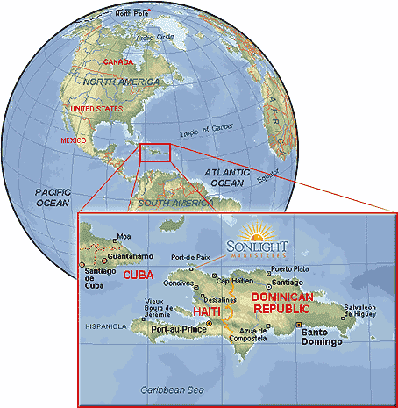

Slide 9
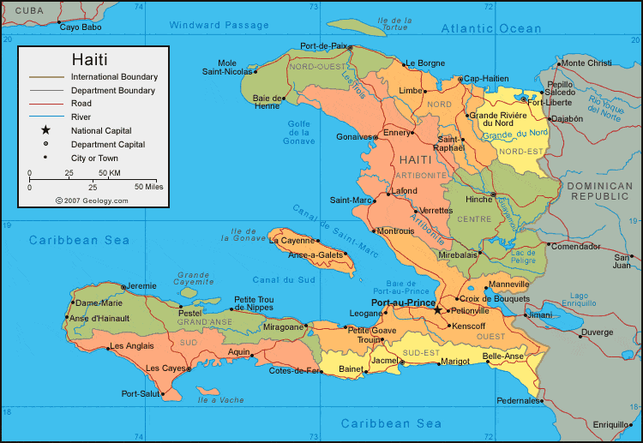
Bonnette Croix de Bouquets Lilavois

Slide 10
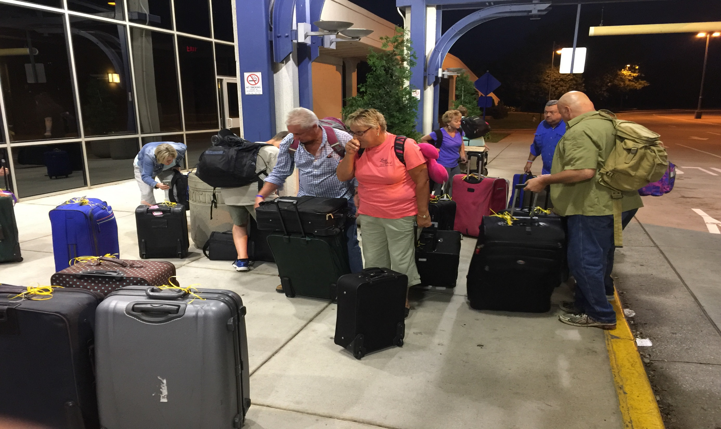

Slide 11
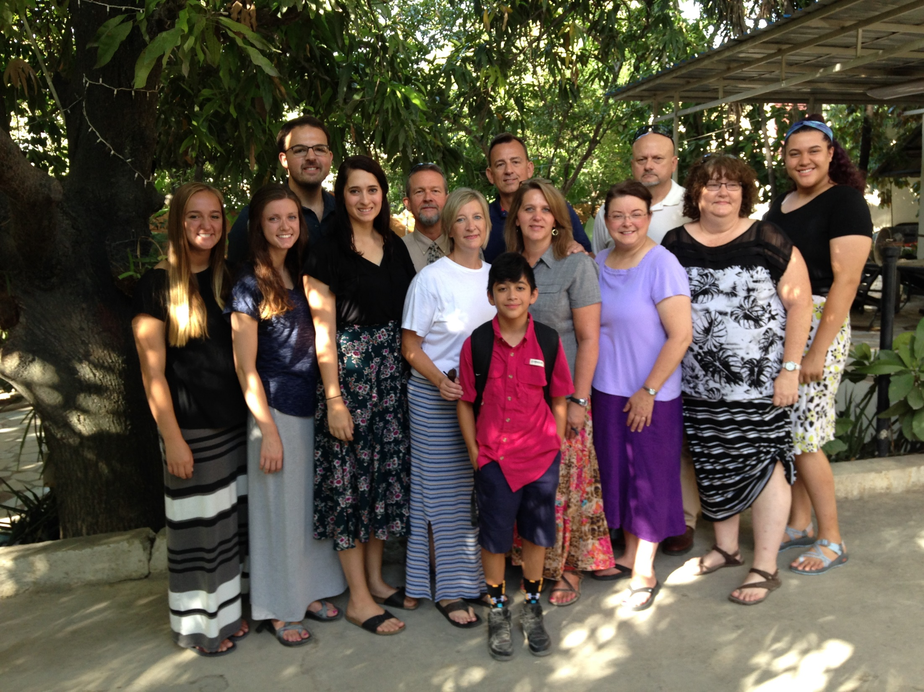

Slide 12
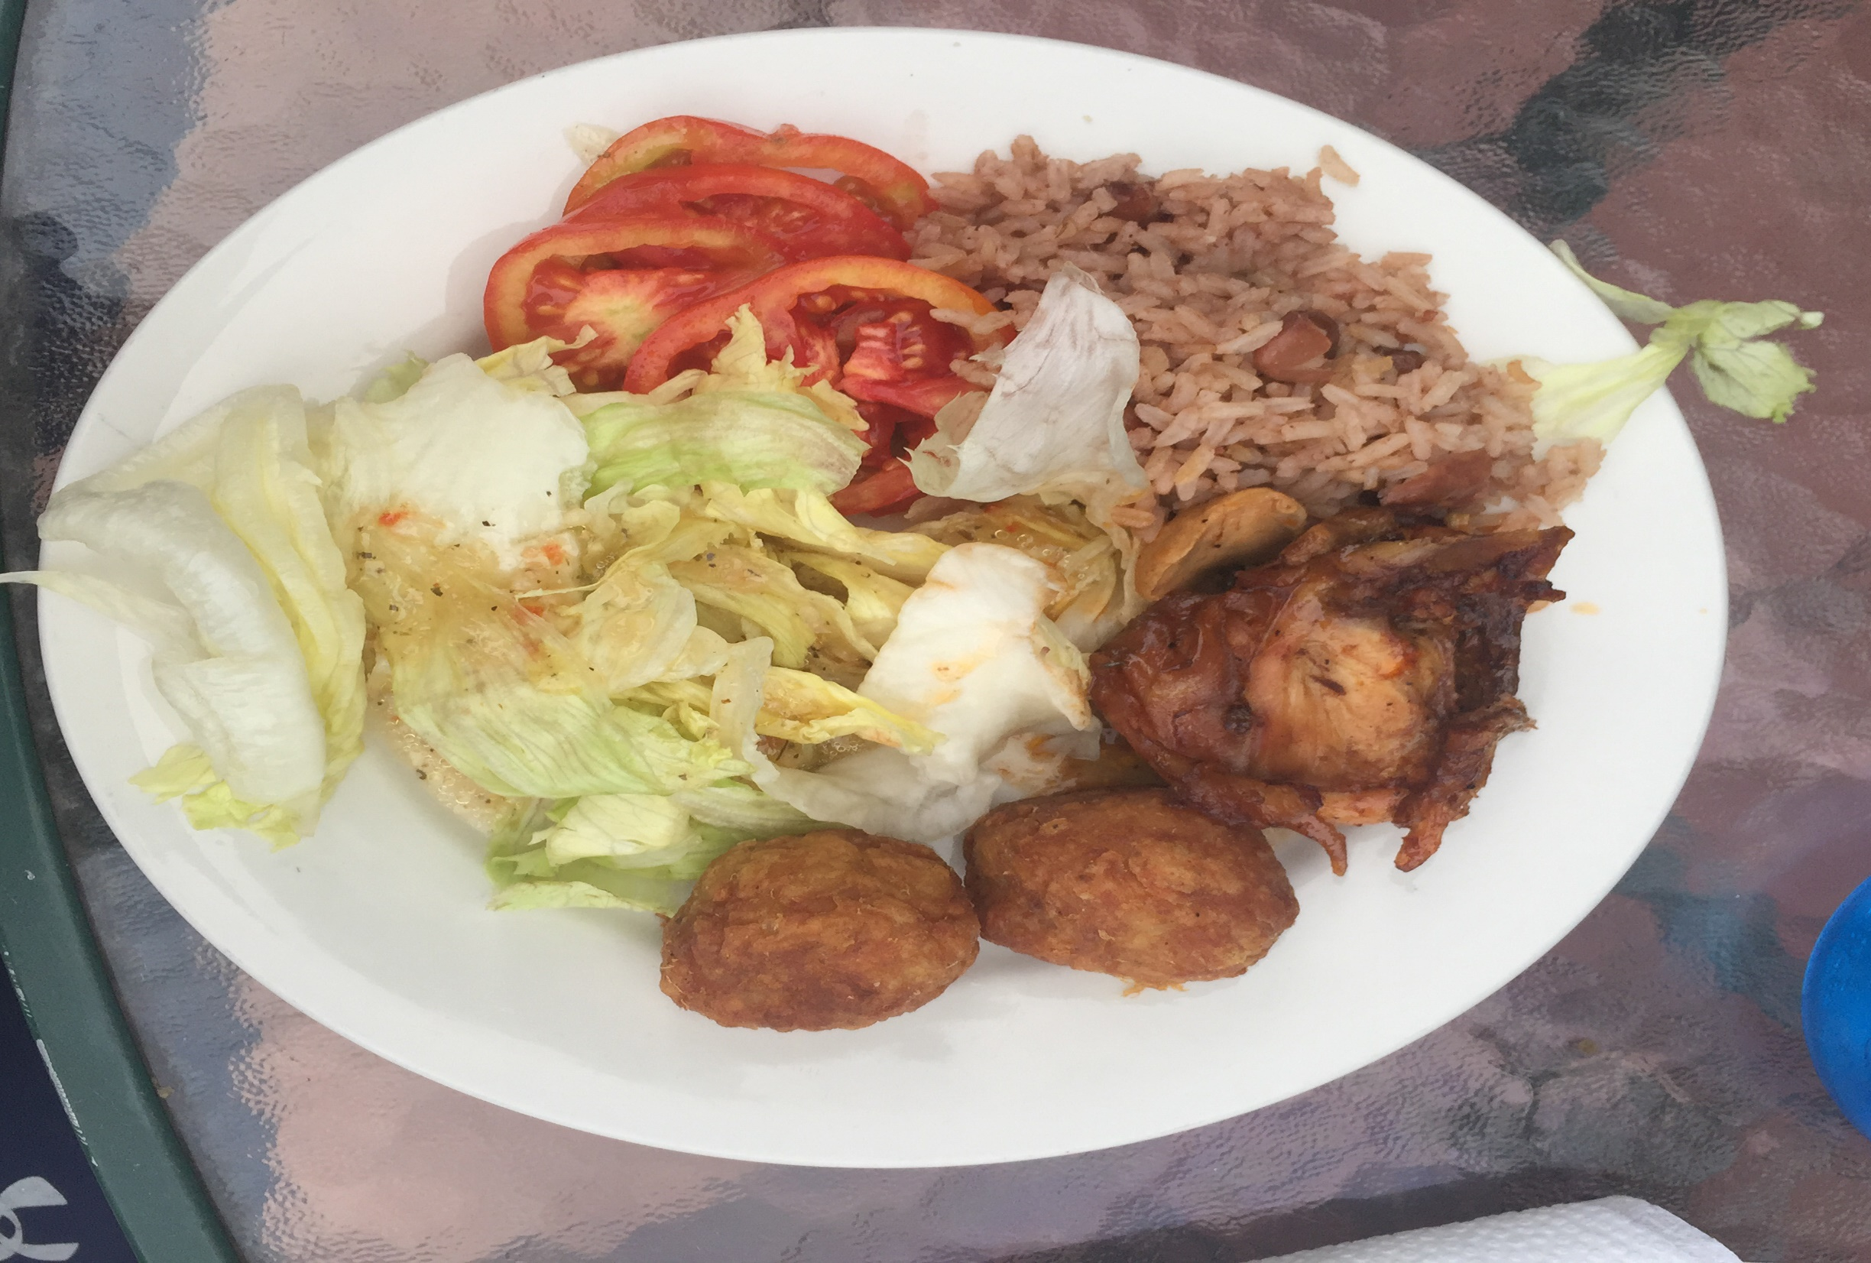

Slide 13
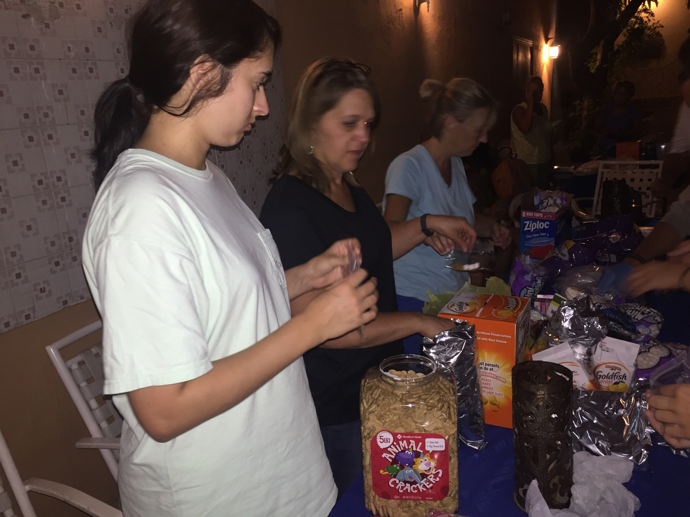

Slide 14
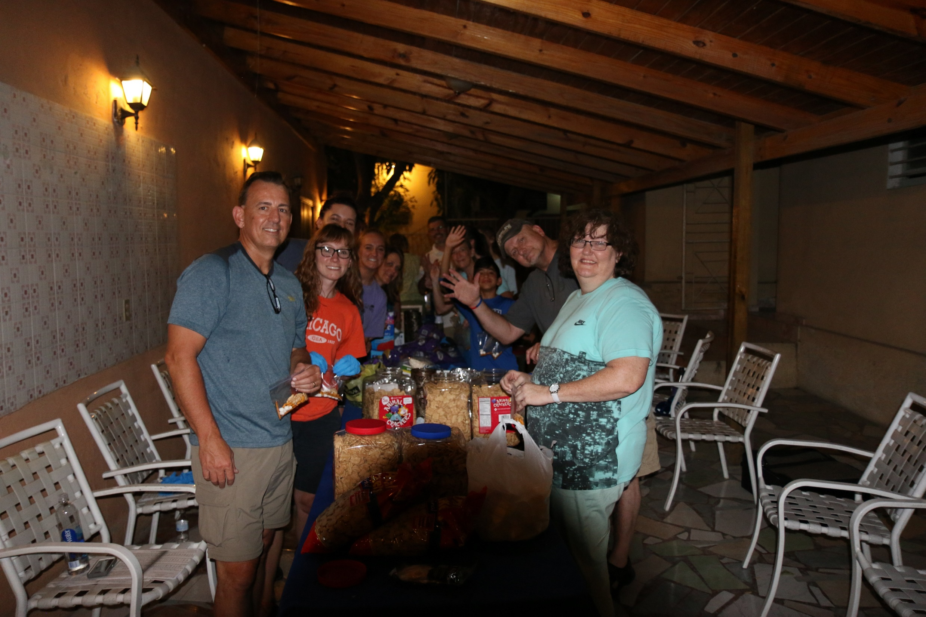

Slide 15
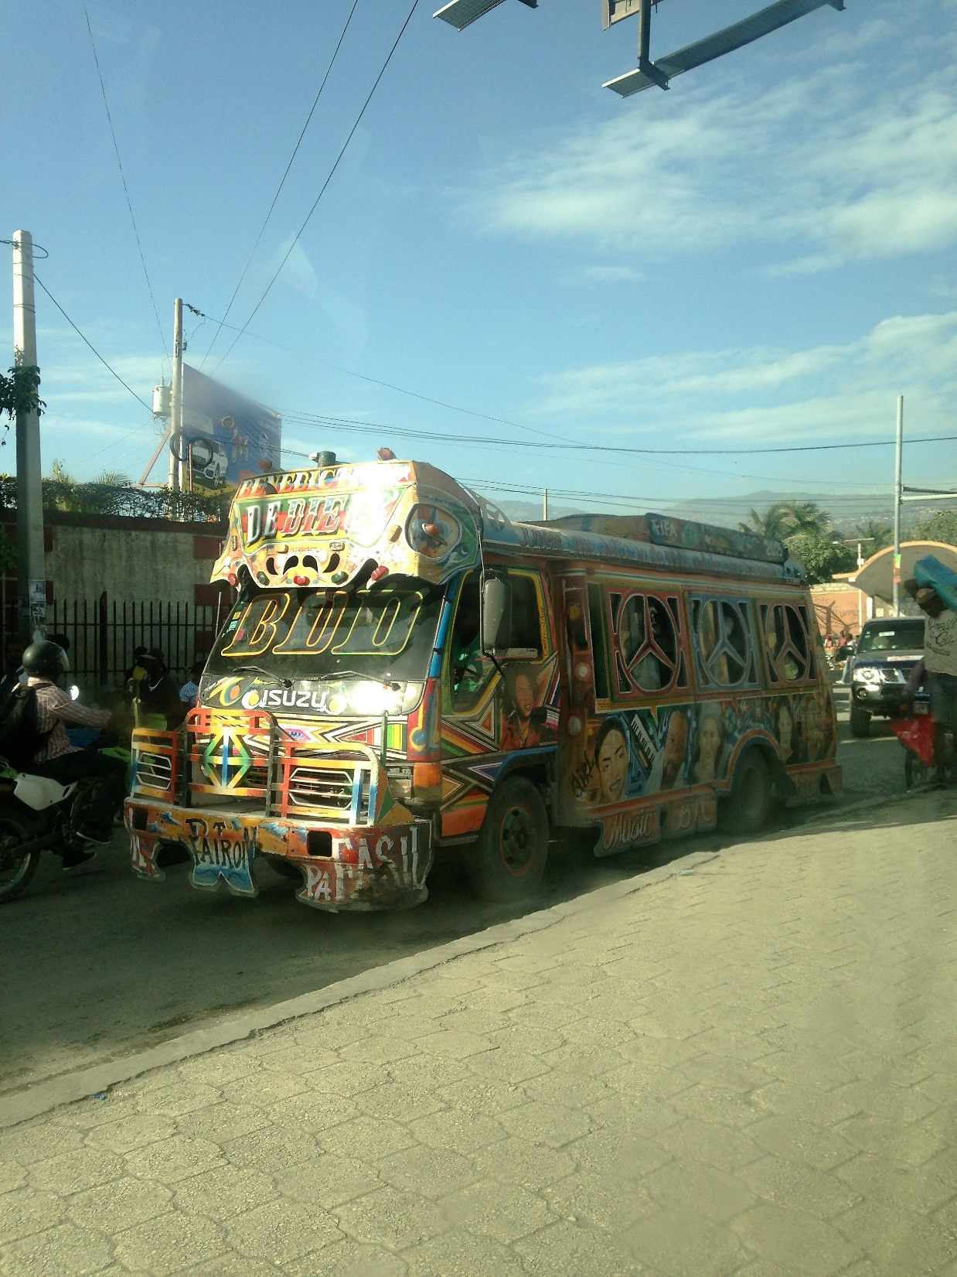

Slide 16
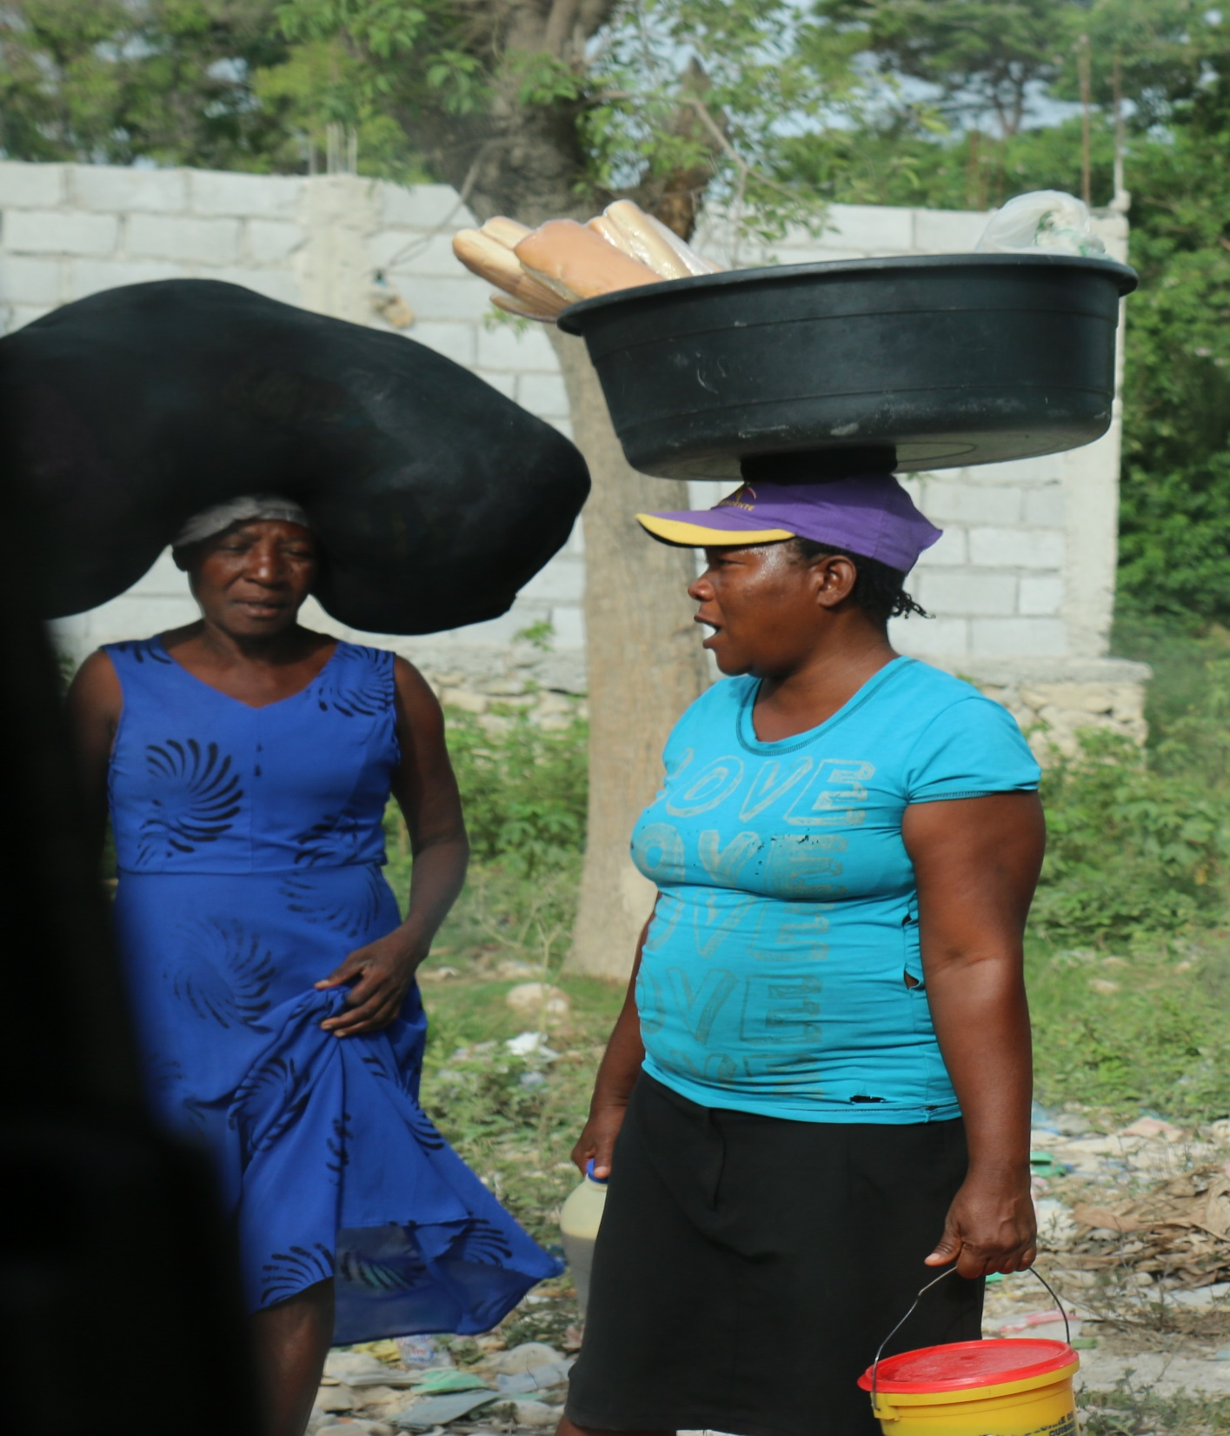

Slide 17
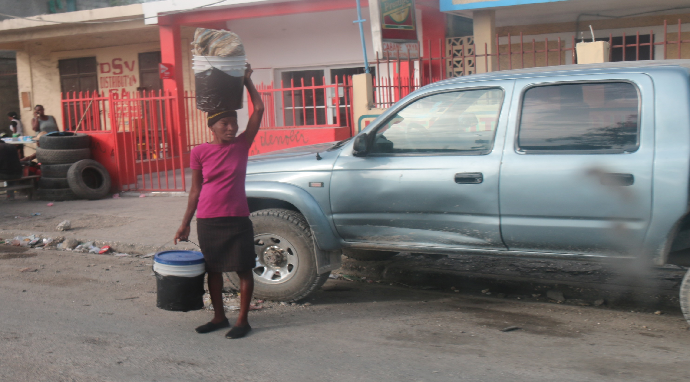

Slide 18
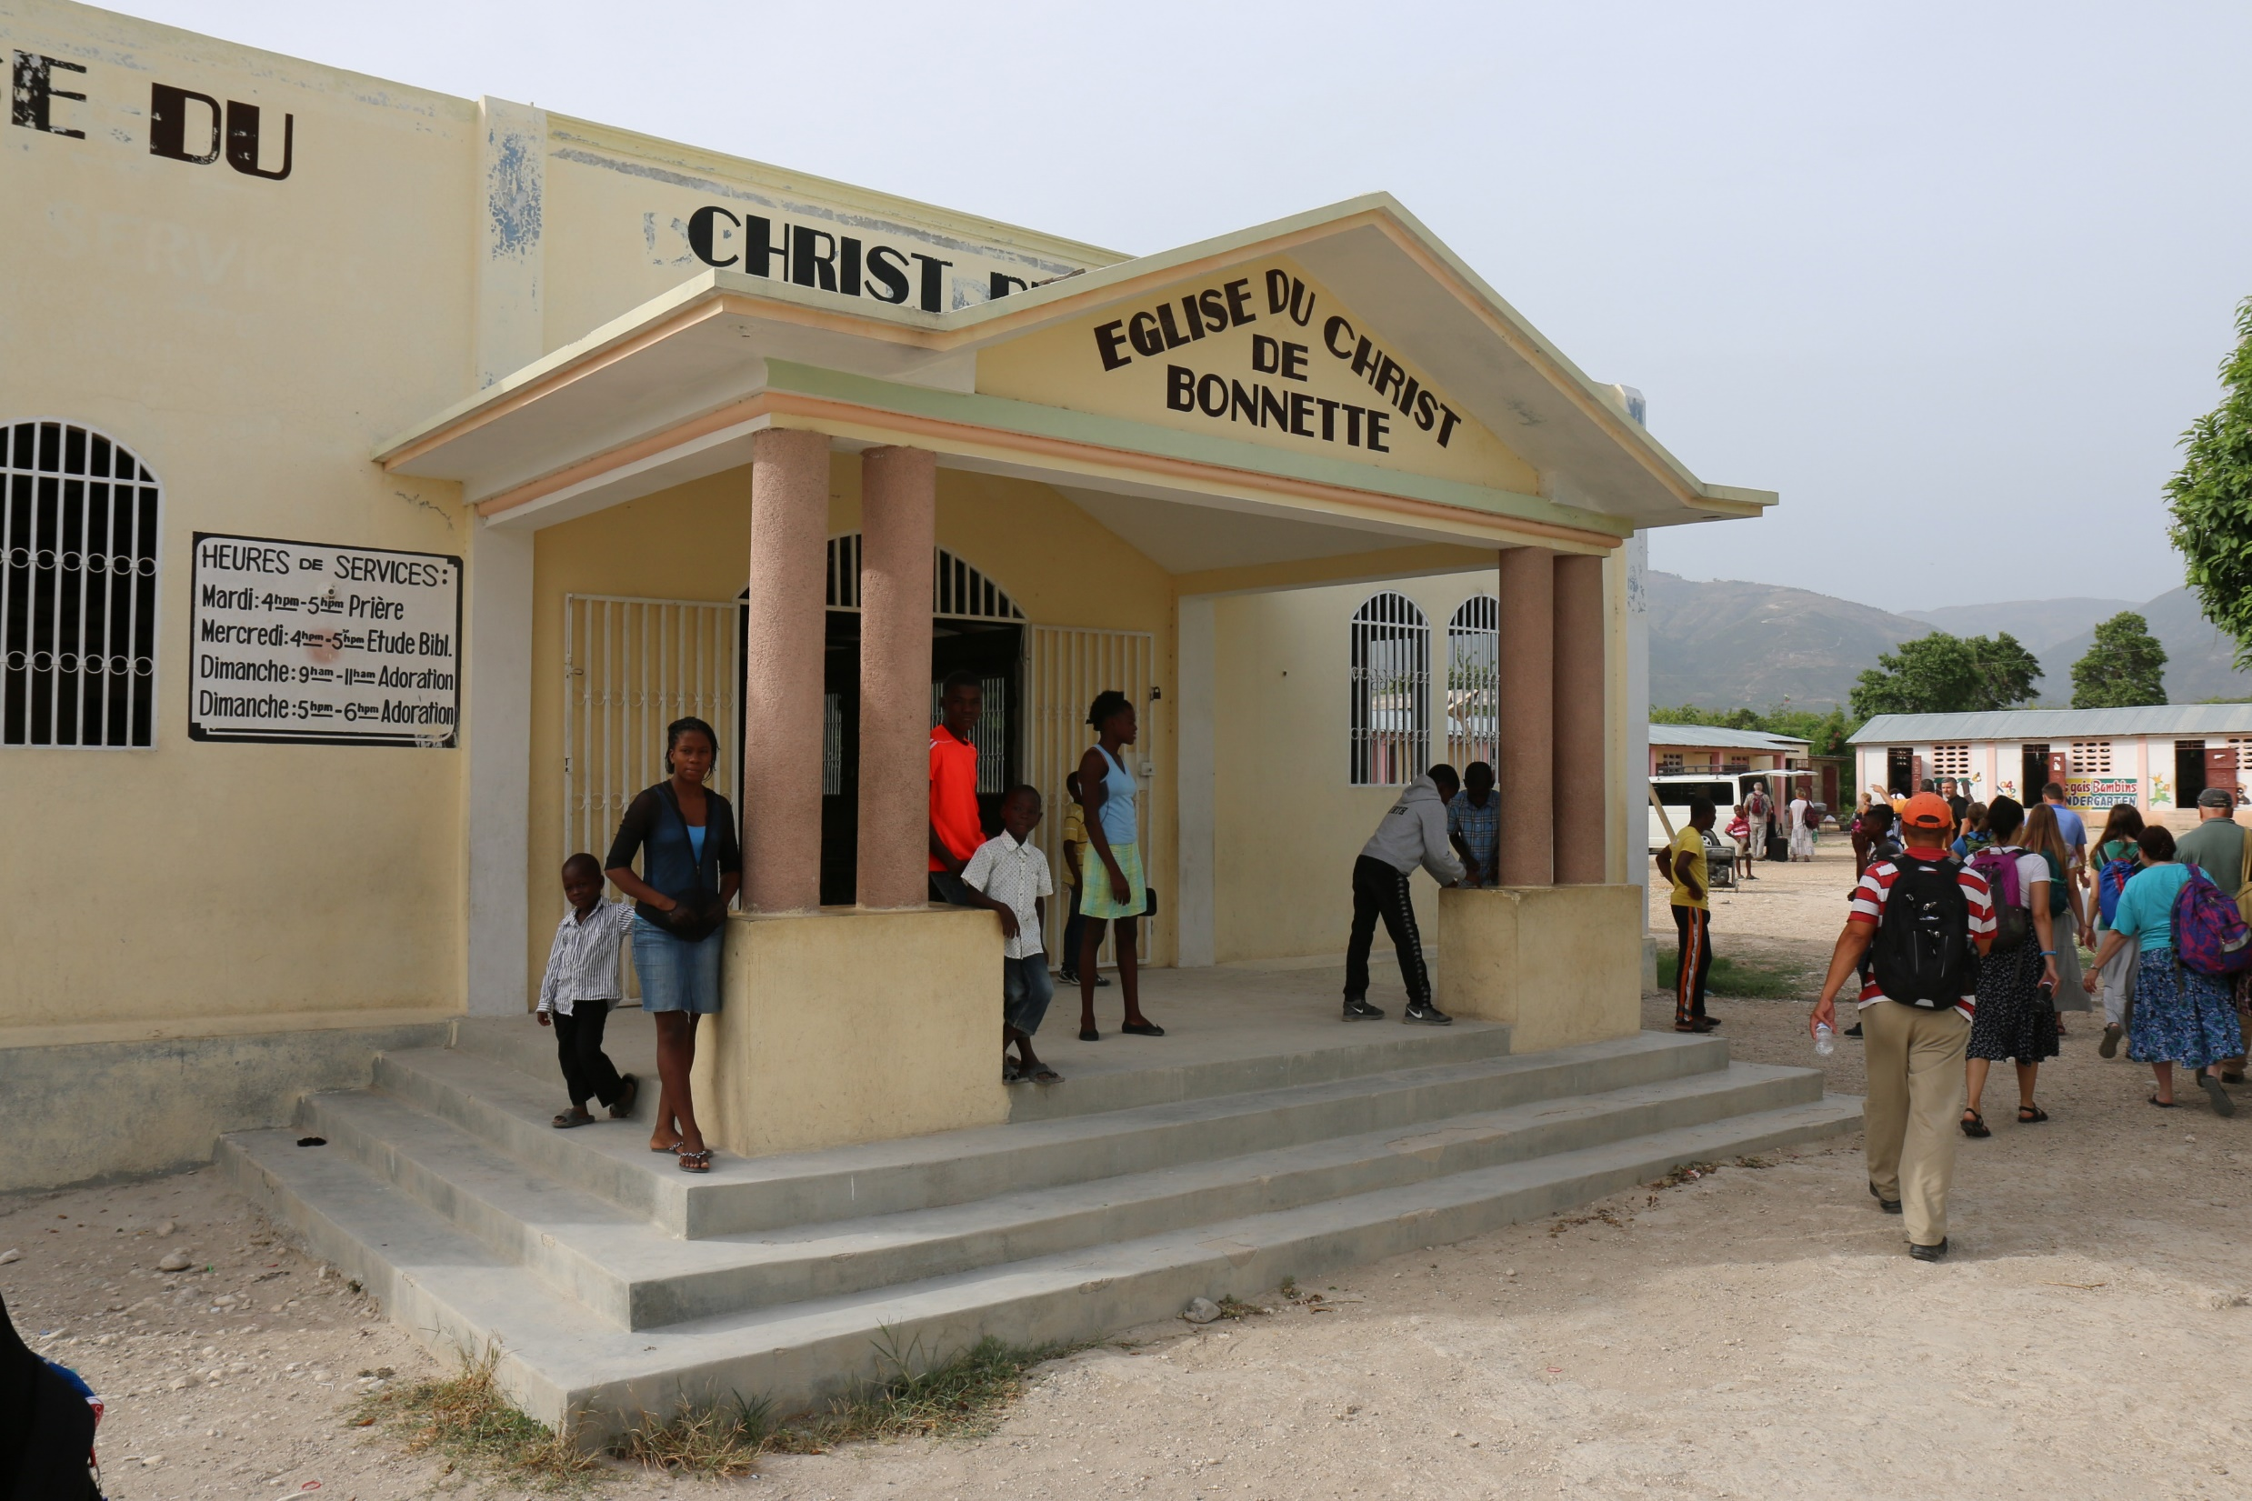

Slide 19
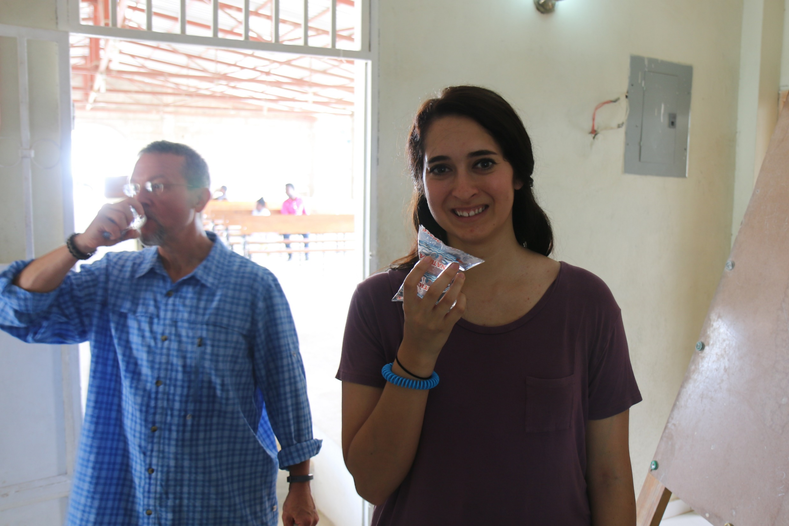

Slide 20
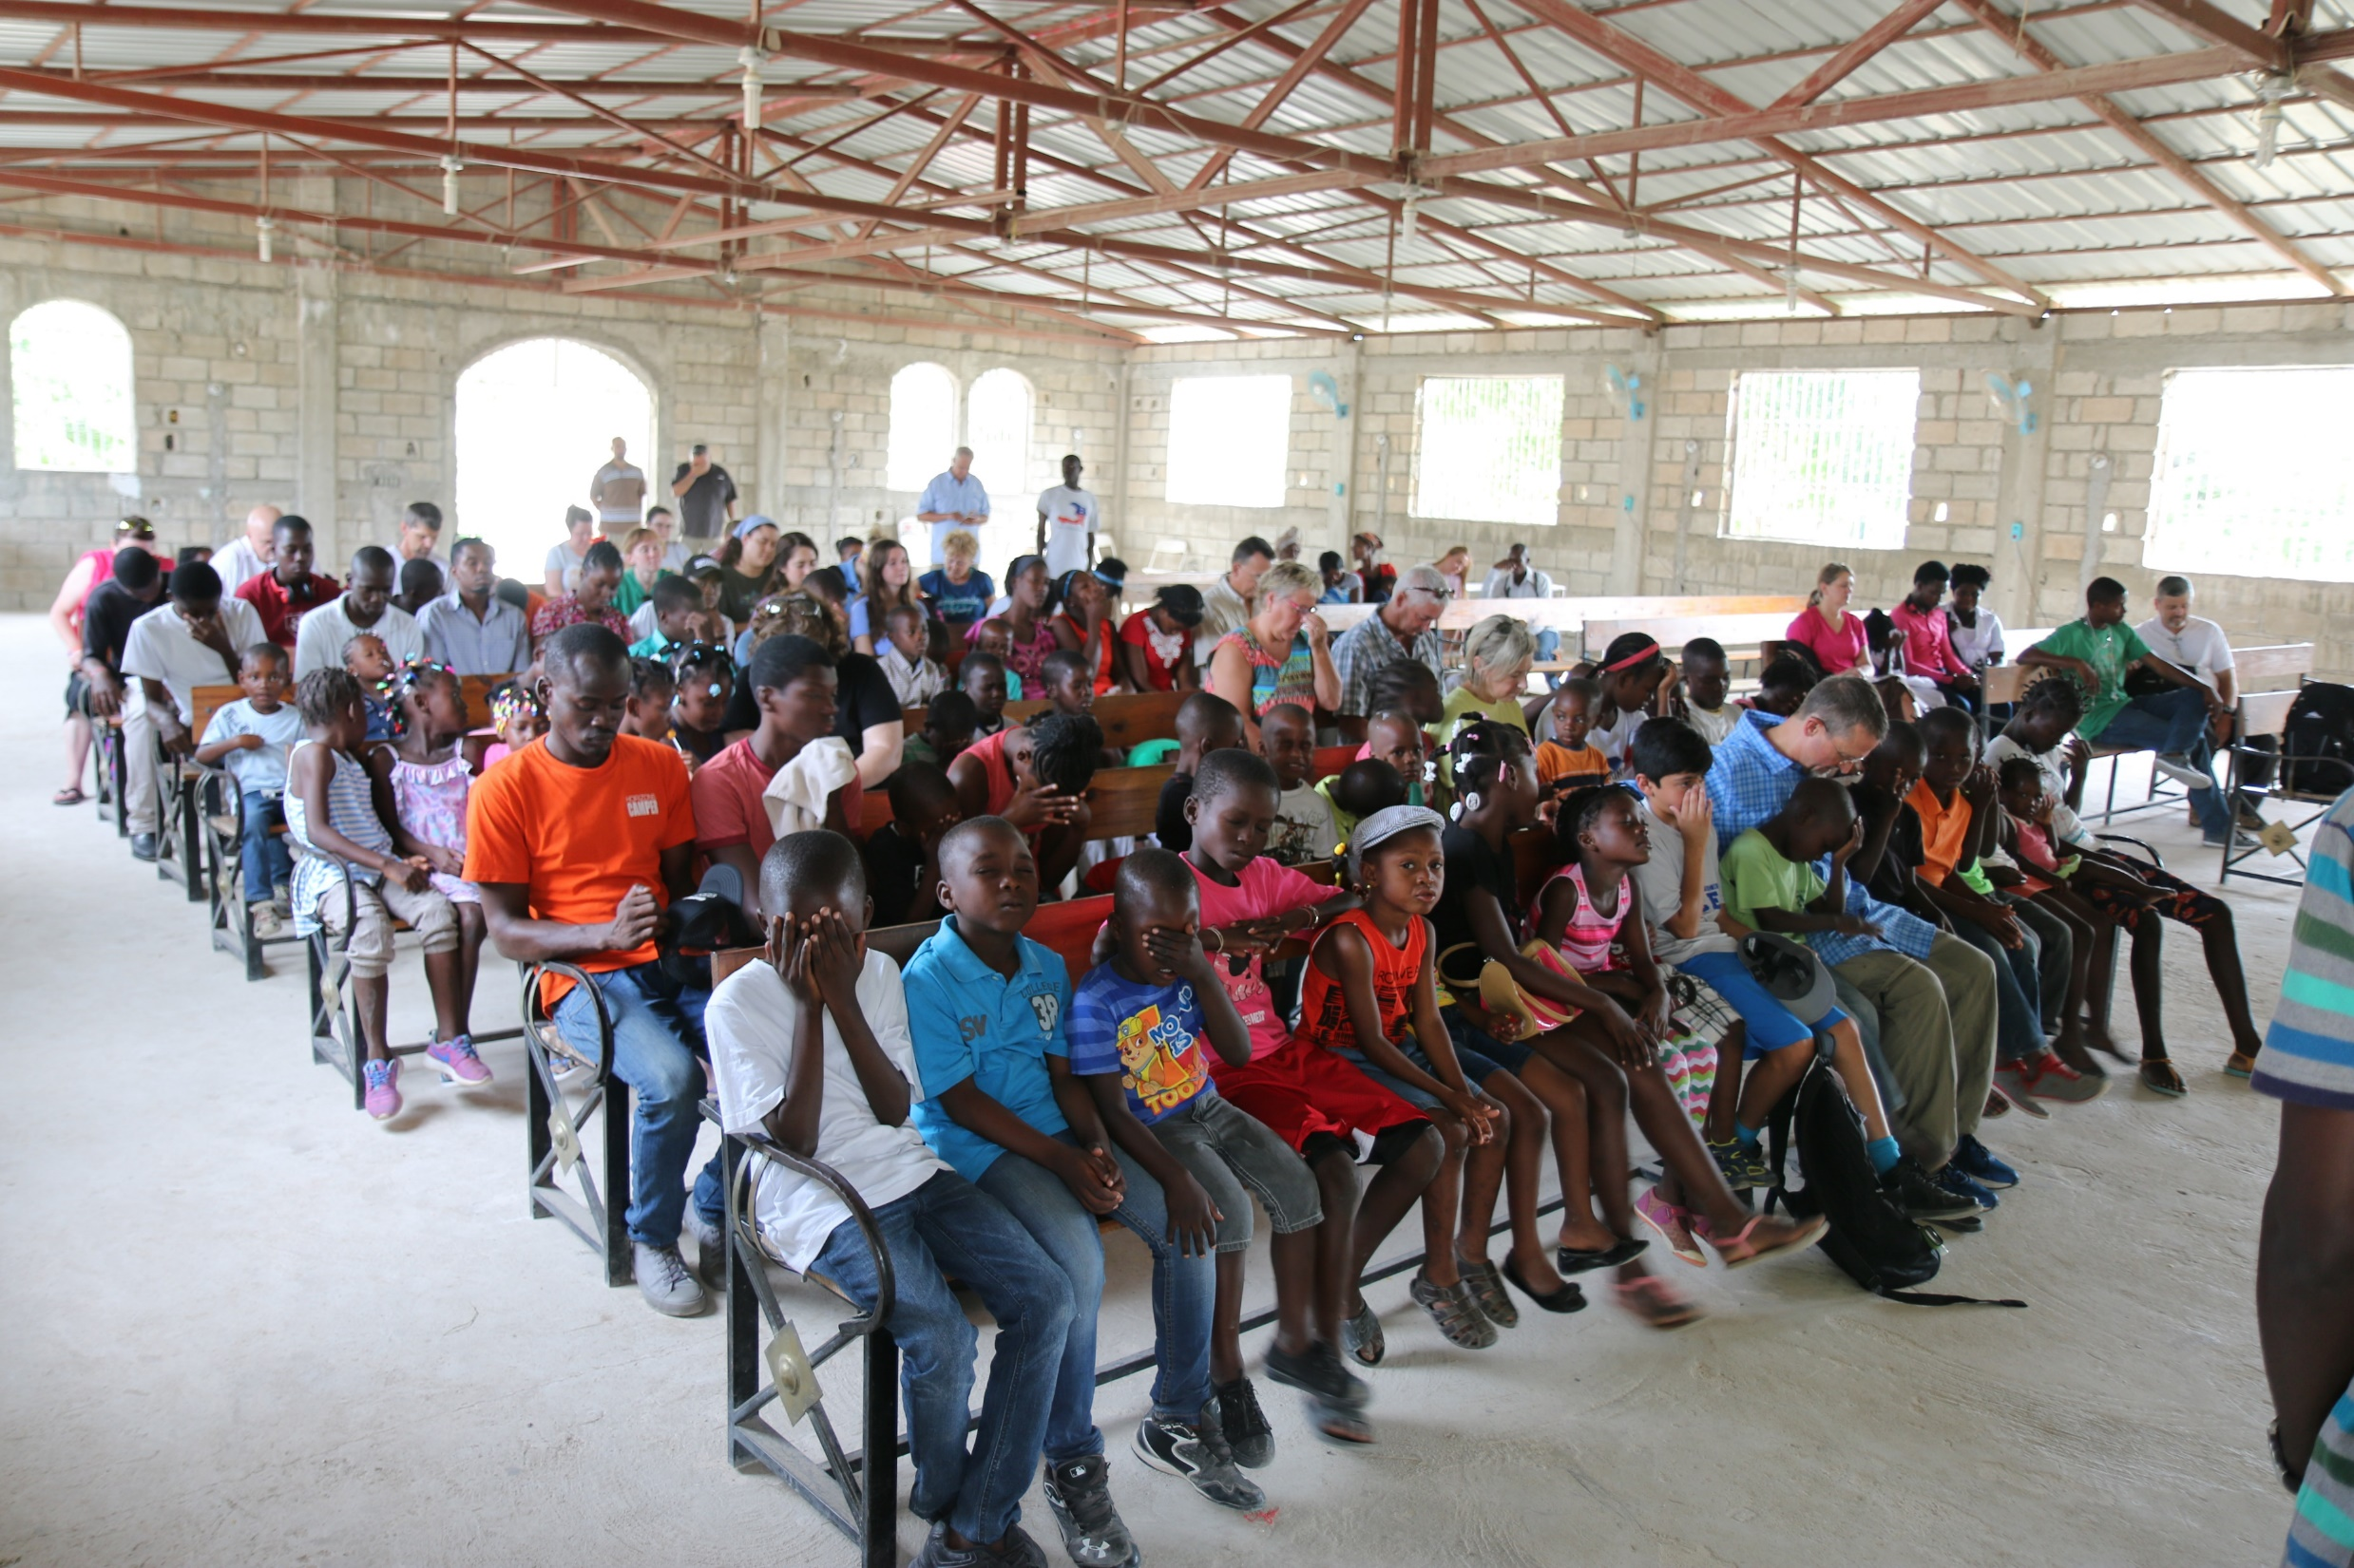

Slide 21
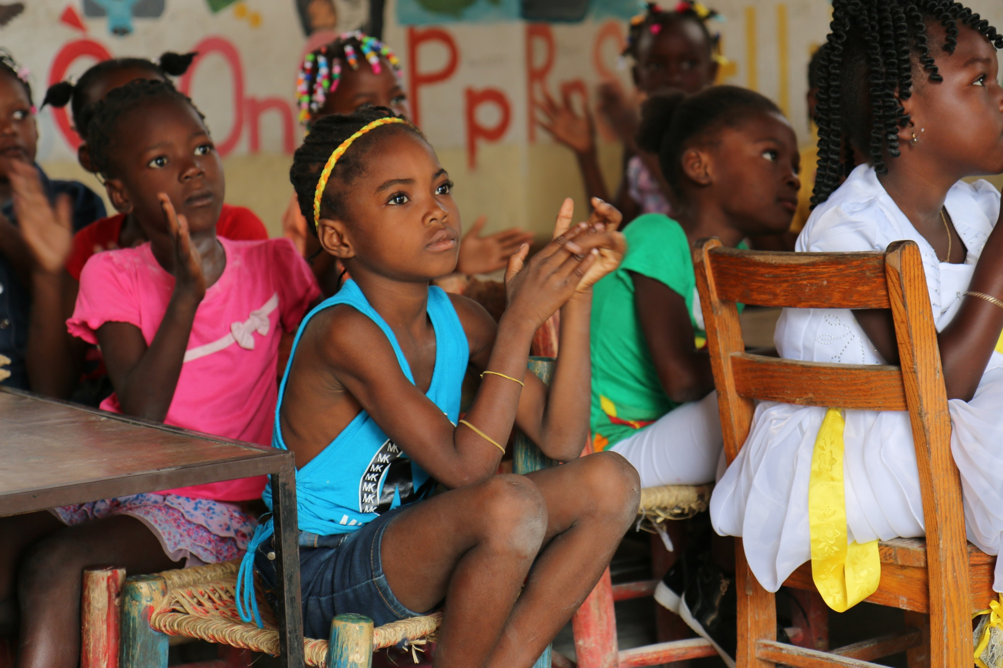

Slide 22
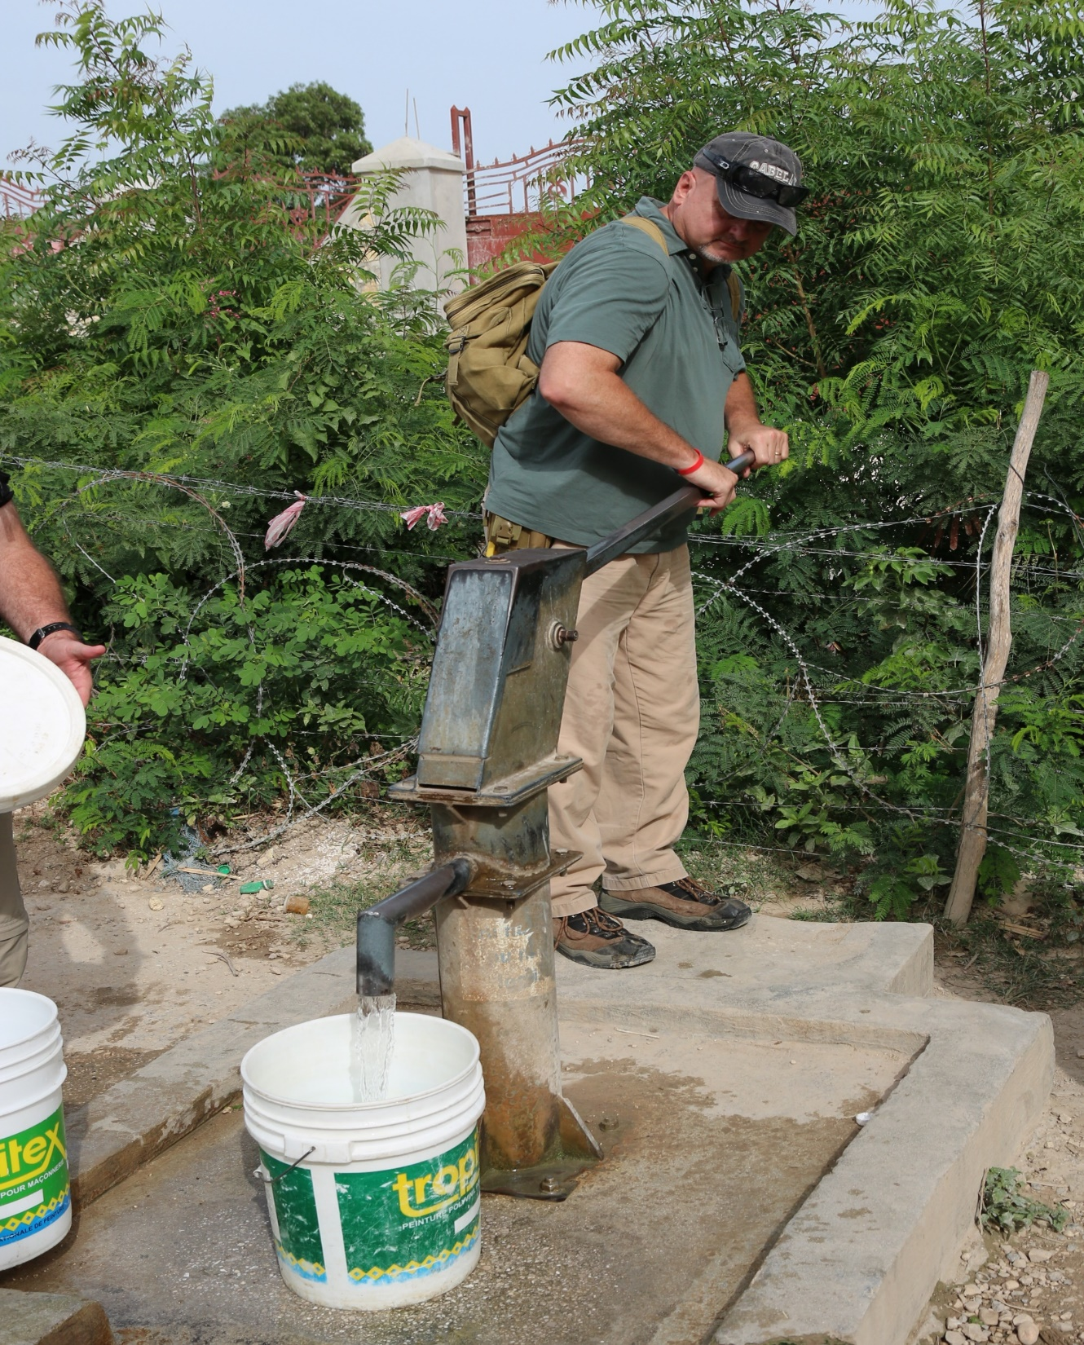
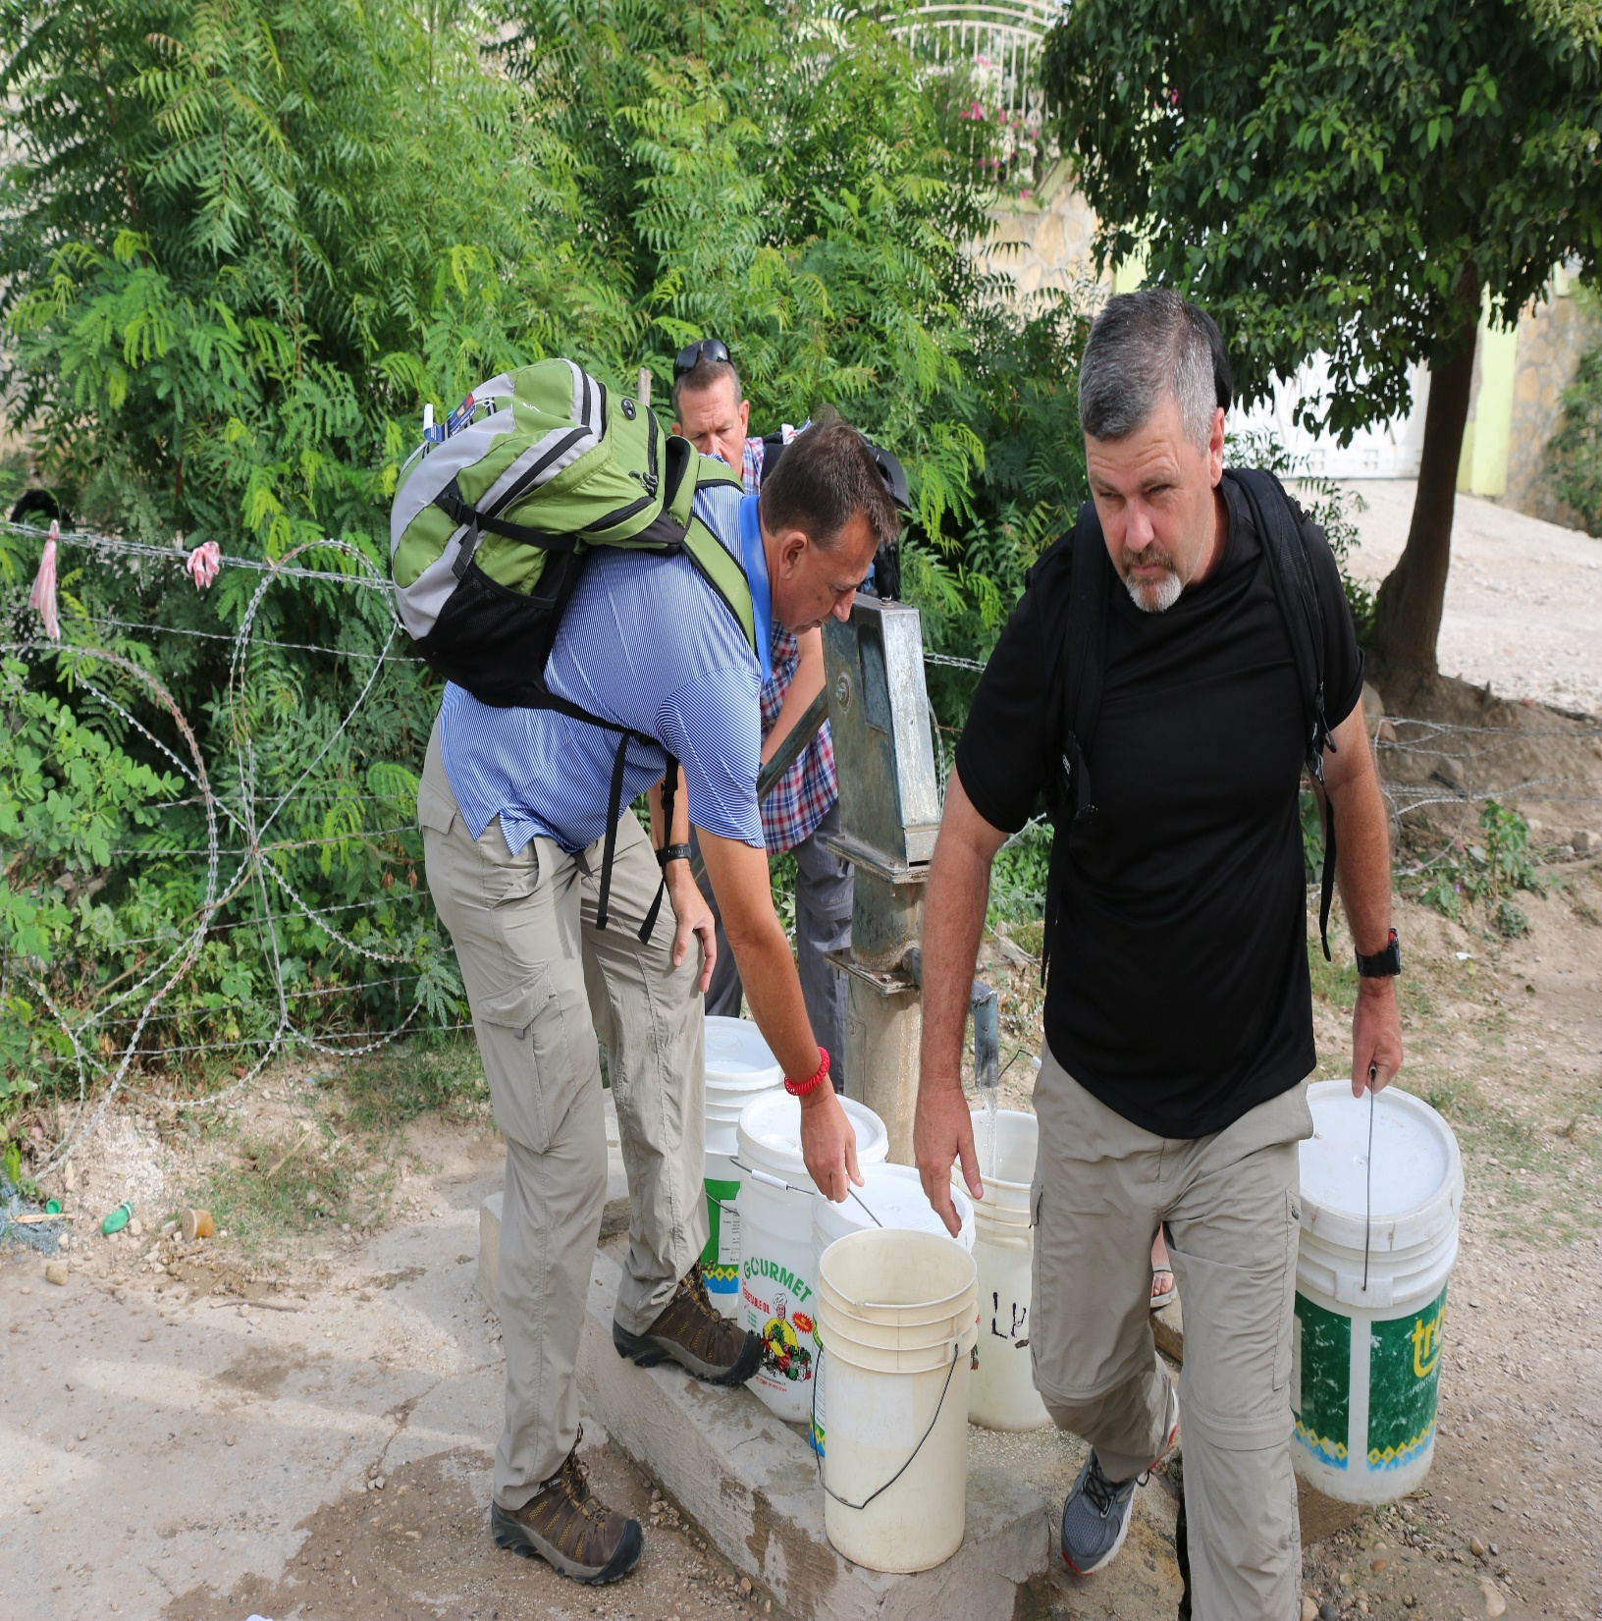

Slide 23
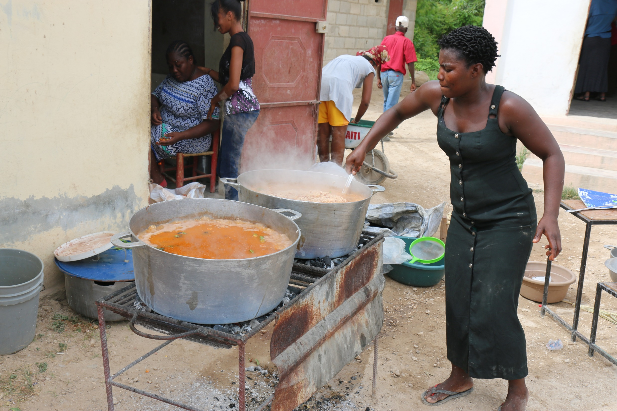

Slide 24
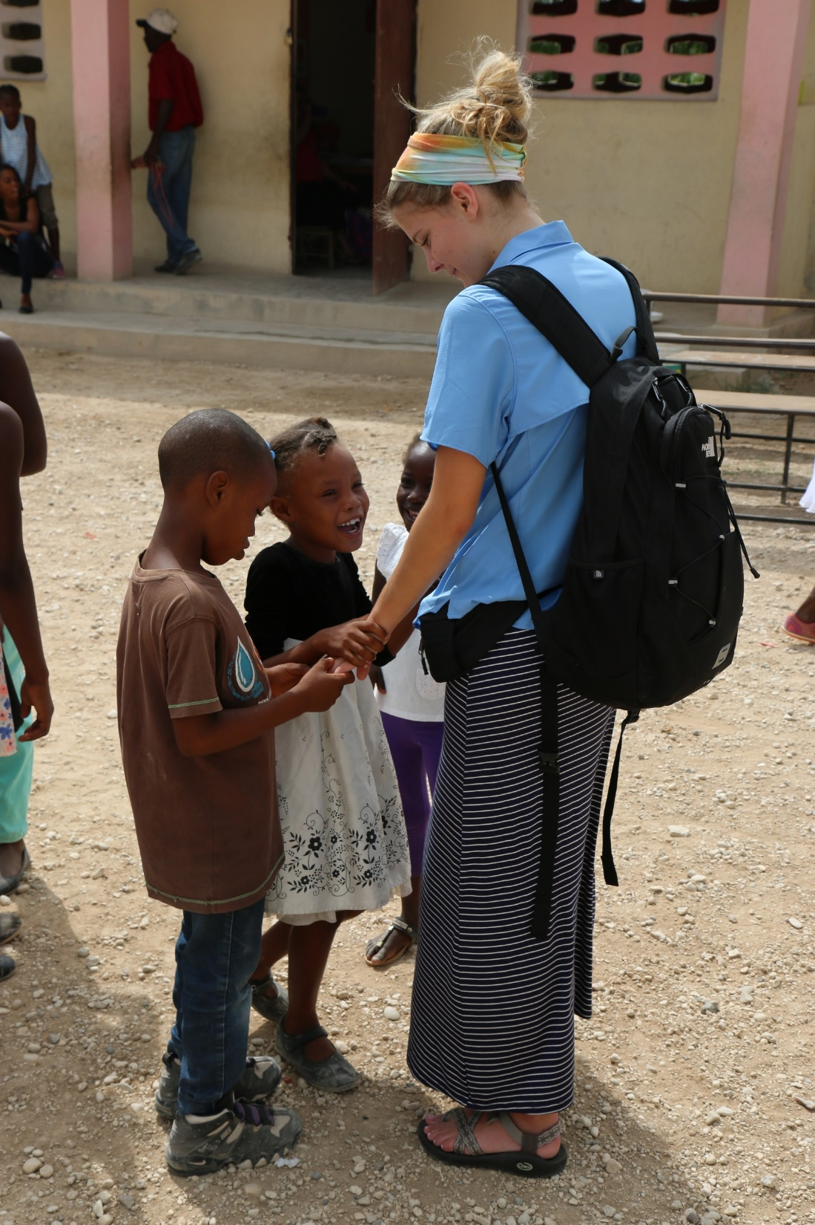

Slide 25
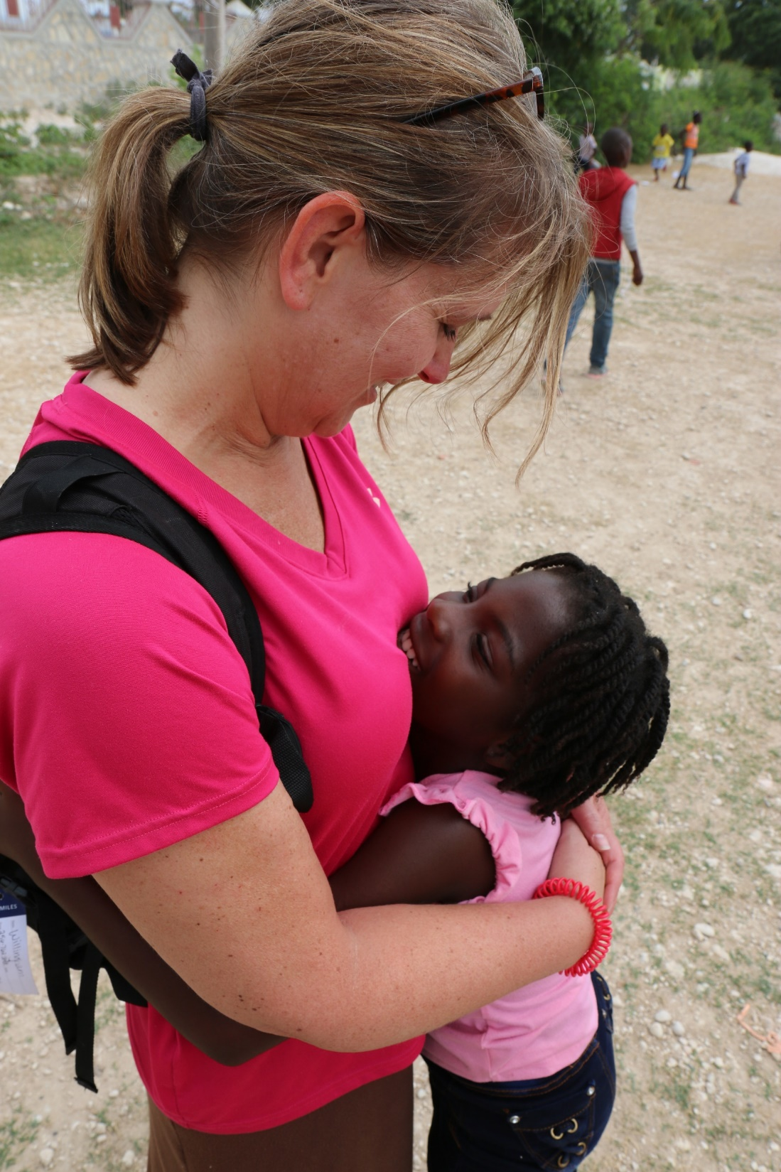
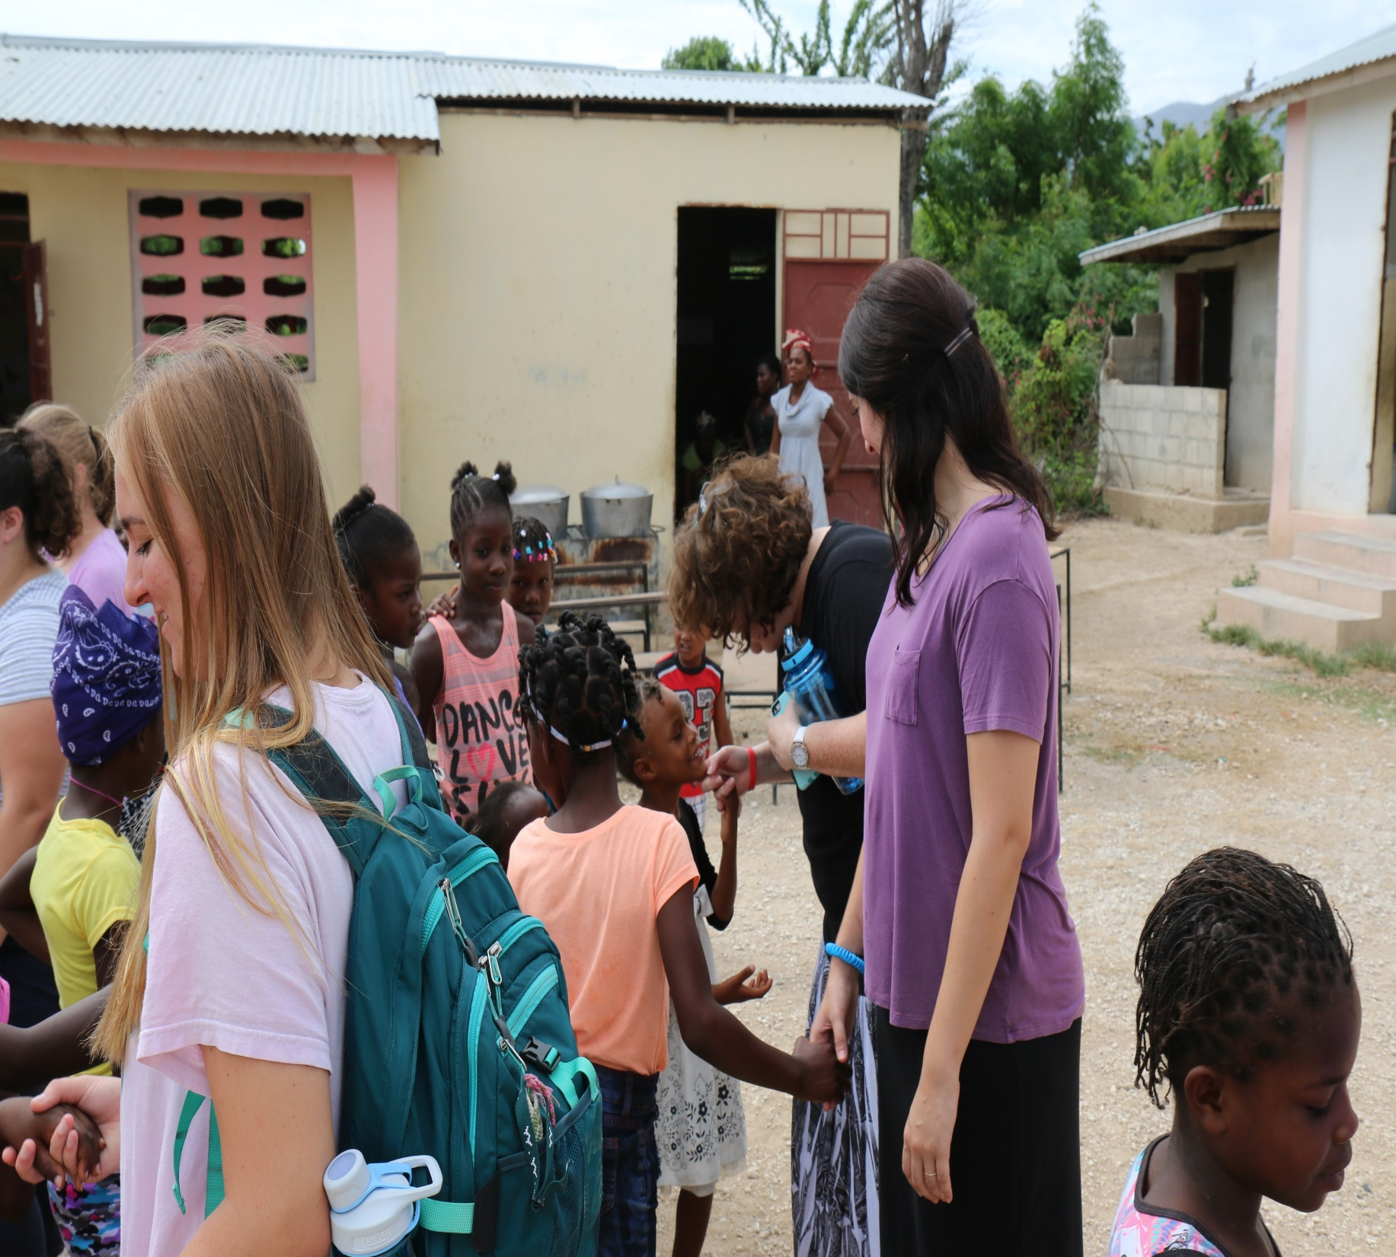

Slide 26
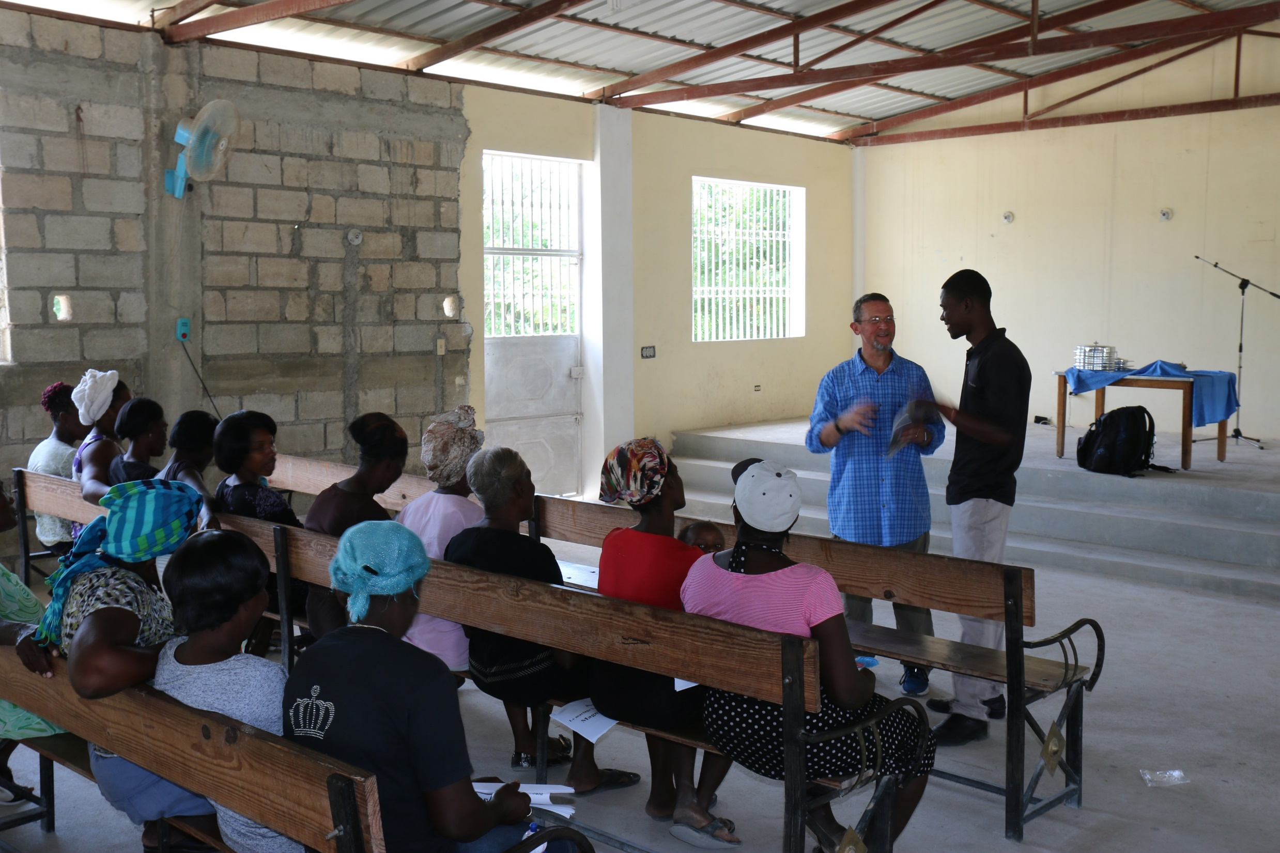

Slide 27
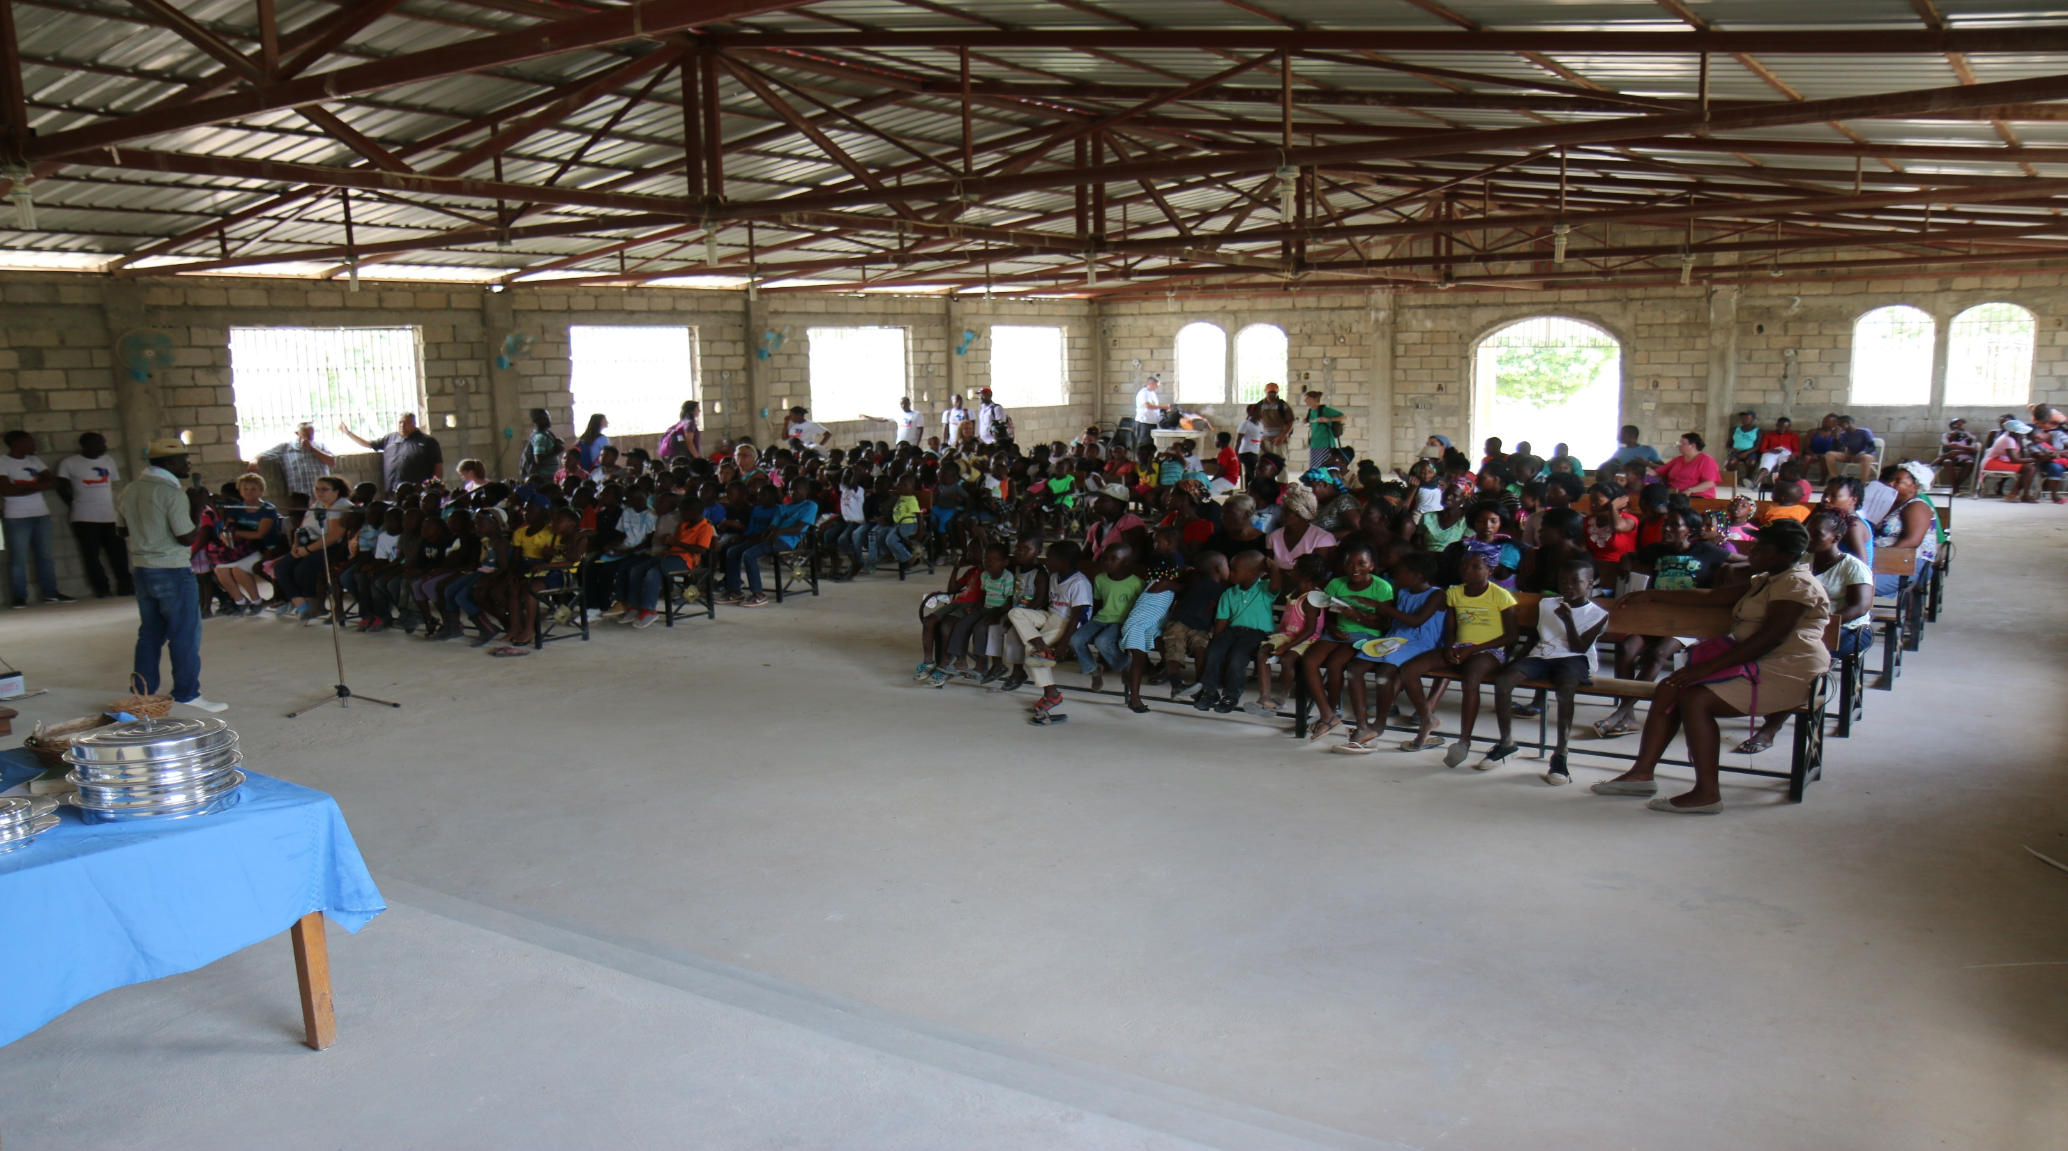

Slide 28
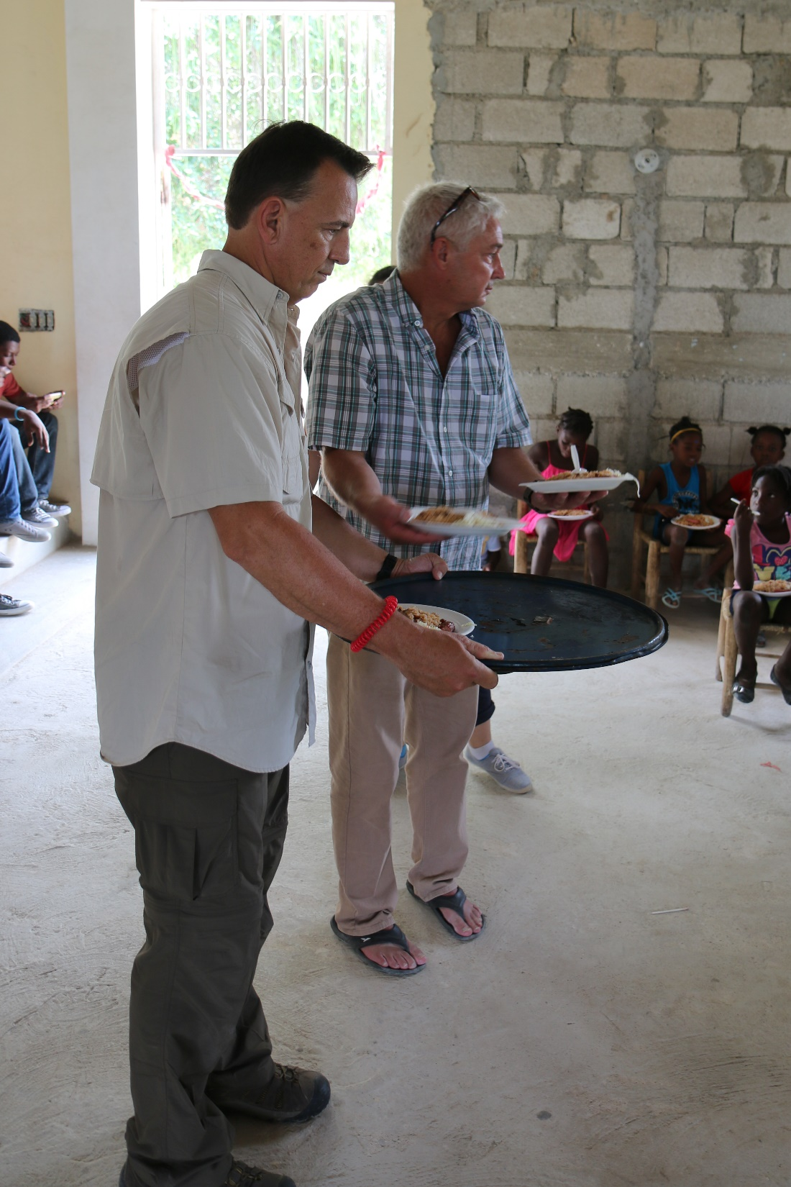
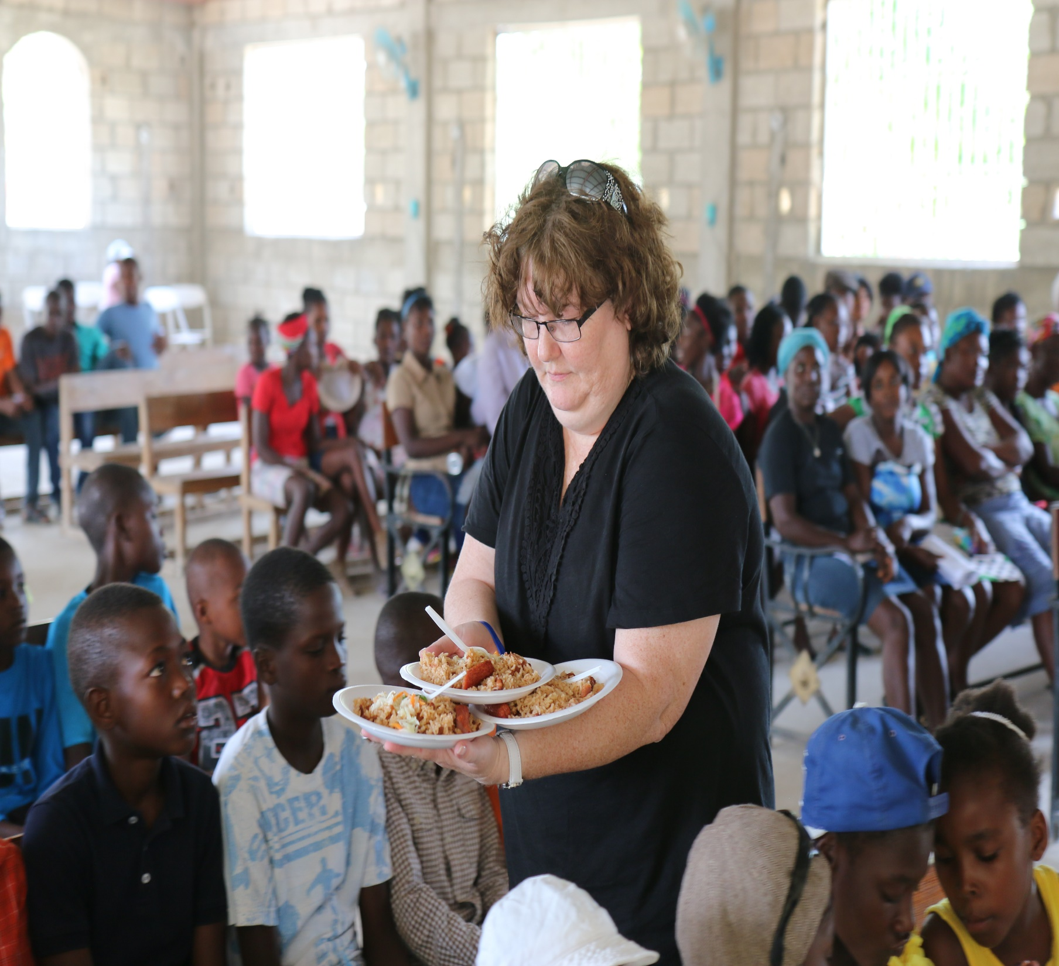

Slide 29
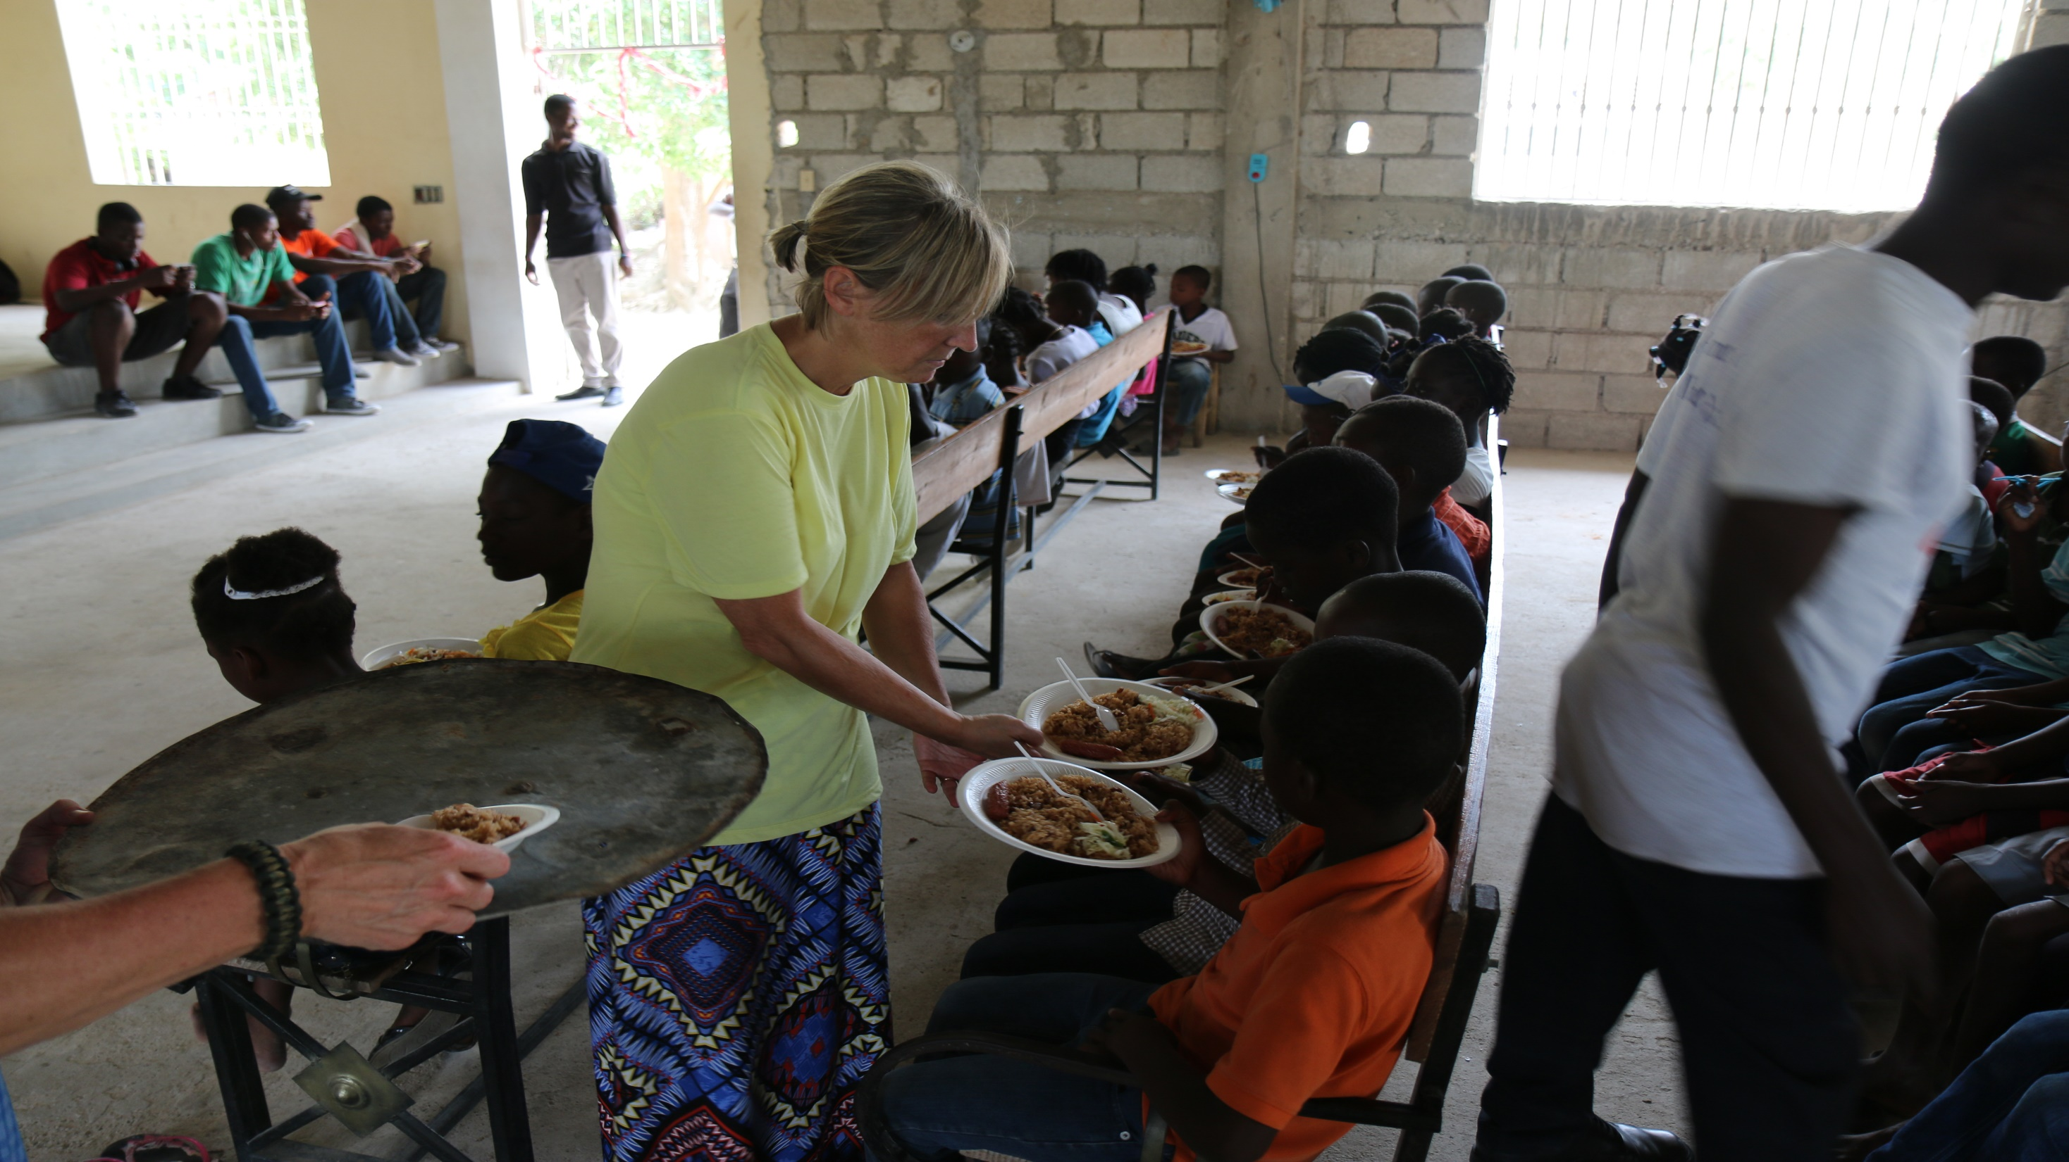

Slide 30
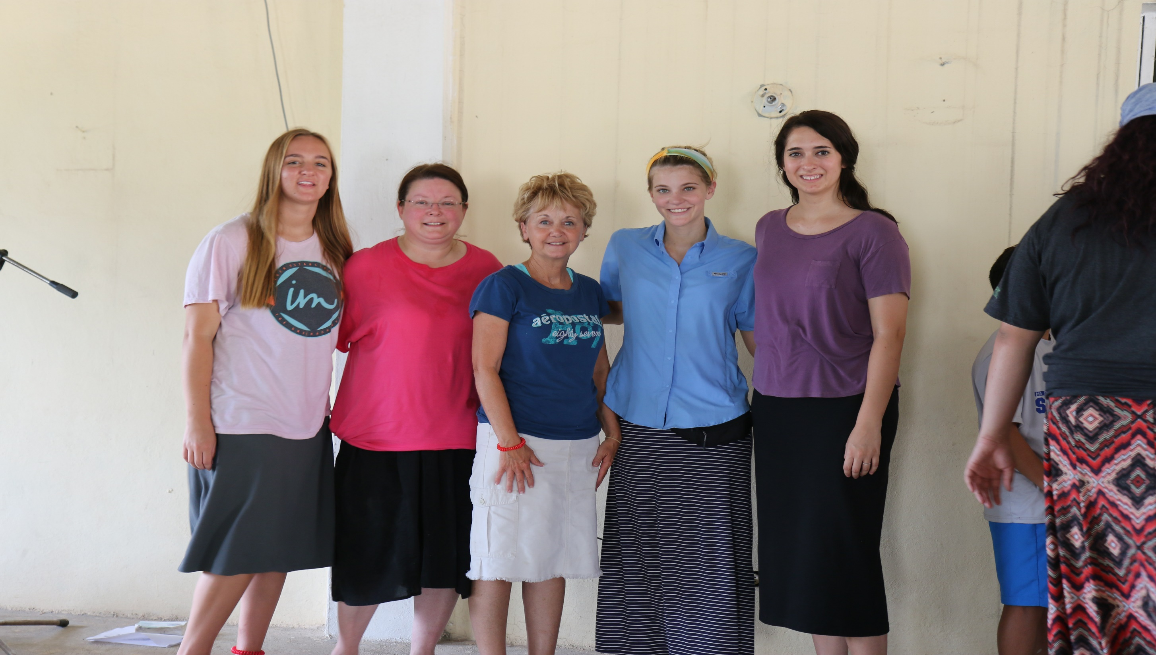

Slide 31
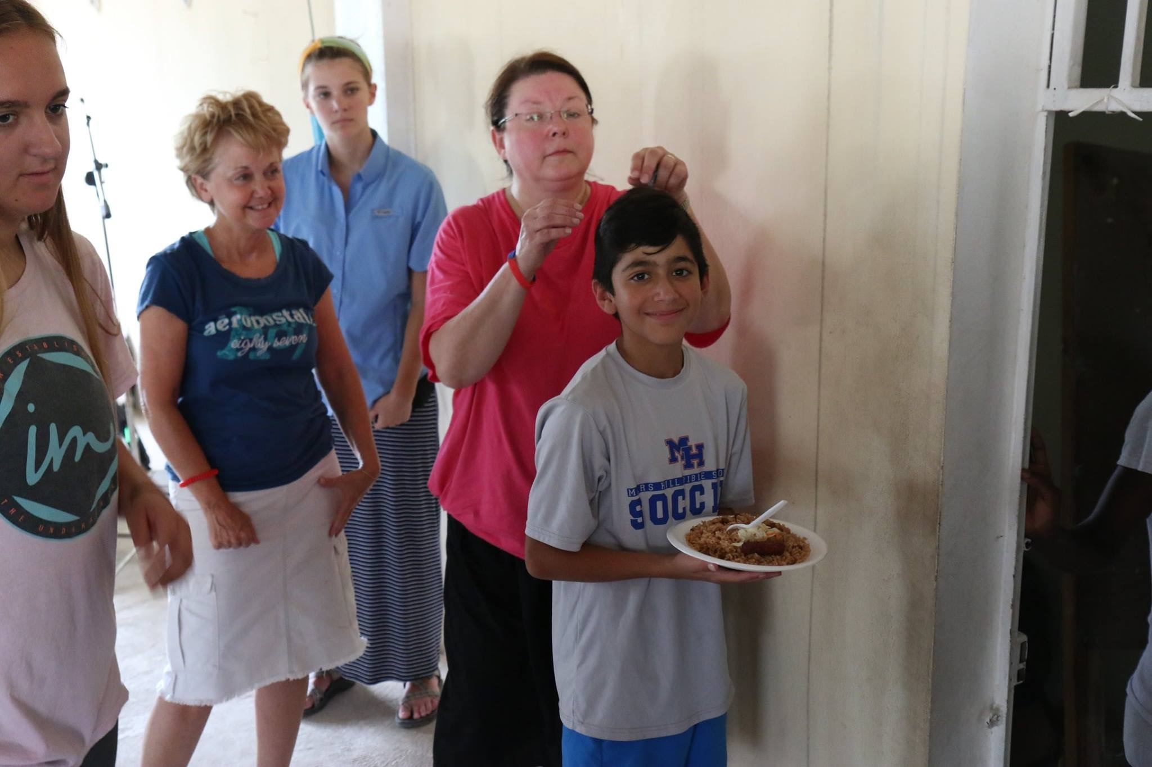

Slide 32
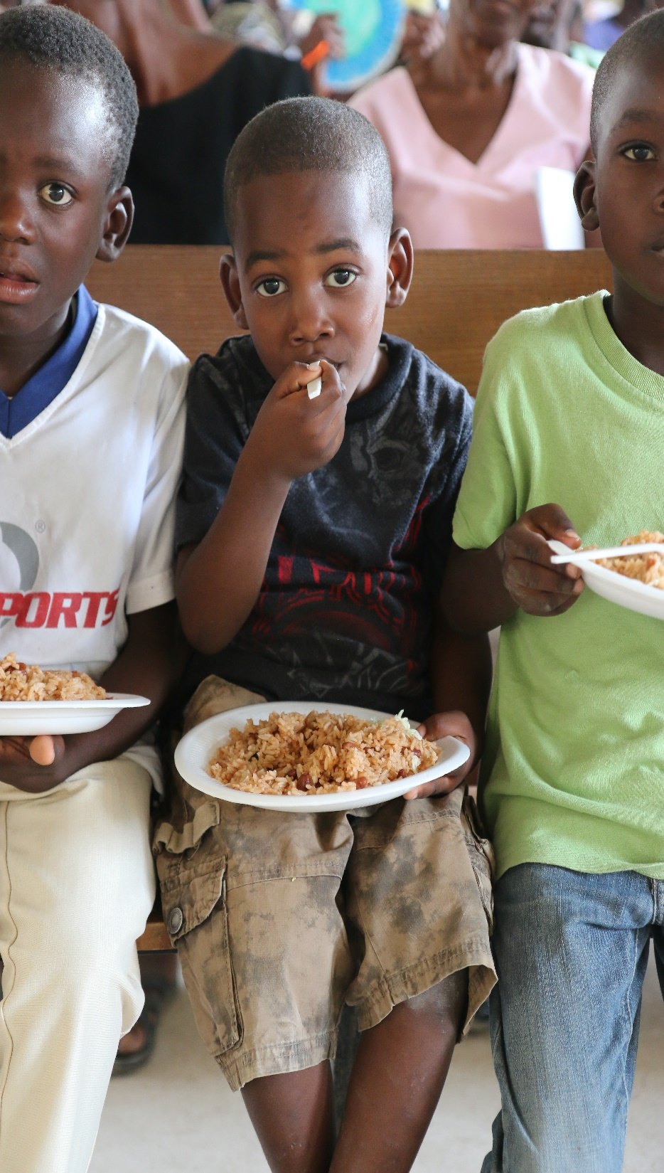
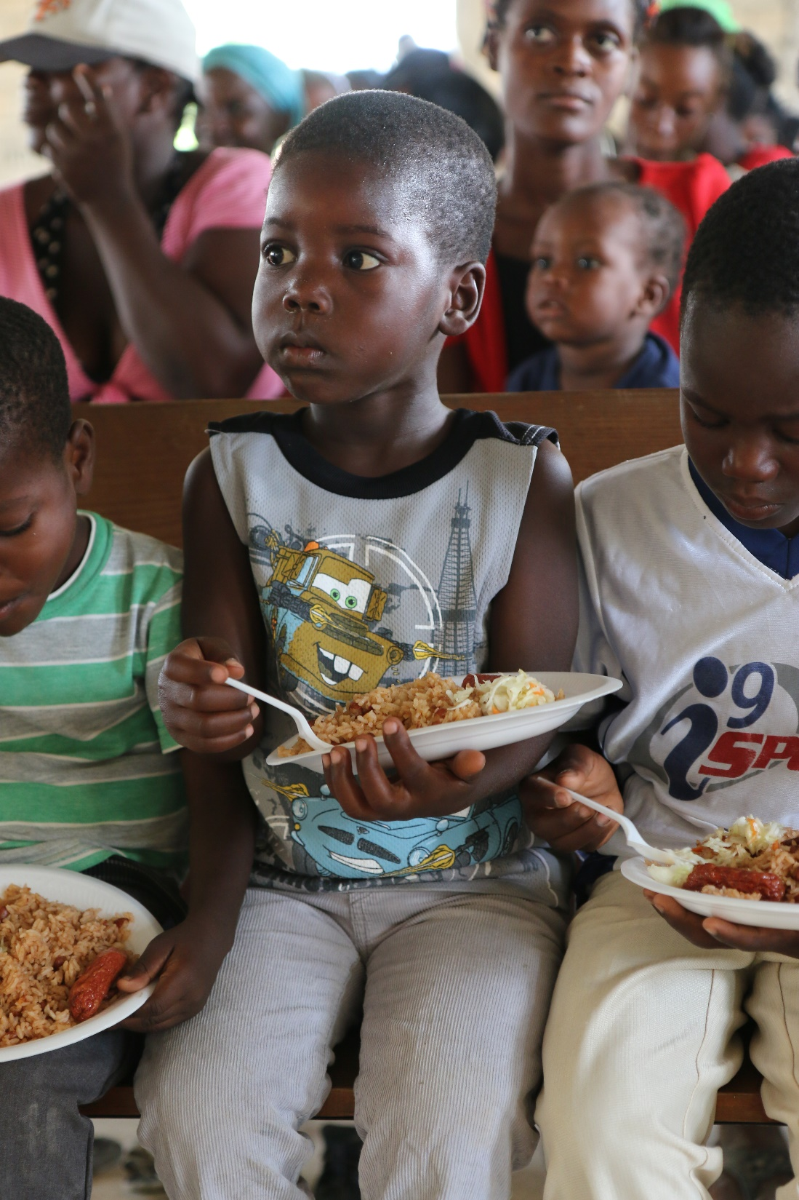
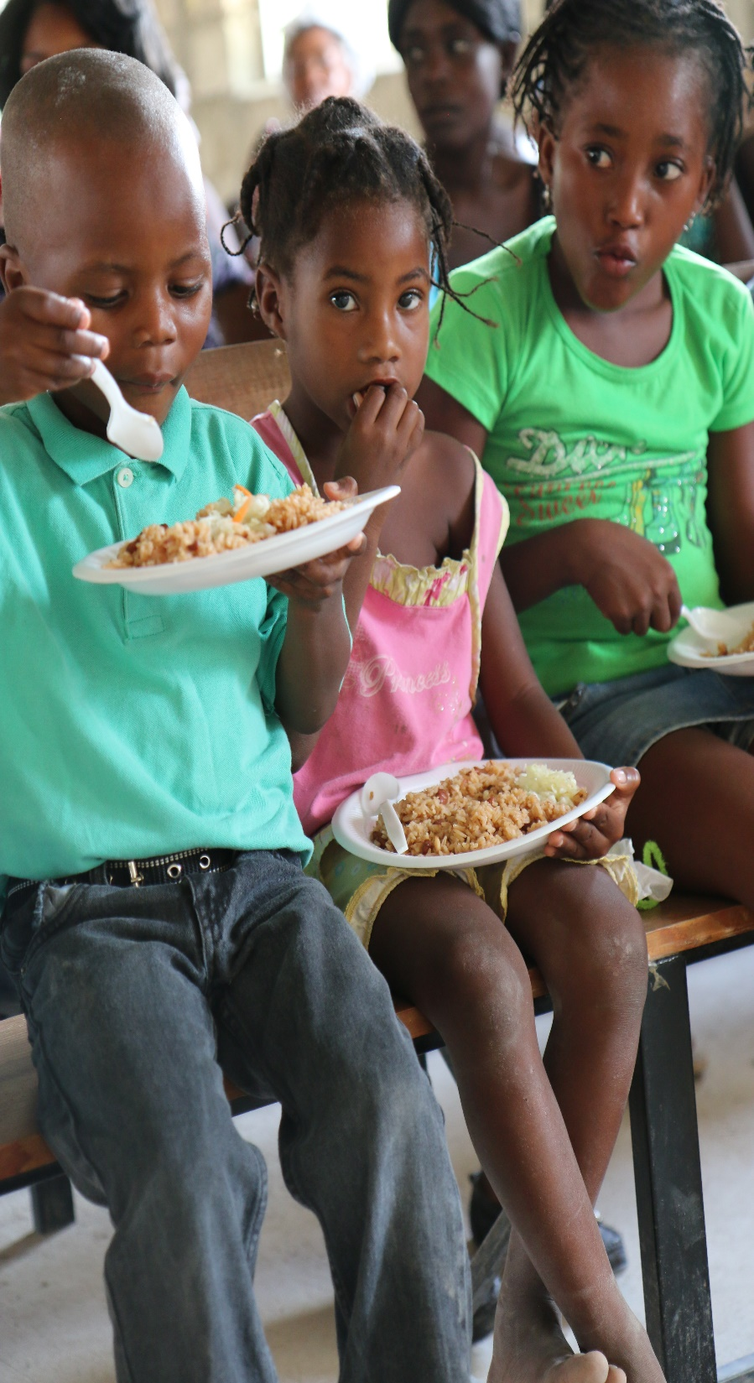

Slide 33
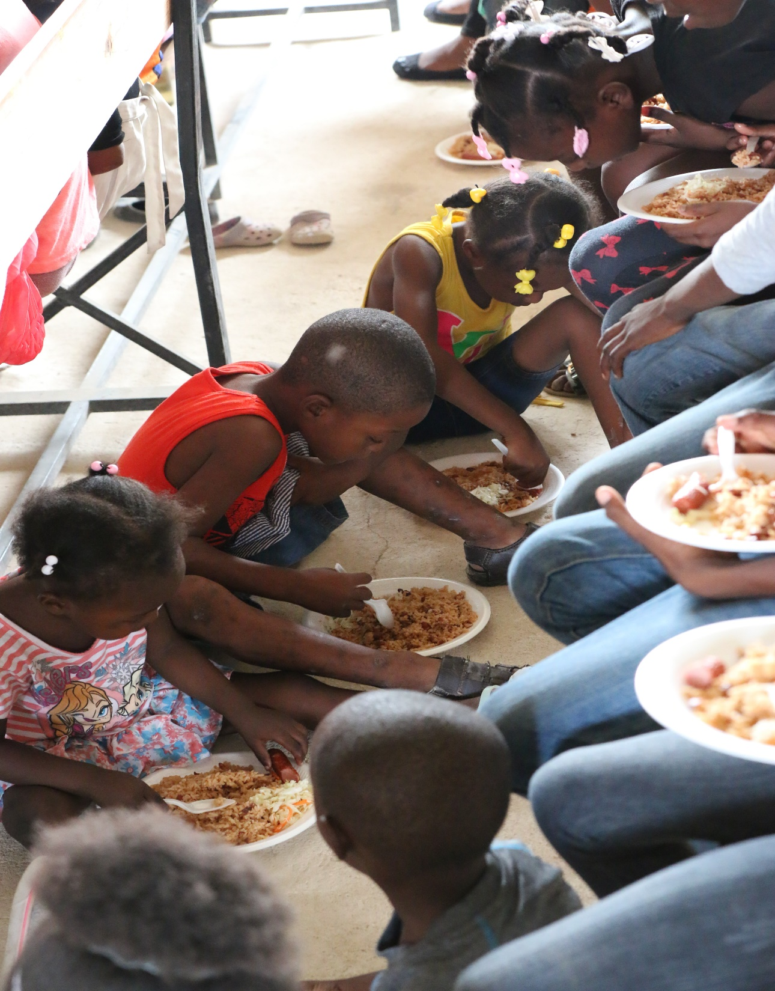
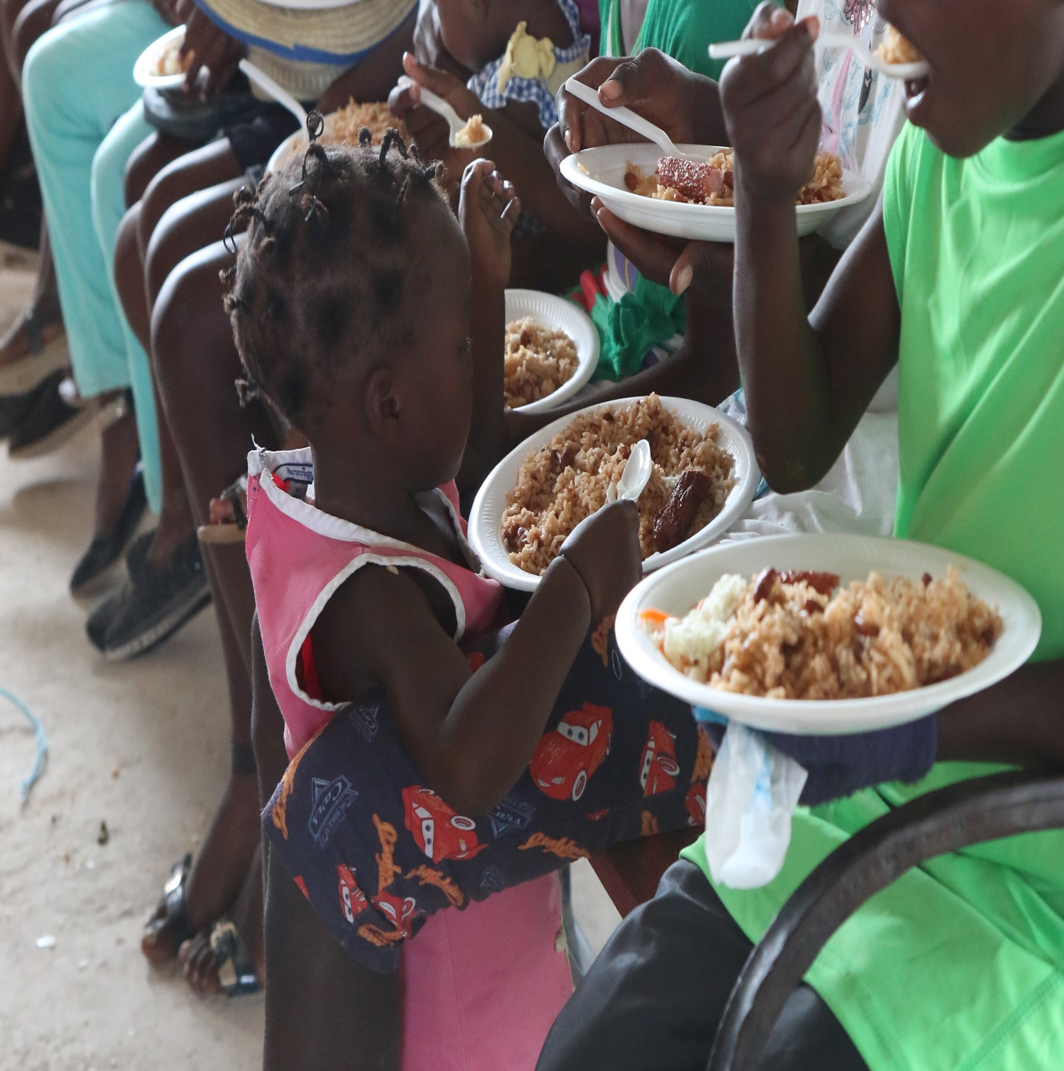

Slide 34
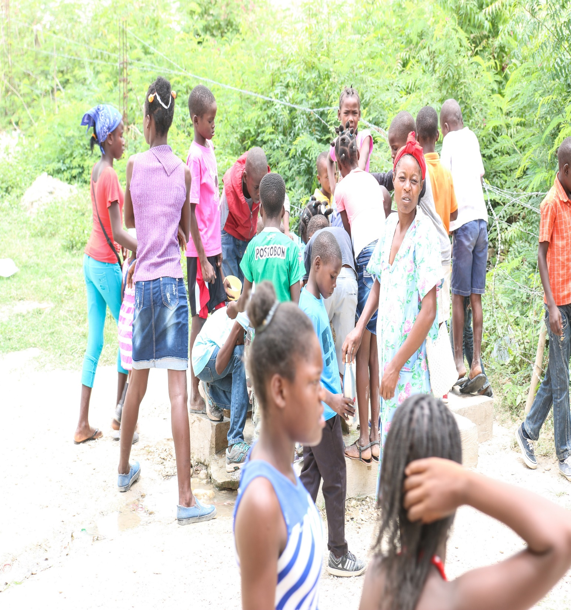
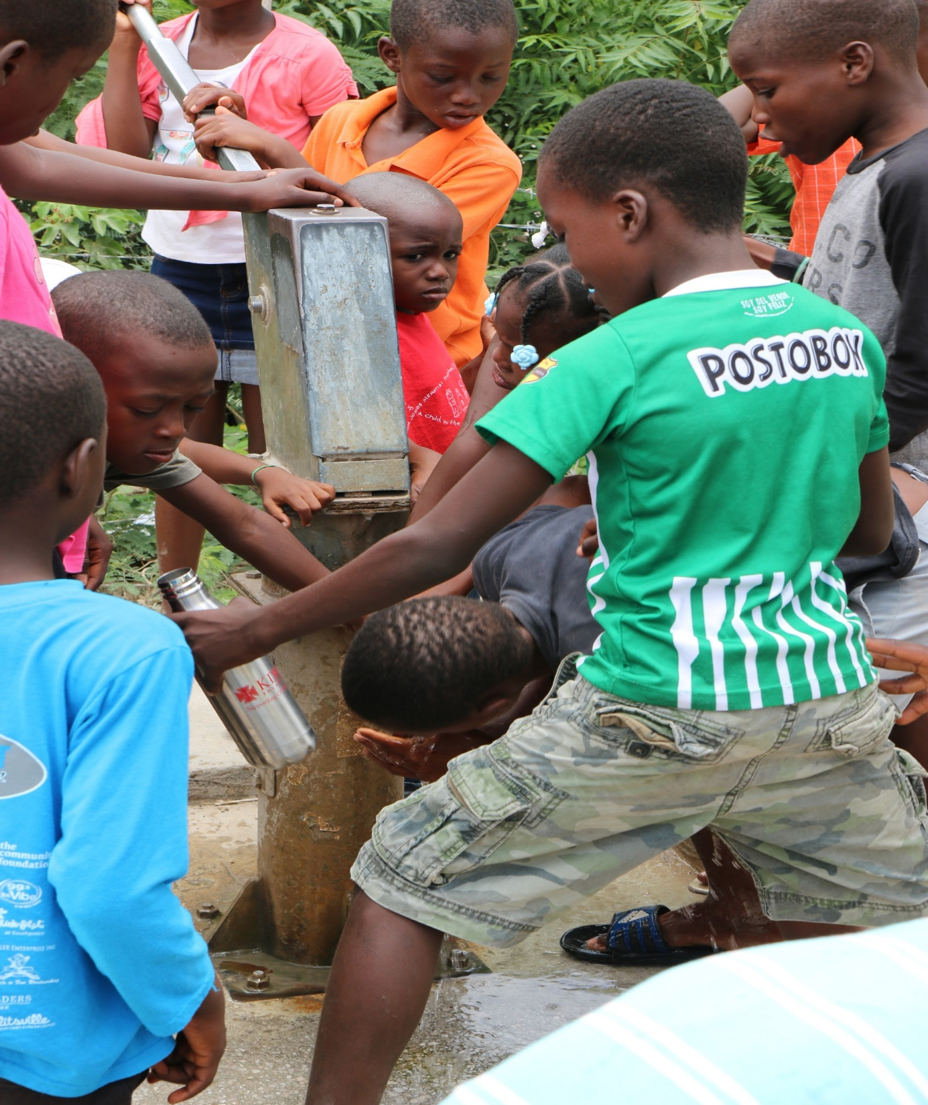

Slide 35
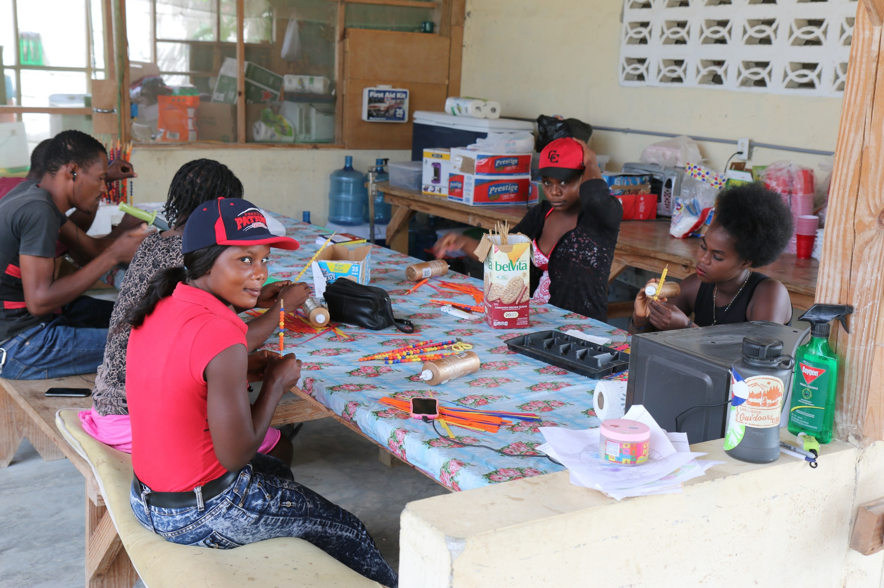

Slide 36
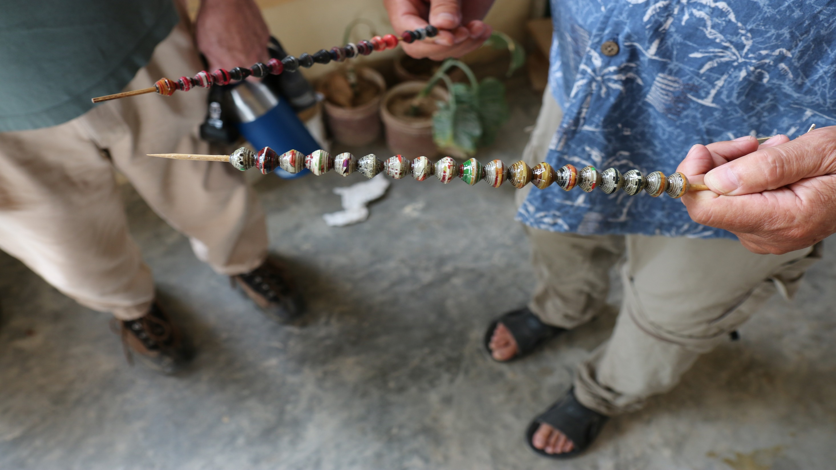

Slide 37
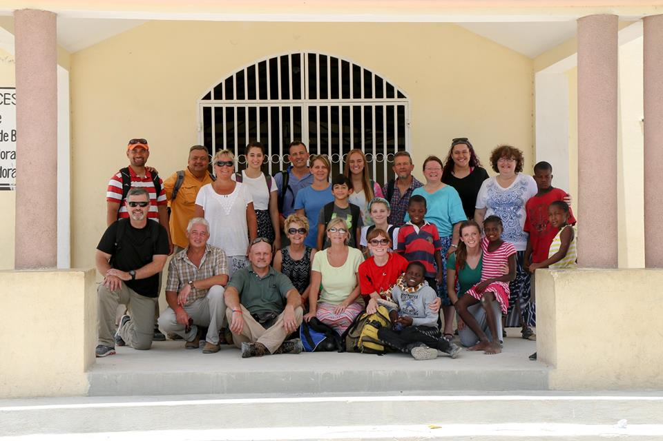
Bonnette

Slide 38
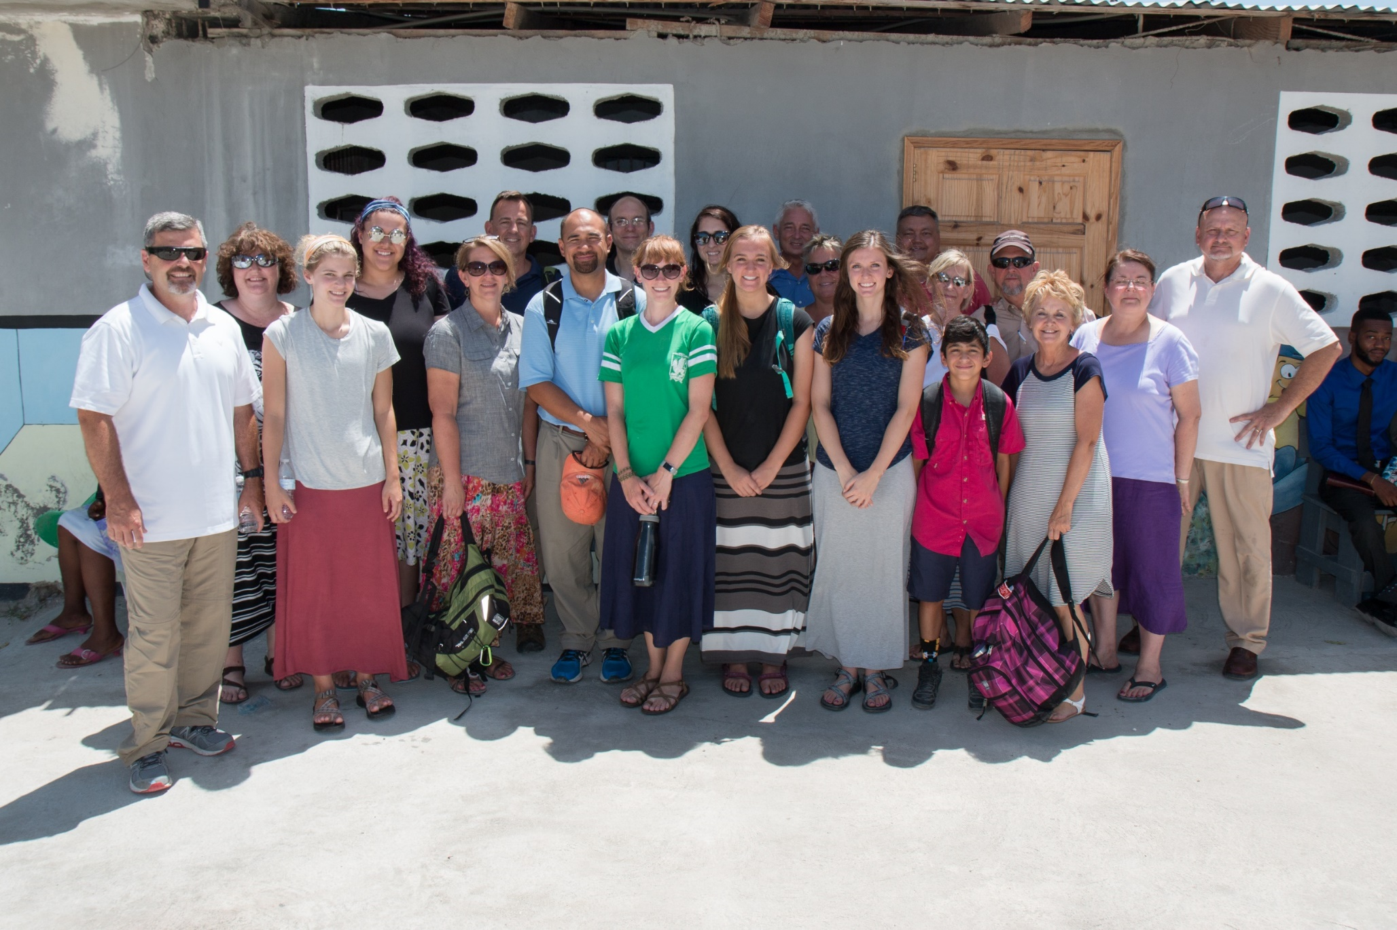
Croix de Bouquets

Slide 39
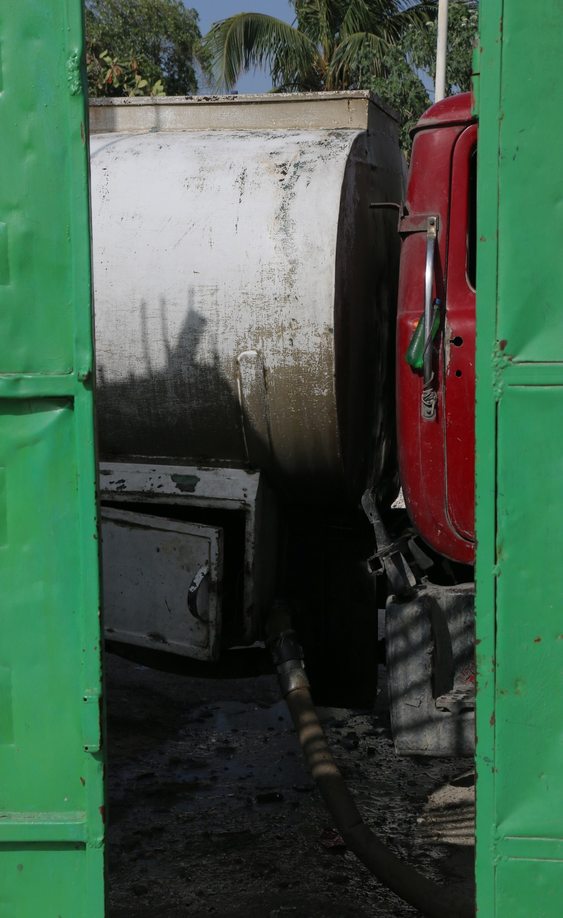
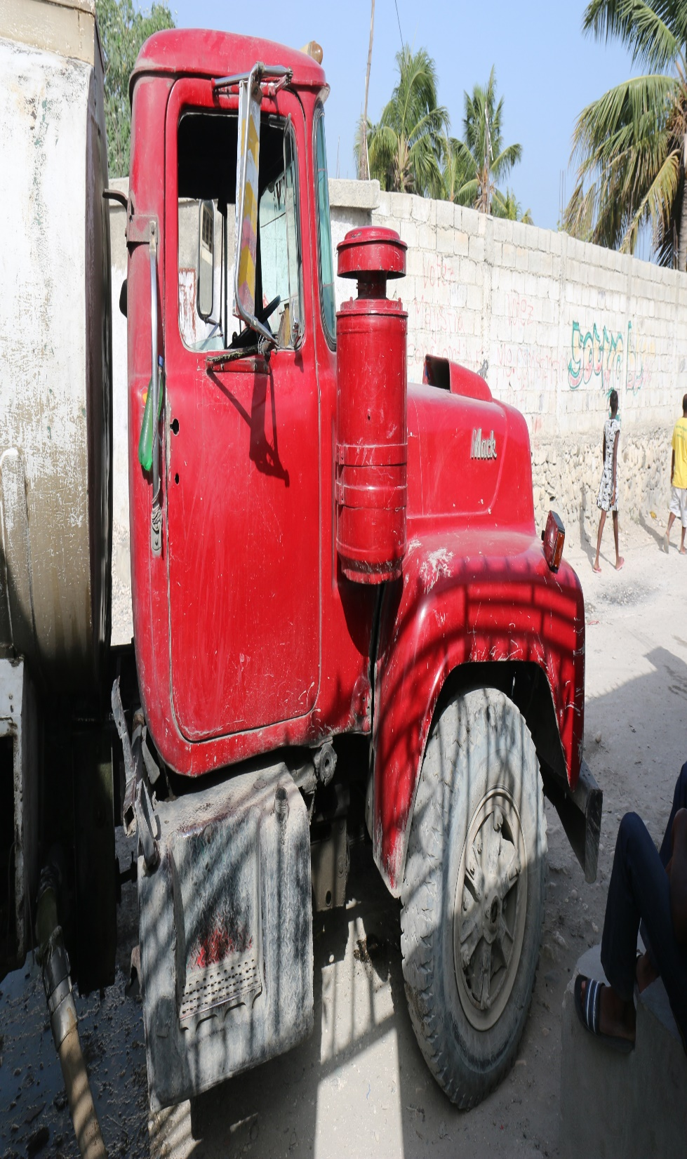
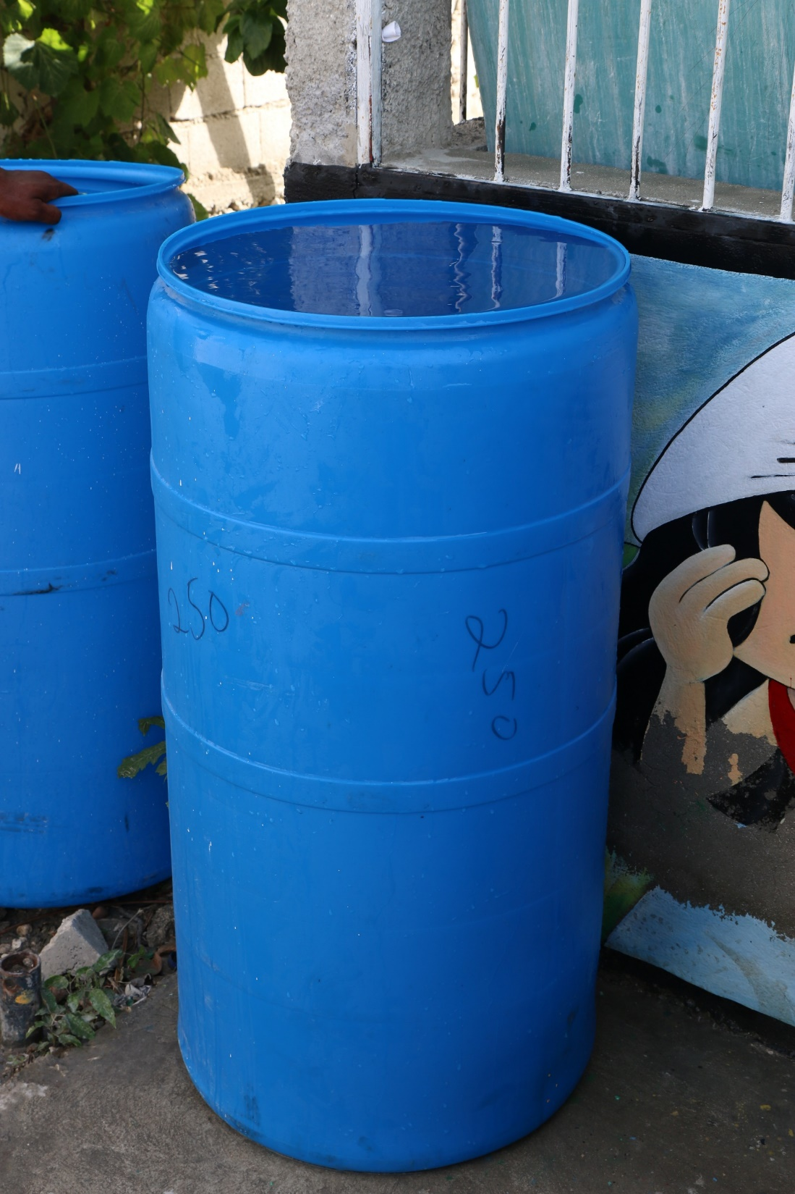

Slide 40
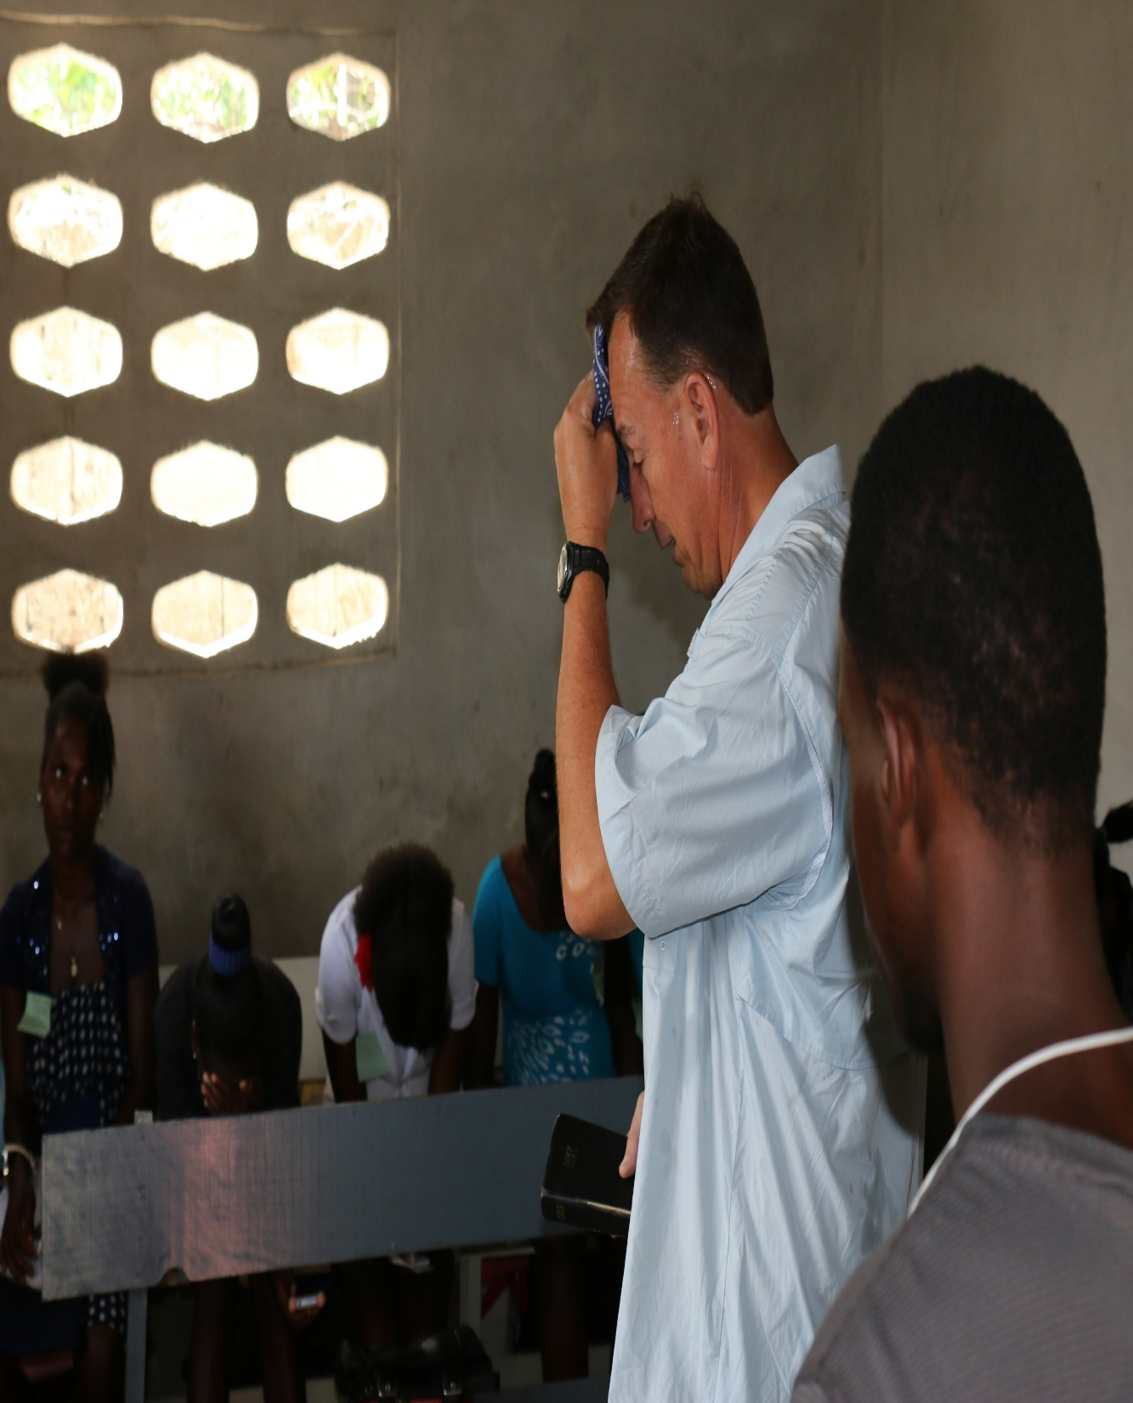
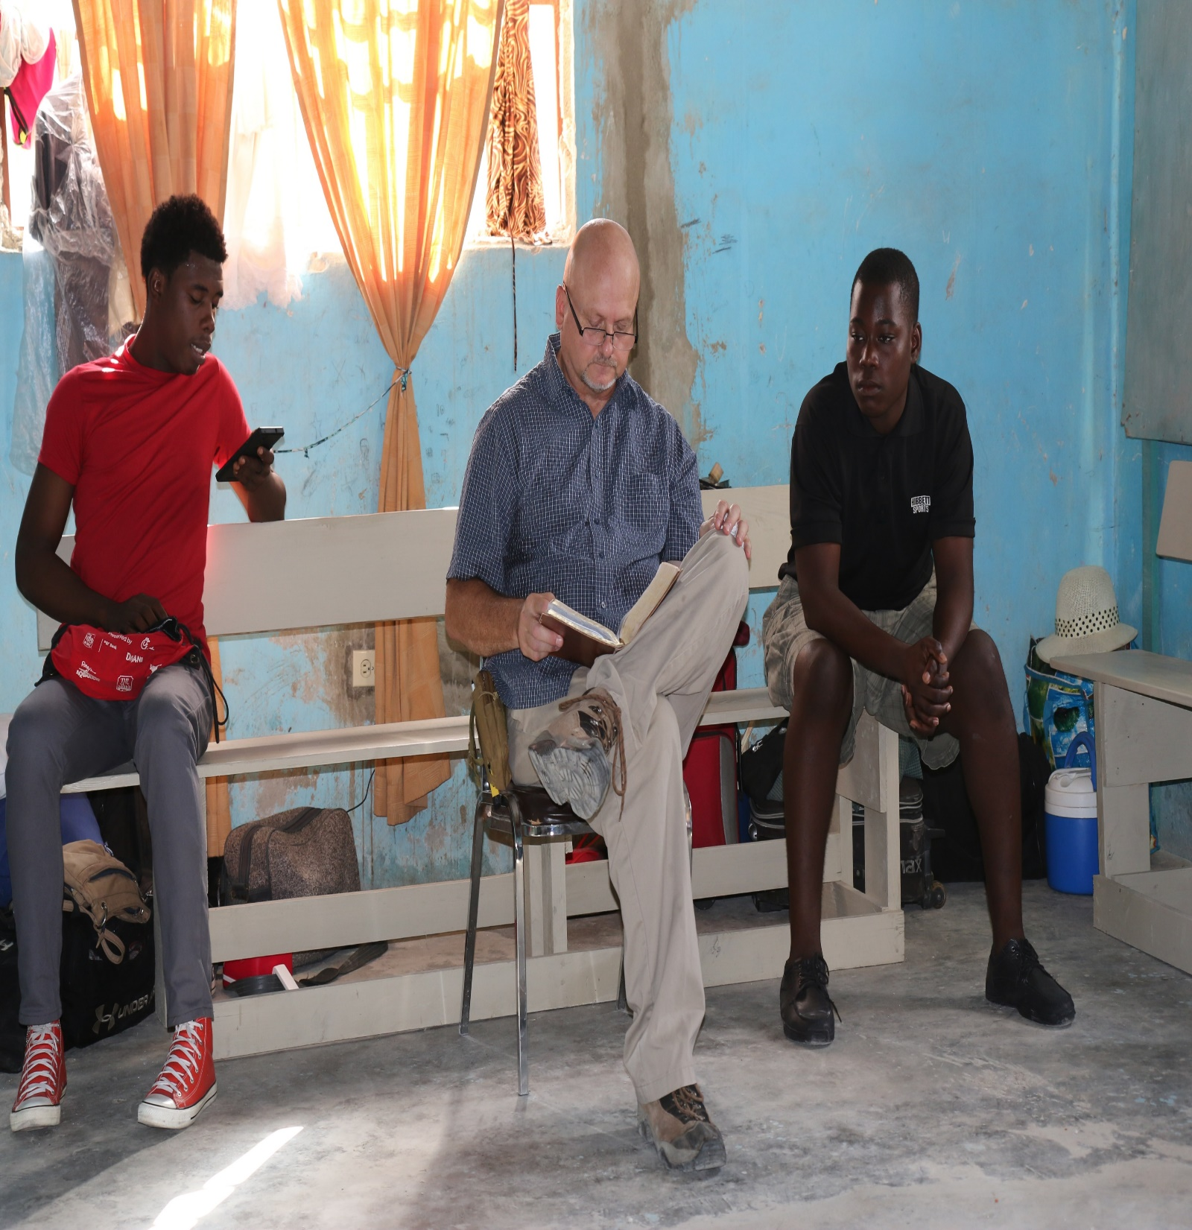

Slide 41
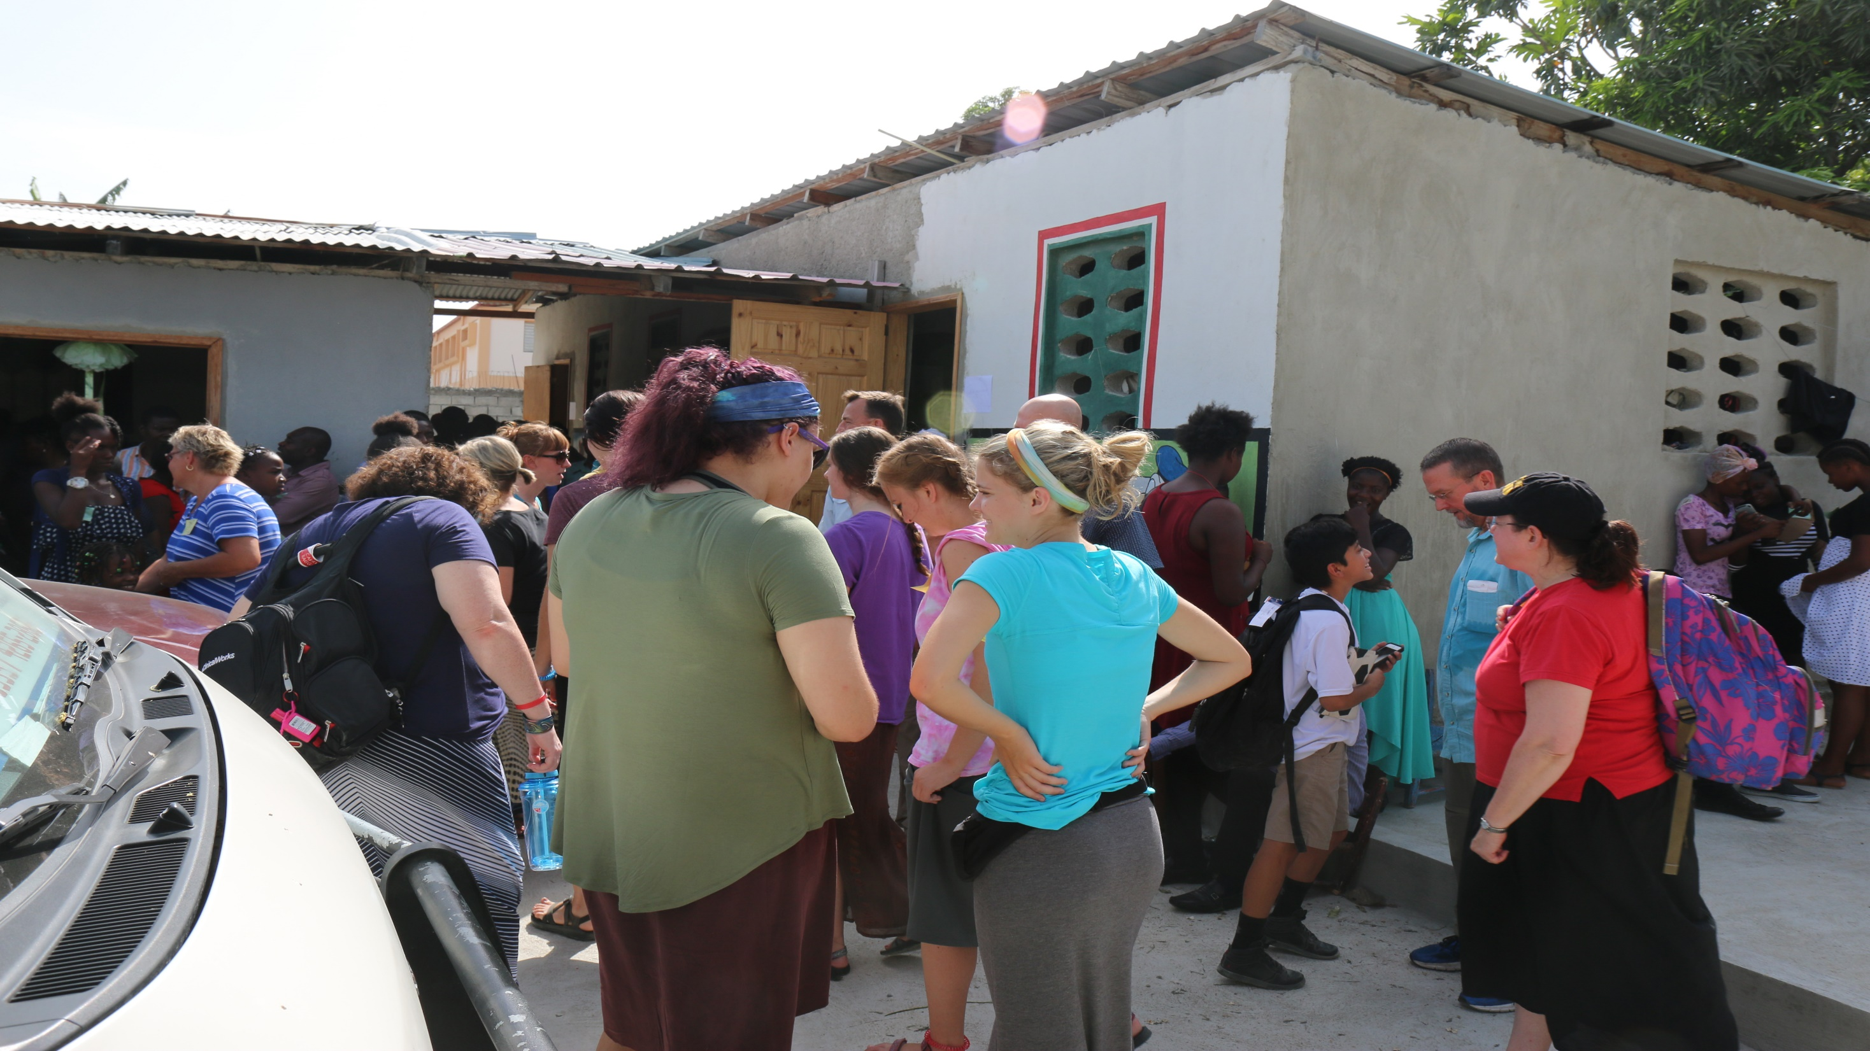

Slide 42
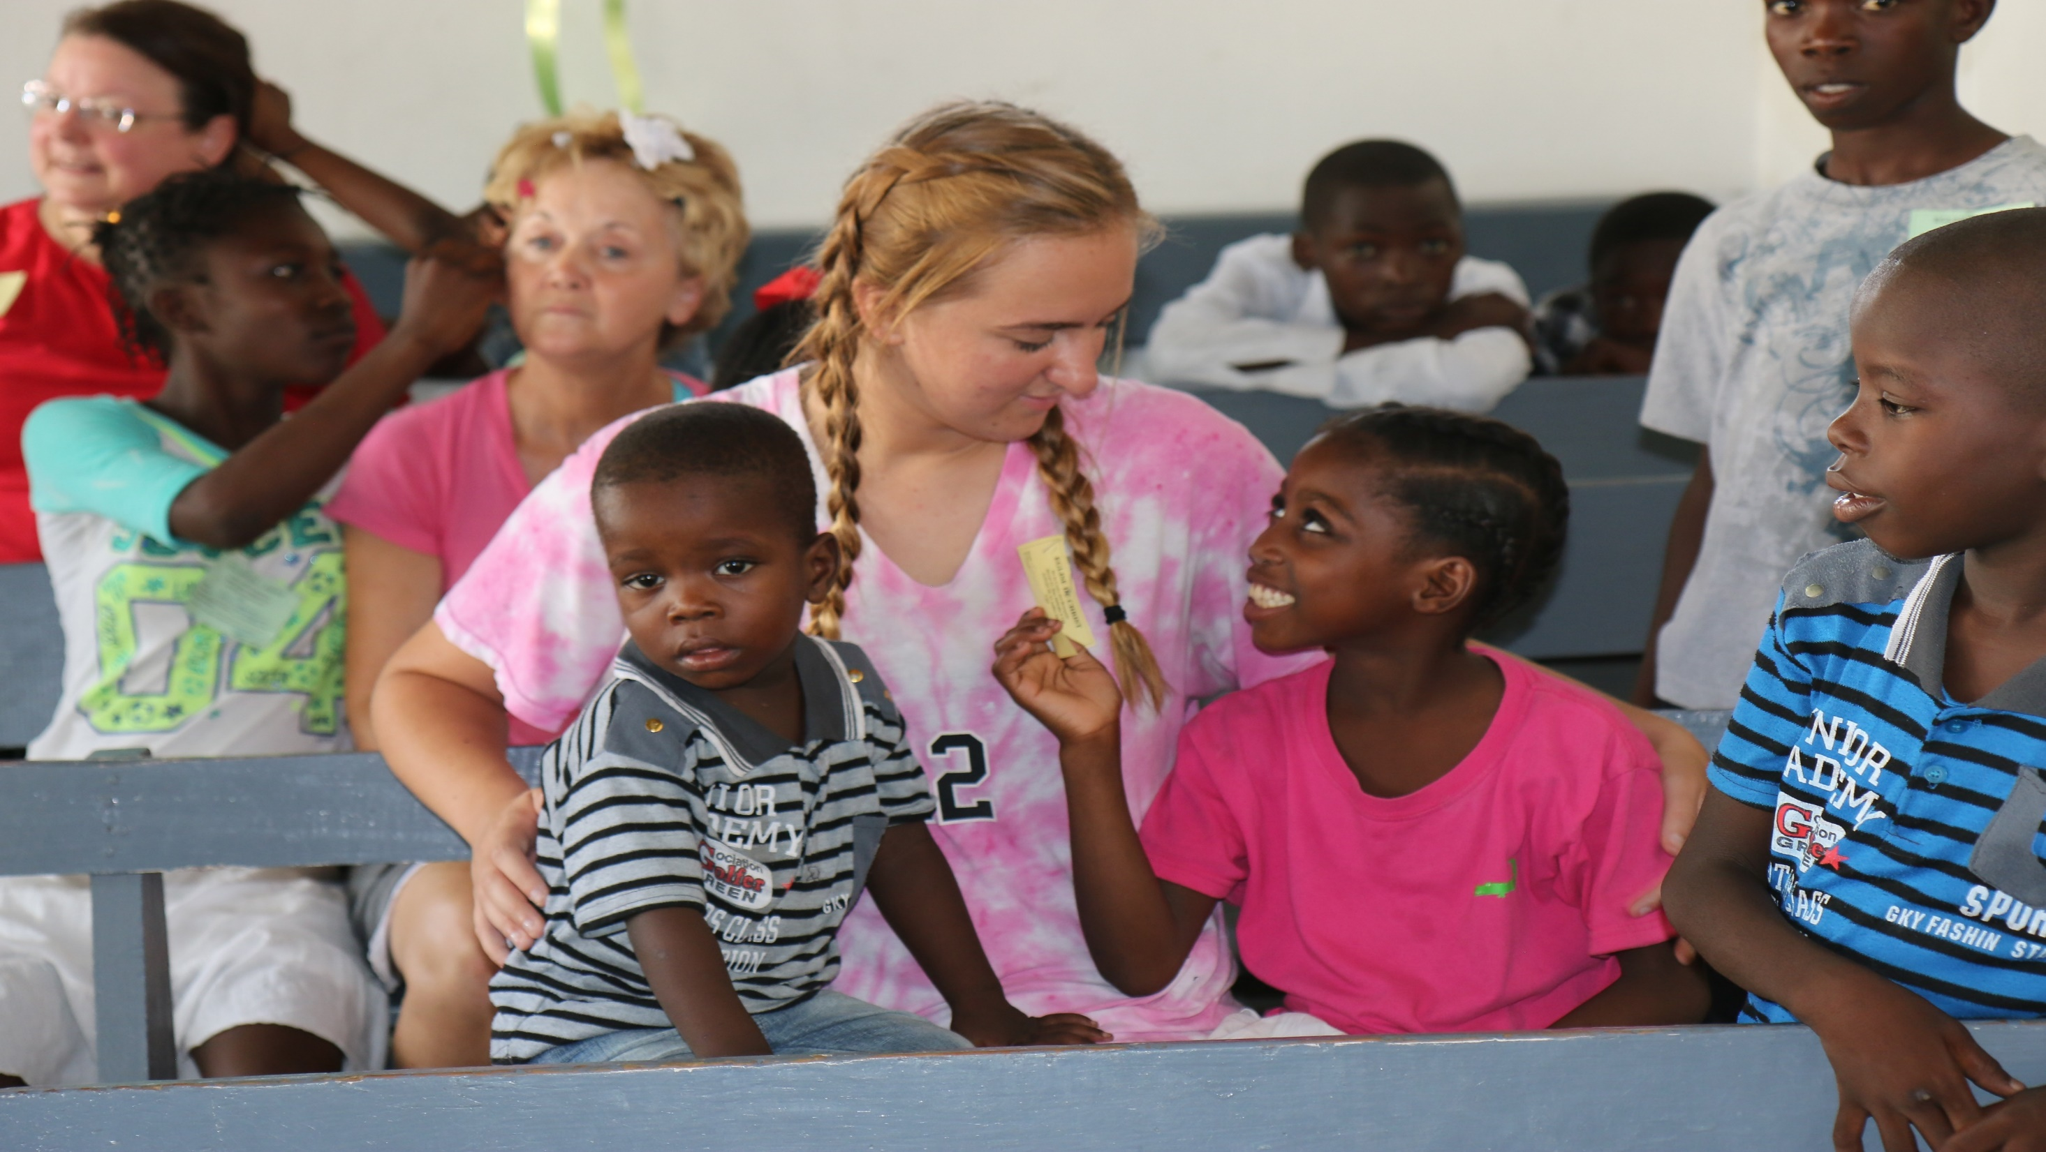

Slide 43
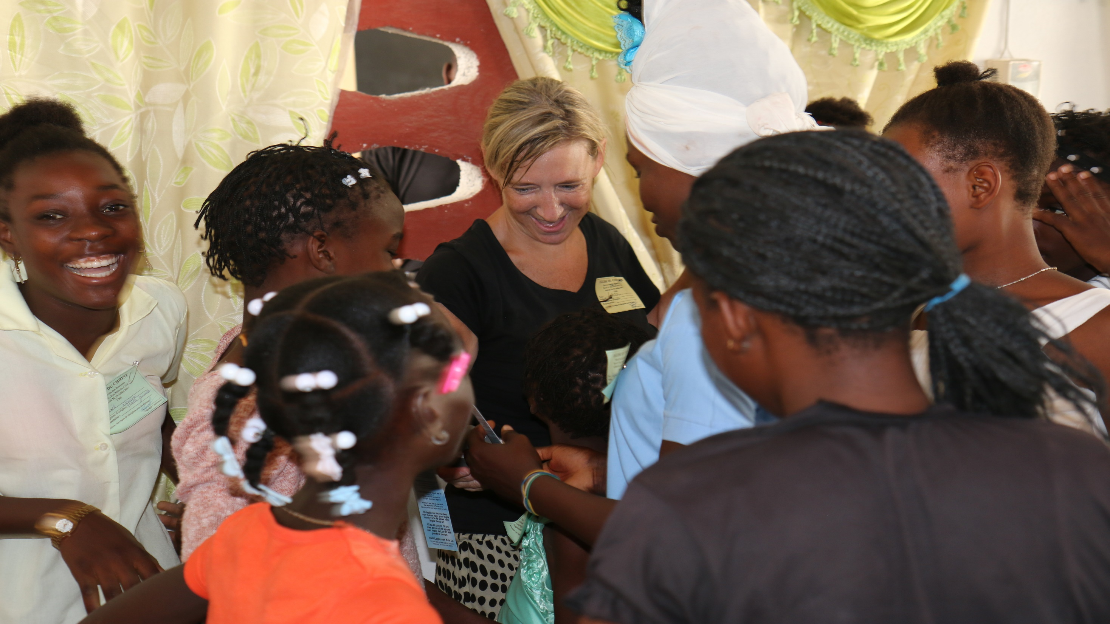

Slide 44
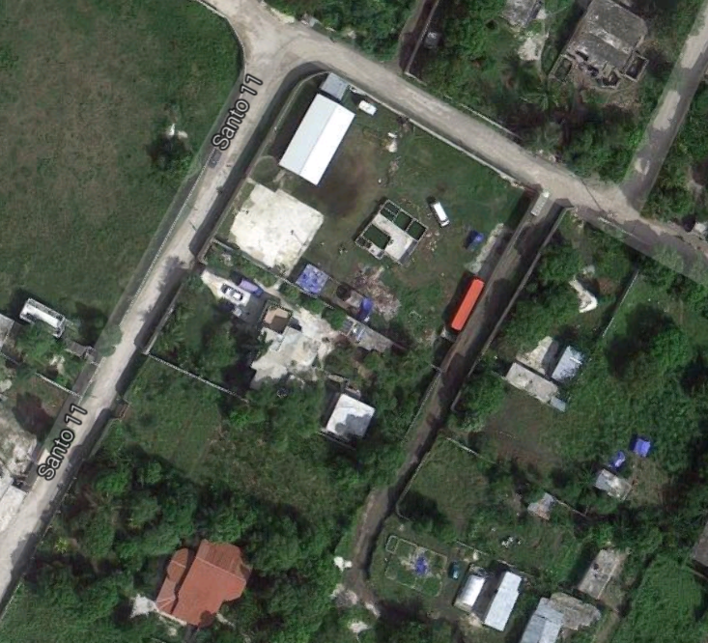

Slide 45
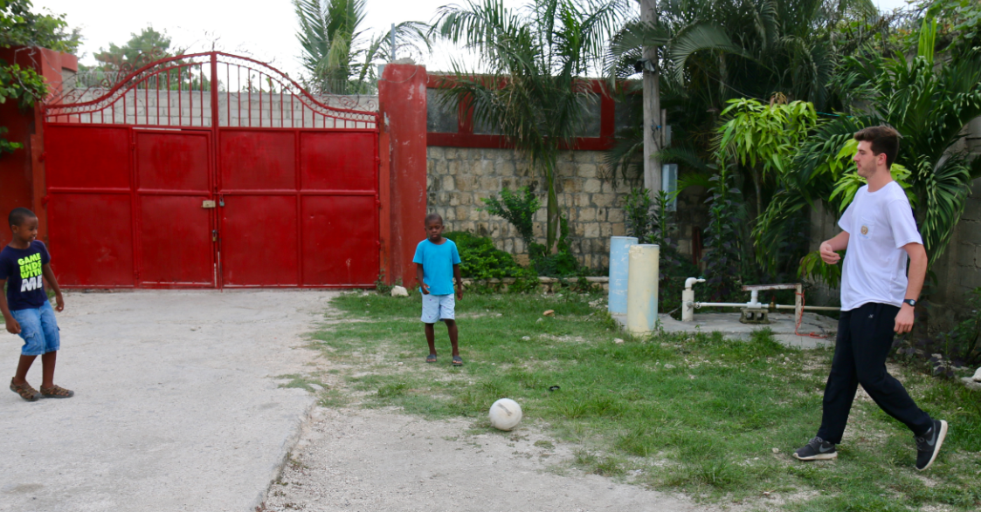

Slide 46
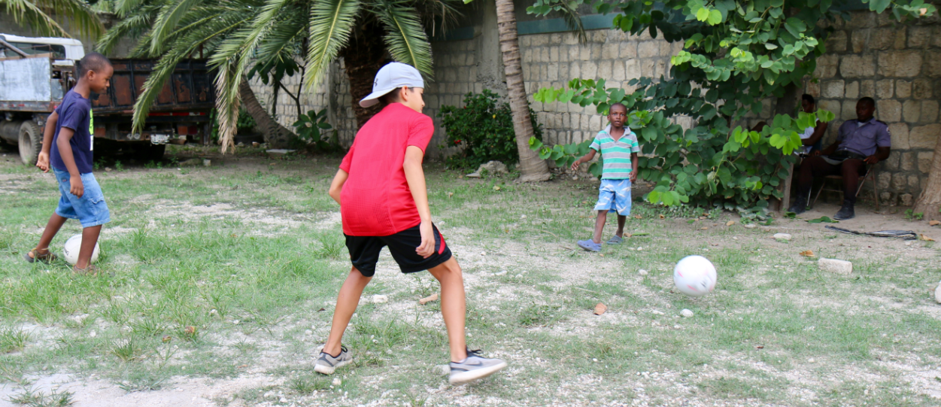

Slide 47
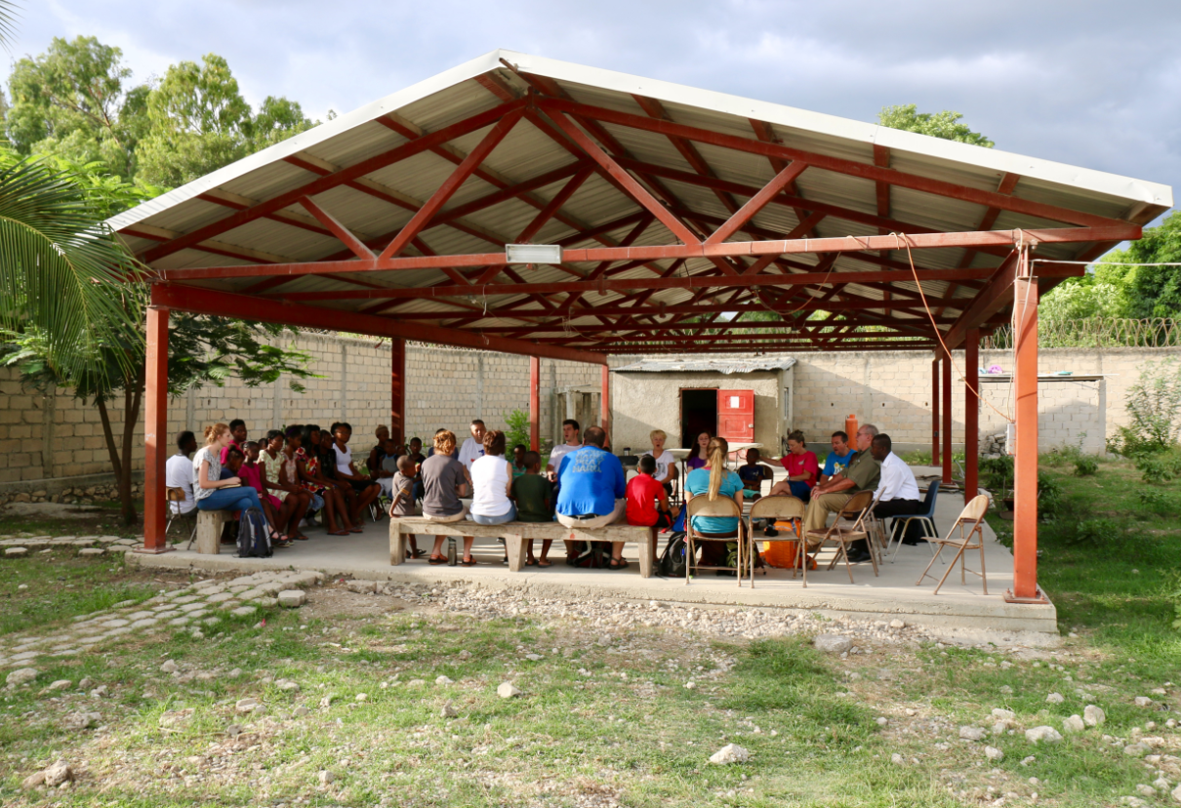

Slide 48


Slide 49


Slide 50

Lilavois

Slide 51


Slide 52


Slide 53


Slide 54


Slide 55



Slide 56



Slide 57



Slide 58



Slide 59



Slide 60



Slide 61



Slide 62



Slide 63


Slide 64


Slide 65


Slide 66


Slide 67


Slide 68


Slide 69


Slide 70


Slide 71


Slide 72



Slide 73



Slide 74



Slide 75


Slide 76


Slide 77


Slide 78


Slide 79


Slide 80



Slide 81


Slide 82


Slide 83

Haiti School of Biblical Studies

Slide 84


Slide 85


Slide 86


Slide 87


Slide 88


Slide 89



Slide 90




Slide 91




Slide 92



Slide 93


Slide 94


Slide 95


Slide 96


Slide 97




Slide 98
How you can help?
Pray
Go or support those who can
Send
$31 per month-orphan
$26 per month-elementary school
www.Liberteministries.com

Slide 99

But whoever drinks of the water I give will never thirst again… John 4.14

Slide 100


