Slide 1
Lessons from the Wise man
Matthew 7:24-29

Slide 2
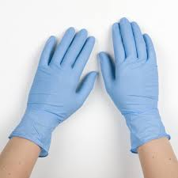
Personal Protective Equipment

Slide 3
1. Protection is Important
Psalm 119: 11 – “Thy word have I hid in mine heart, that I might not sin against thee.”
Psalm 119: 105 – “Thy word is a lamp unto my feet, and a light unto my path.”

Slide 4
2. Preparation is necessary
Blueprint
Gathering supplies
Ephesians 6: 11-17

Slide 5
3. Proper execution delivers us to Safety
Galatians 6:9 – “And let us not be weary in well doing; for in due season we will reap, if we faint not”

Slide 6
Revelation 22:12 – “AND BEHOLD , I COME QUICLKLY; AND MY REWARD IS WITH ME, TO GIVE TO EVERY MAN ACCORDING AS HIS WORK SHALL BE.”

