Slide 1
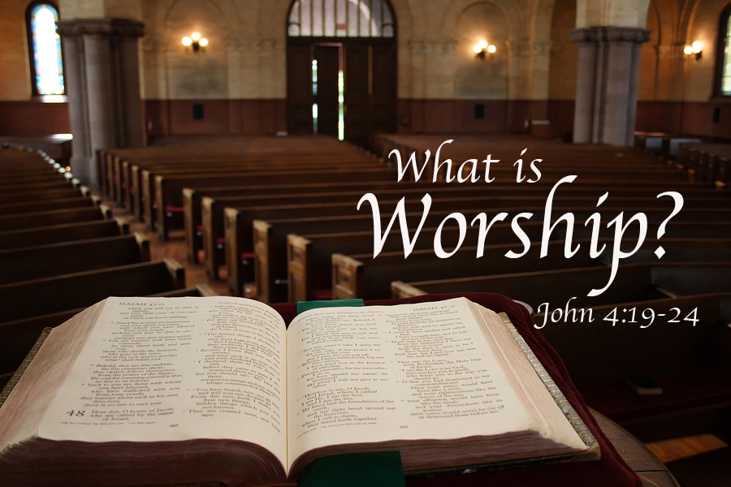

Slide 2
Worship
Worship is a distinct action.
True worship only belongs to God, but many objects and “gods” are worshipped.
“Worship” comes from “worth-ship.”

Slide 3
Worship
Worship requires a worshipper—people.
Worship requires an object of worship—God.
  Not idols. Isa. 2:8; Rom. 1:21-23; Matt. 4:10.
Worship needs to be done in spirit and truth.
  Matt. 22:37-38; 15:8-9.

Slide 4
Attitude in worship
Psalm 122:1. Are we glad to gather at a house of worship? Worship isn’t about what we want. Rather it is about what God desires.
Psalm 100. Be thankful to God.
Isaiah 6:1-8. Awe in the presence of God, unworthy of Him.

Slide 5
Worship words
Proskeneo: 59 times in the NT. “The custom of prostrating oneself before a person and kissing his feet, the hem of his garment, the ground, etc. The Persians did this in the presence of their deified king, and the Greeks before a divinity or something holy.”
(Arndt, Gingrich and Danker, p. 723).

Slide 6
Worship words
Latreuo: Used 18 times in the NT. “serve, in our lit. Only of carrying out religious duties, esp. of cultic nature, by human beings” (Arndt and Gingrich, p. 468). “It is not enough to say that latreuein has religious significance. One must say that it has sacral significance. Latreuein means more precisely to serve or worship cultically, especially by sacrifice.”
(G. Kittel’s Theological Dictionary of The New Testament, Vol IV, p. 60).

Slide 7
Worship words
Worship involves the inner attitude of the worshiper (proskuneo) and the external acts he does in worship (latreuo).
“You shall worship (proskeneo) the Lord your God, and Him only you shall serve (latreuo).” Matt. 4:10.

Slide 8
Examples of worship
Wise men worshipped Jesus, Matt. 2:11.
Satan wanted Jesus to worship him, Matt. 4:8-10.
A man worshipped Jesus, Matt. 9:18.
The disciples worshipped Jesus, Matt. 14:33.
Worship to many gods, Acts 17:22-25.

Slide 9
Spirit and truth
John 4:19-24. Where and how of worship.
Spirit—from within us, the inner intentions, not just the outward actions. Not the cold, formal ritual sometimes found.
Truth—doing things based on the doctrines God has provided.

Slide 10
Our worship
God is the object of our worship. We look to the Bible for direction for acceptable worship.
This series will continue to examine how God views our worship as well as a focus on each avenue of our worship as we are gathered together as a congregation.

