Slide 1
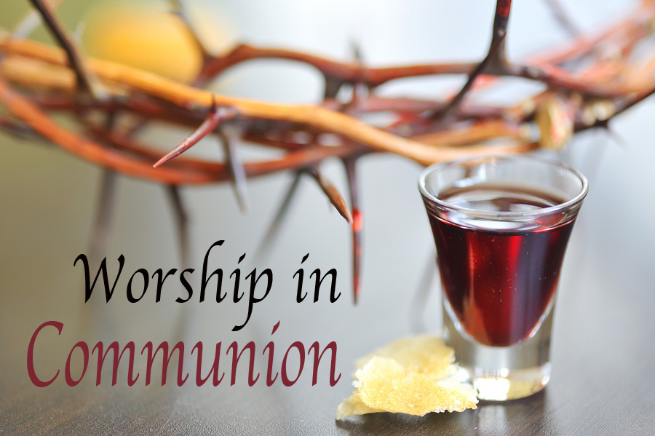

Slide 2
Lord’s Supper - Communion
Instituted on the night Jesus was betrayed.
A memorial of the body and blood sacrificed for the remission of our sins.
Matt. 26:26-29; Mark 14:22-25;
Luke 22:14-20; 1 Cor. 11:23-25.

Slide 3
Specifics
Bread, unleavened, body of Christ.
Cup, fruit of the vine, blood of Christ.
Day, first day of the week. Acts 20:7.
Requirement, take in a worthy manner.
1 Cor. 11:27-32.

Slide 4
Significance
A memorial. 1 Cor. 11:24-25. Ref. Passover, Deut. 16:1-8, Mishna, Pesahim 10.5, “as if.”
A proclamation, 1 Cor. 11:26.
An Examination, 1 Cor. 11:27-32.

Slide 5
Our focus
Backwards to cross, 1 Cor. 11:23-25.
Upwards to God, 1 Cor. 10:15-17, 11:27-29.
Inward examining self, 1 Cor. 11:28-32.
Forward proclaiming each week, 1 Cor. 11:26.
Outward showing unity and
respect in the church,
1 Cor. 11:17-22.

Slide 6
As we partake of the communion…
Remember His sacrifice.
Anticipate His return.
Reflect on your standing with Him.

