Slide 2
What if God told you to preach to your enemies?
Lord/God used 39 times in 48 verses. 20 personal pronouns for God. This book is very focused on God.
Jonah is the only prophet whose career the miraculous plays a prominent role

Slide 3
Jonah is the only minor prophet with his major activity on foreign soil
Jonah is the only minor prophet mentioned by Jesus
Jonah is the only Old Testament character likened by Jesus to Himself. Matt. 12:38-41; 16:4; Luke 11:29-32

Slide 4
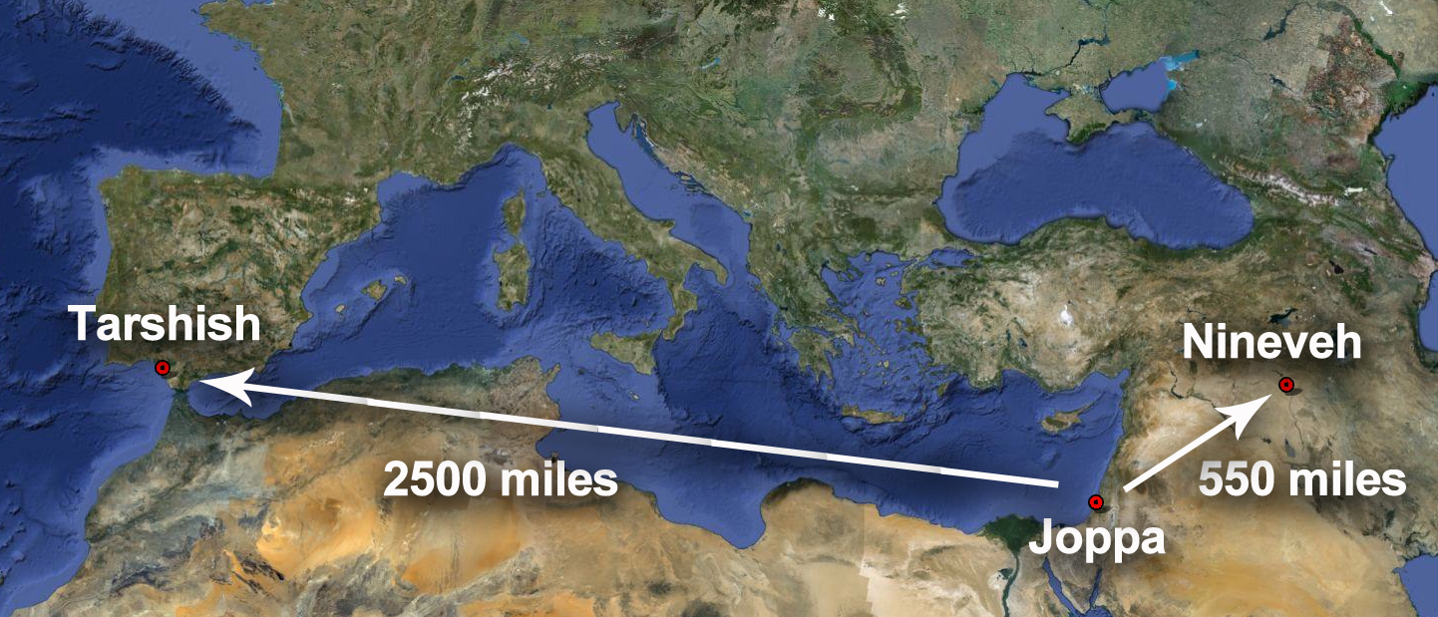
We can’t hide from God
Tarshish about 2,500 miles west Nineveh about 500 miles east
Even though his faith in God was wavering he still influenced the sailors to look to God

Slide 5
Jonah prayed from inside the fish
Literally no place else to turn but God
Repentance and remorse can at times be very short-lived

Slide 6
Jonah’s sermon is only 8 words!
Nineveh hears and repents
God sees the fruit of their repentance and relents
What preacher doesn’t want people to turn to God? Jonah

Slide 7
Nineveh repents but Jonah isn’t happy
God teaches him a lesson concerning his attitude toward the plant and the people

Slide 8
Do you have a troubled faith at times?
Why not make sure of that faith today?

