Slide 2
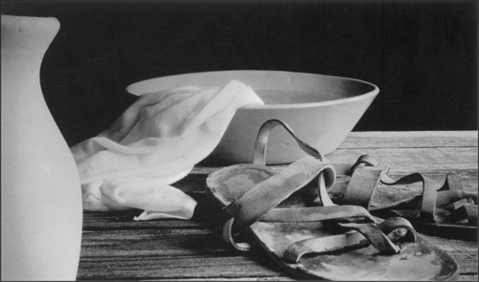
Make Me A Servant
The Humility of Love
John 13:1-17
Google Images

Slide 3
Main Characters
The Apostles
Judas
Peter
Jesus

Slide 4
Judas
John 13:2, 11, 21, 26-30
There had been good in him or he wouldn’t be an Apostle.
Allowed his heart to be open to Satan’s temptation (James 1:13-15).
He was well respected and never imagined he would betray Jesus.
Am I living like Judas?

Slide 5
Peter
John 13:6-10, 22-25
John 13:6, 9 “⁶Lord, are You washing my feet?”, “⁹You shall never wash my feet!”
Lord, I can’t let you take the form of a servant and wash my feet. I mean, You are Jesus, the Messiah, the Christ.
Jesus says, “If I do not wash you, you will have no part with Me.”
Peter – I am all in then. “Lord, not my feet only, but also my hands and my head!”
Am I living like Peter?

Slide 6
Jesus
Jesus Loved all of His followers – vv.1-3
Jesus became a servant – vv.4-11
Jesus Challenges His followers to Serve as He has – vv.12-20
Google Images

Slide 7
Will You
And Show the Humility of Love John 13:1-17
Google Images

