Slide 1
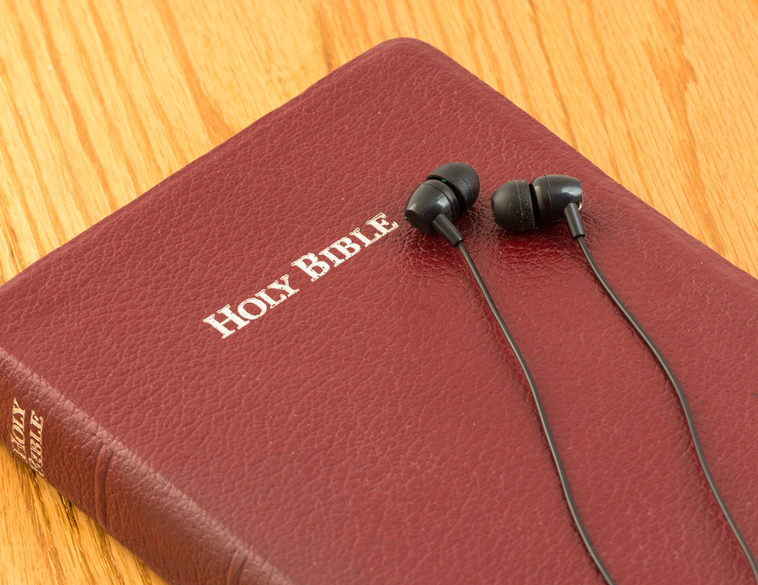
Listen to
God
2 Tim. 3:14-17
Purpose: To explore ways to improve our Bible reading.

Slide 2

Benefits of Bible reading
It will keep you from sin (Psalm 119:11)
It will strengthen you (Psalm 119:28)
It will guide your way (Psalm 119:105)
It will bring you joy (Psalm 119:111)
It will lead you to wisdom (Psalm 119:130)
It will protect you from stumbling (Psalm 119:165)
It will bring you back to God (Psalm 119:176)

Slide 3

Set a time and place
Be consistent
Remove distractions
Pray for understanding
For better Bible reading

Slide 4
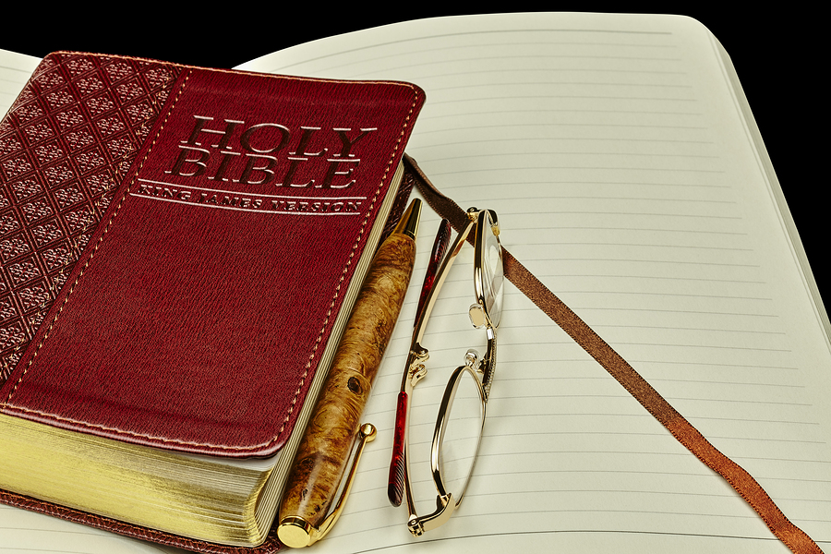
Make notes, highlight, underline
Do, don’t just hear
What is the one key lesson?
Are we willing to do what God says to do?
How
does it change us?

Slide 5
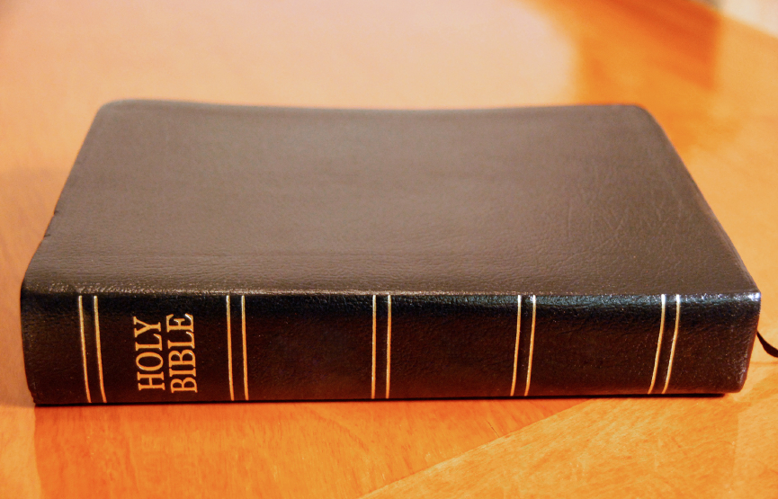
Are you listening to God?
Prov. 6:16-19. Don’t do these!
Matt. 5:43-44. Yes, pray for enemies.
Eph. 4:25-32. Don’t tear down, build up!

Slide 6

Are you listening to God?

